Slide 1
Ch.4. Crystal Chemistry
Ionic (Atomic) Radii & Coordination Number (CN)
Ionic radius:
Hypothetical radius (size) of an ion (cation or anion)
Calculated values from the bonding distances
CN
Number of one kind of the bond forming ions (atoms) surrounding the other, which are forming the first direct bonding
Determined by radius ratio (r₊/r₋)

Slide 2
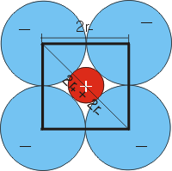
l = 2r₋ d = 2r₋ + 2r₊
d = √2 l
r₊/r₋ = 0.414
Why is CN so significant?
Would the ratio calaculated by the above way be maximum or minimum
for the given CN?

Slide 3
Can you calculate the following radius ratios for the given CN?
Radius ratio | CN | Geometry
<0.155 | 2 | linear
0.155 – 0.225 | 3 | Triangular (trigonal)
0.225-0.414 | 4 | tetrahedral
0.414-0.732 | 4 | tetragonal
0.414-0.732 | 6 | octahedral
0.732-1.0 | 8 | cubic
>1.0 | 12 | cubic (face centered)

Slide 4
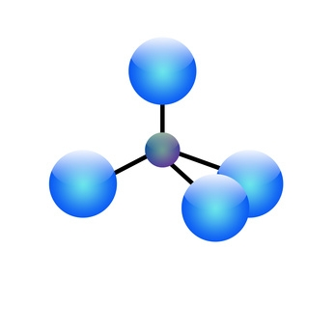
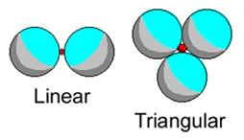
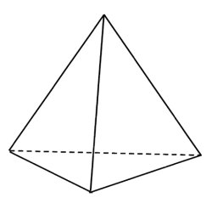
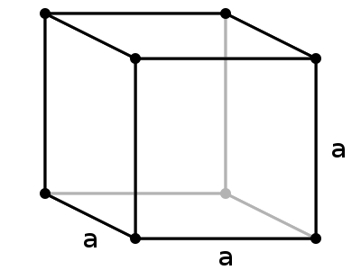
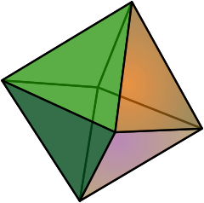
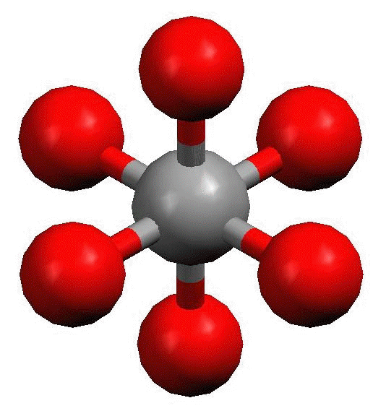
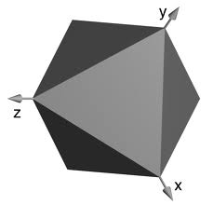
Tetrahedral

Slide 5
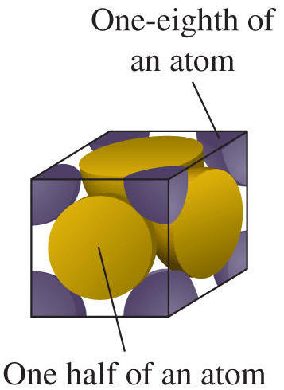
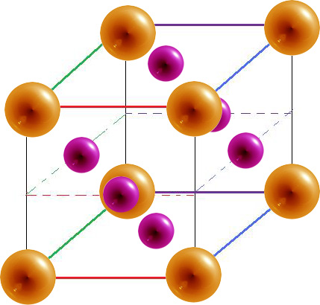

Slide 6
Ch.4. Crystal Chemistry
Chemical Bonding and Physicochemical Properties of a Mineral
Chemical bonding:
Holding constituents with forces (energies)
Types of chemical bonding
Ionic: electron transfer, Coulombic (electrostatic) force
Covalent: sharing electrons, covalency
Metalic: sharing free electron (delocalized)
Van der Waals: bonding due to other weak forces (Keesom, Debye, London forces)

Slide 7
In minerals, often
Covalent > ionic > metallic > van der Waals
Bonding strengths (& it’s heterogeity) controls
Hardness
Cleavage
Fracture
Texture (crystal form)
Etc.

Slide 8
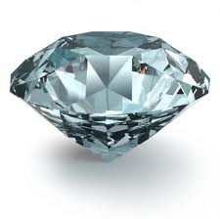
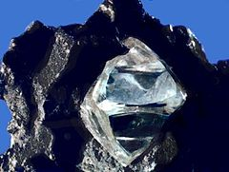
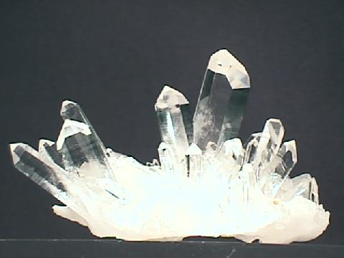
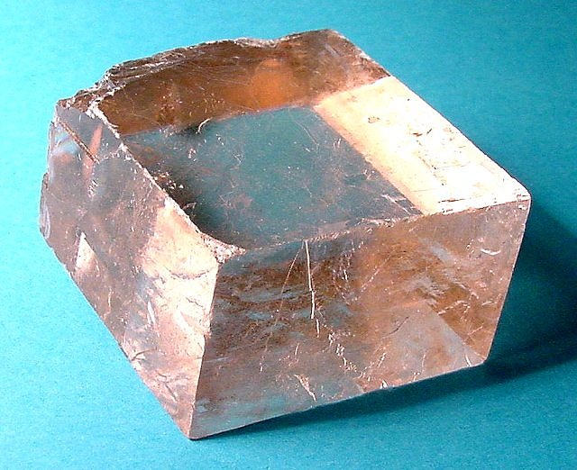
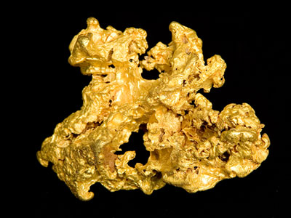
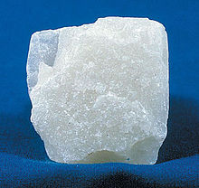
Chemical Bonding & Hardness
C: Diamond – perfectly covalent
(What about graphite?)
SiO2; quartz –
partly covalent,
partly ionic
Covalent>>ionic
CaCO3; calcite
Partly covalent,
Partly ionic
Ionic>>covalent
Au; gold
metallic
Mg3Si4O10(OH)2;
Talc
Covalent + ionic +
Van der Waals

Slide 9
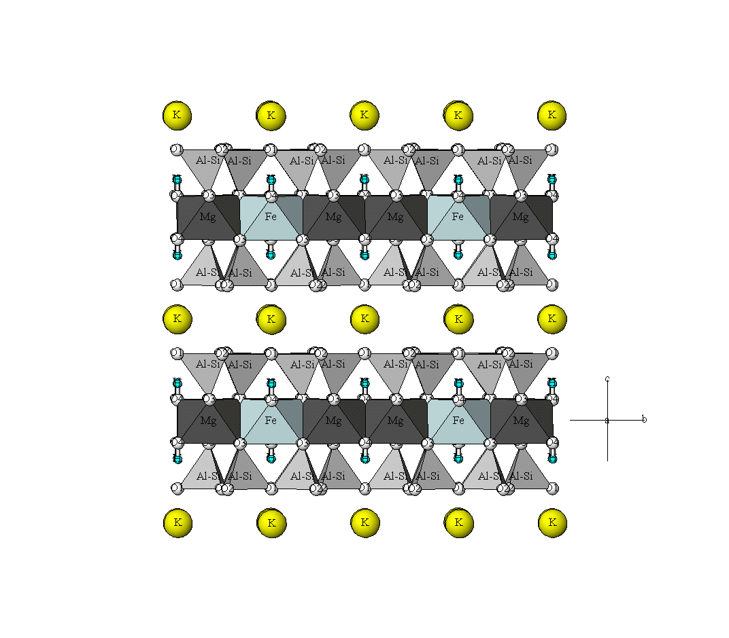
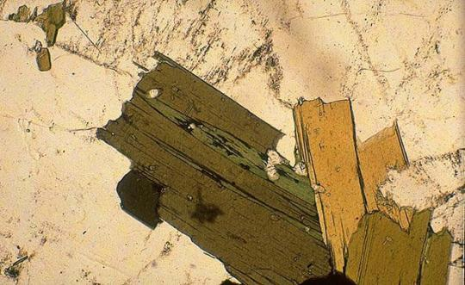
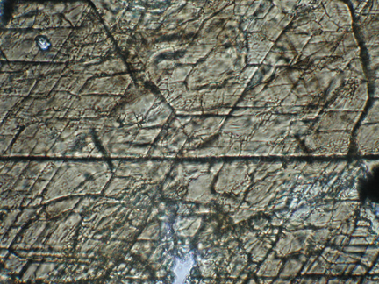
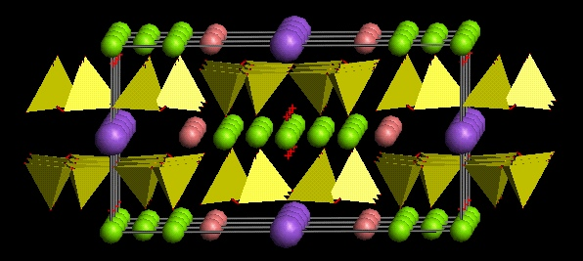
Chemical Bonding & Cleavage
From http://staff.aist.go.jp/nomura-k/english/itscgallary-e.htm
Biotite
From http://www.earth.ox.ac.uk/~davewa/pt/pt02_amp.html
Amphibole (hornblende)

Slide 10
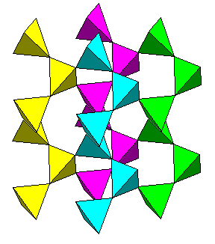
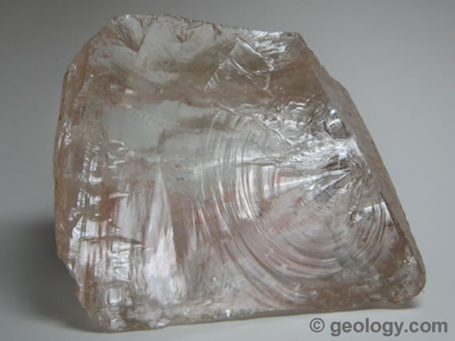
Chemical Bonding & Fracture
Structure of quartz
Conchoidal fracture of quartz
From http://www.uwgb.edu/dutchs/Petrology/QuartzStruc.HTM
From http://geology.com/minerals/quartz.shtml

Slide 11
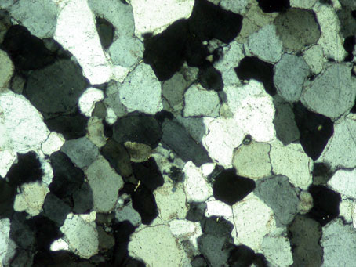
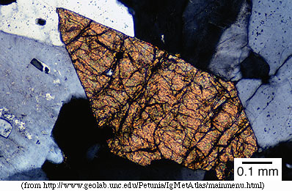
Chemical Bonding & Textures (forms)
Quartzite
Sphene
From http://www.uwgb.edu/dutchs/Petrology/QuartzStruc.HTM

Slide 12
Ionicity of bonding
Electronegativity (χ): Measure of the tendency of an atom or a functional group to attract an electron to itself.
Pauling (1960)
I = 1 - exp[-0.25(χ_{A} - χ_{B})²].
Hannay & Smyth (1946)
I = 0.16(χ_{A} - χ_{B}) + 0.035(χ_{A} - χ_{B})². (χ_{A} should be always bigger than χ_{B})
For a coordinated bonding
I_{c} = (N/M)I + (1-N/M).
Where N=number of valence electrons of the atom coordinated and M=coordination number

Slide 13
Calculated ionicities of common bondings in silicates
Bonding | M | I
Si-O | 4 | 0.3294
Al-O | 4 | 0.5575
Al-O | 6 | 0.7050
Fe(III)i-O | 6 | 0.6567
Fe(II)-O | 6 | 0.7828
Mg-O | 6 | 0.8332
K-O | 6 | 0.9432
Na-O | 6 | 0.9370
Ca-O | 6 | 0.8663
K-O | 12 | 0.9686
Na-O | 12 | 0.9666
Ca-O | 12 | 0.8754
H-O | 1 | 0.2522

Slide 14
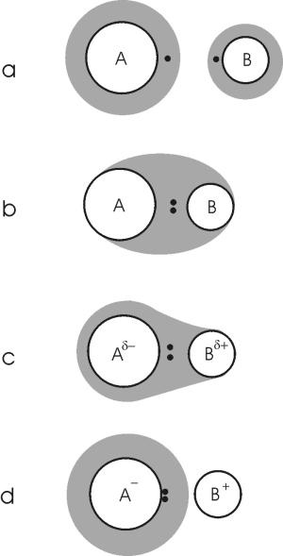
Isolated atoms
Ideal covalent bonding
Covalent-ionic bonding
Ideal ionic bonding

Slide 15
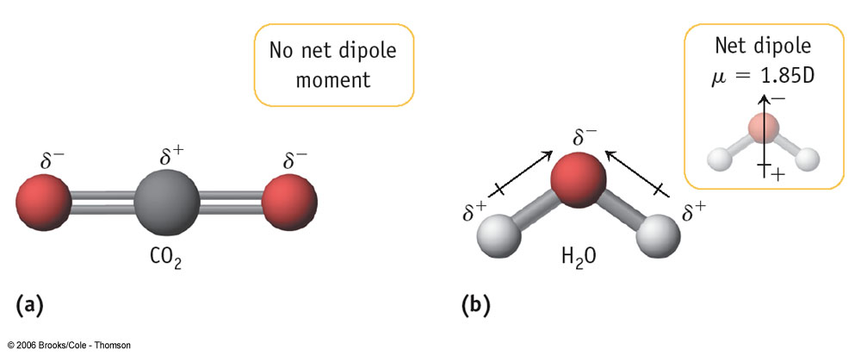
Significance of the ionicity
Determine the crystallization sequence of the minerals in a magma.
Affect the reactivity of the minerals, especially with water (weathering susceptibility?)
Water: Polar substance

Slide 16
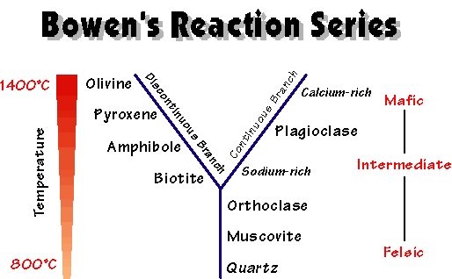
polymerization
covalency
Can you tell the resitivity of the minerals against weathering in terms of covalency?
Why do sandstones primarily consist of quartz?

