Slide 1
Ch.2.
Condensation, precipitation and the meteoric water line
Evaporation – kinetically controlled
Condensation - (mostly) equilibrium fractionation
Data from Global Network of Isotopes in Precipiatation (GNIP) by IAEA
Available at www.iaea.or.at:80/programs/ri/gnip/gnipmain.htm
The regression of the data gives (Rozanski et al., 1993)
δD=8.17(+/-0.07)δ¹⁸O + 11.27 (+/-0.65) ‰ VSMOW

Slide 2
Rainout and Rayleigh distillation
How does it rain?
“Rainout”: the process cooling & loosing the vapour as precipitation along the migration pathways from it’s source → distills heavier isotopes from the vapour → vapour progressively becomes depleted → Rayleigh-type distillation
R = R_{o} f ^{(α–1)}
Rainout is an evolution towards colder and isotopically-depleted precipitation

Slide 3
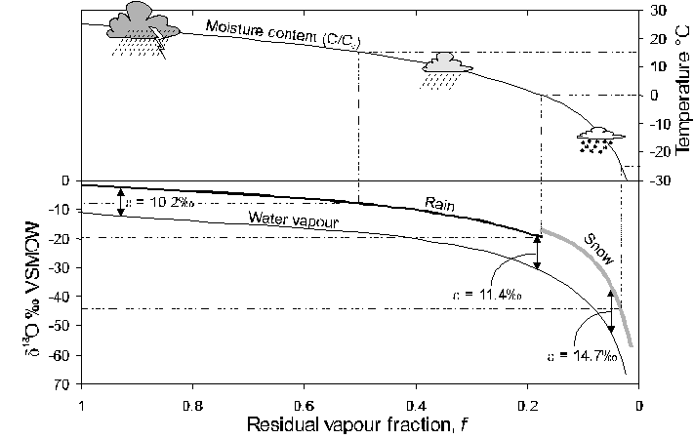
Fig. 2-13 The change in the ¹⁸O content of rainfall according to a Rayleigh distillation, starting with d¹⁸O_{vapour} = -11‰, temperature = 25&deg;C, and a final temperature of –30&deg;C. Note that at 0&deg;C, fractionation between snow and water vapour replaces rain-vapour fractionation. The fraction remaining has been calculated from the decrease in moisture carrying capacity of air at lower temperatures, starting at 25&deg;C (from calculations for Fig. 2-4). Dashed lines link d¹⁸O of precipitation with temperature of condensation.

Slide 4
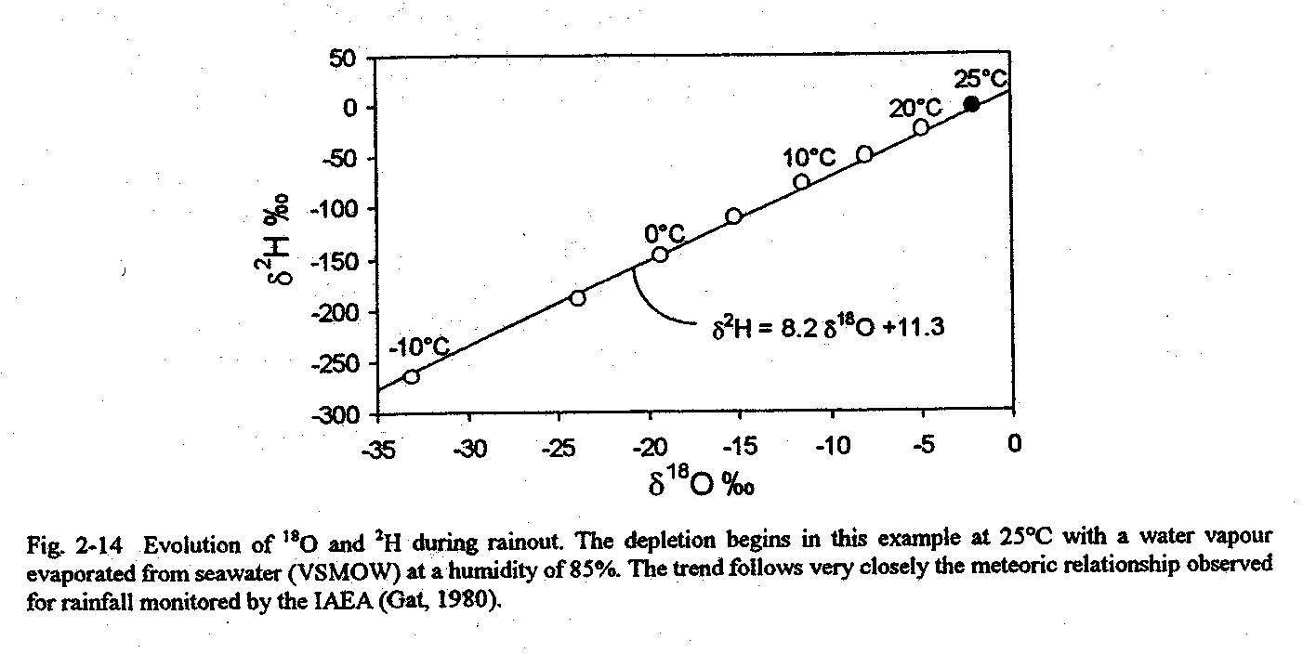
At any point along the trajectory, the isotopic composition of the vapour becomes:
δ¹⁸O_{v(f)} ≈ δ_{o}¹⁸O_{v} + ε¹⁸O_{l-v} · ln f
The rain produced by the vapour at any given f:
δ¹⁸O_{rain(f)} ≈ δ¹⁸O_{v} + ε¹⁸O_{l-v(T)}

Slide 5
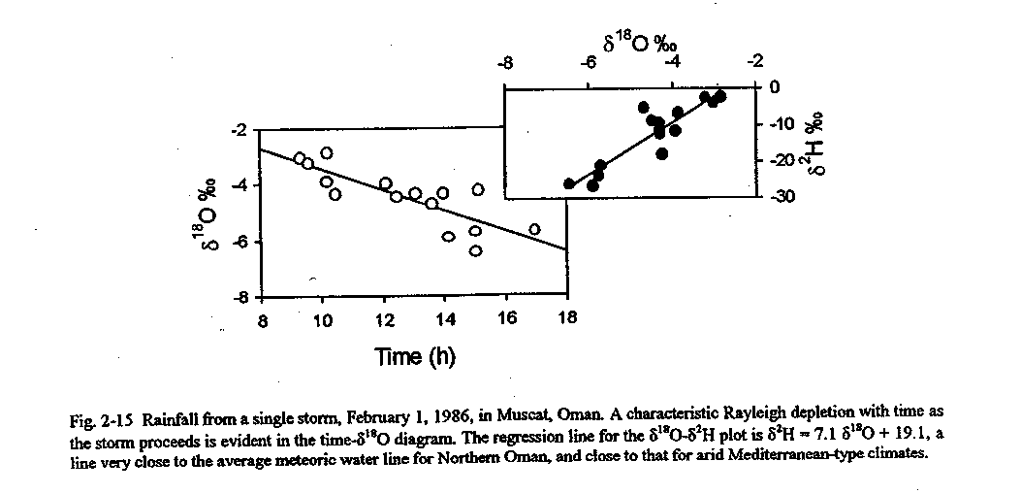

Slide 6
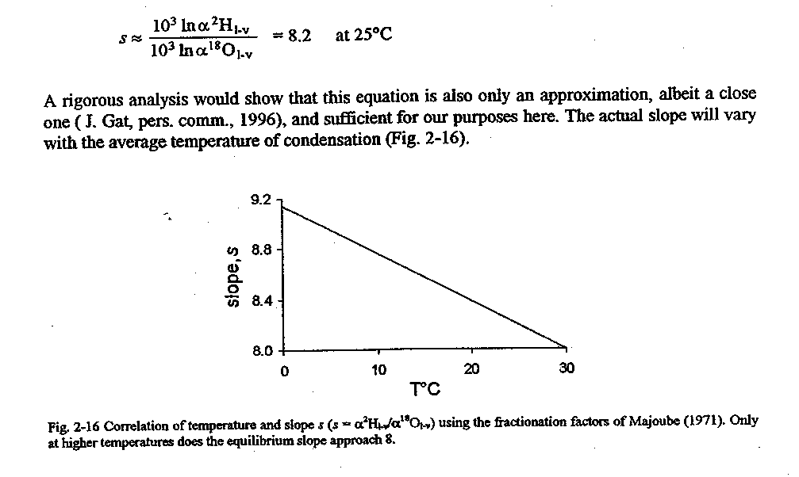
Slope of the meteoric water line
Due to the ratio of the fractionation factors for H and O of equilibrium fractionation during the condensation

Slide 7
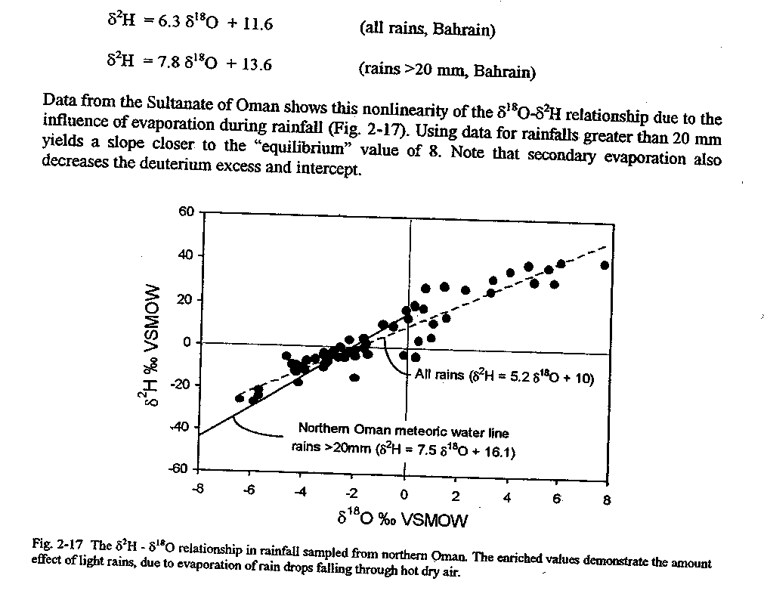
Effect of second evaporation
What is “amount effect”? (Dansgaard, 1964)

Slide 8
Local meteoric water lines
Origin of the vapour mass
Second evaporation (humidity)
Seasonality of precipitation
Topography
Source
Climate
Topography

Slide 9
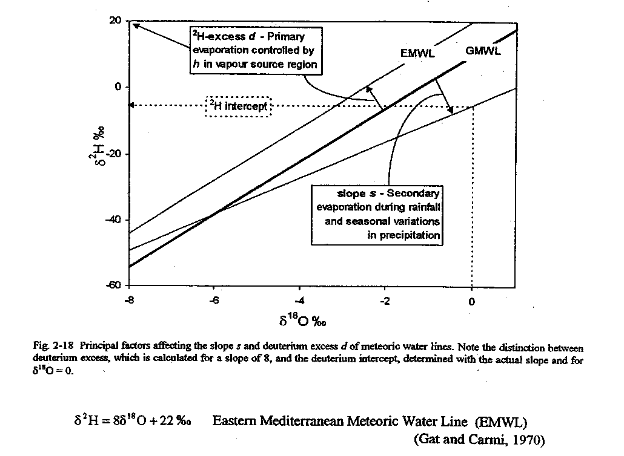

Slide 10
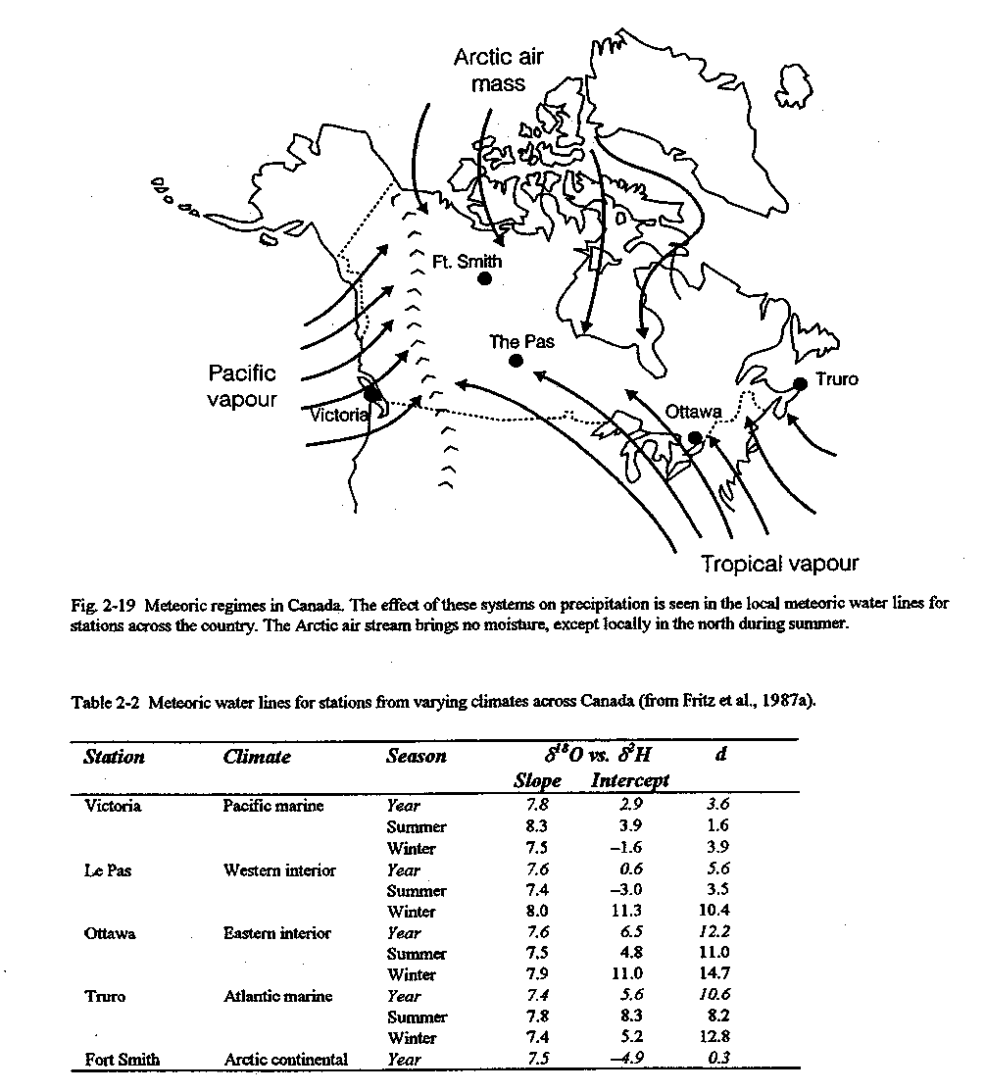

Slide 11
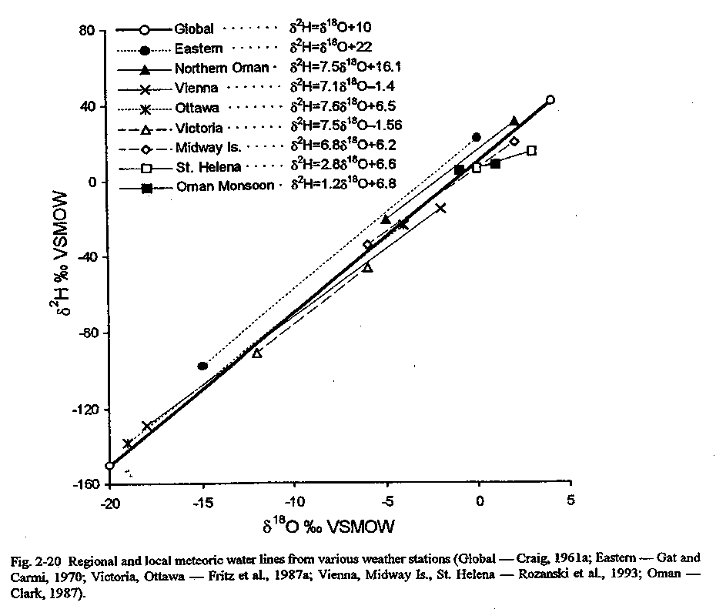

Slide 12
A Closer Look at Rayleigh Distillation
R=R_{o}f^{(α-1)}
For the example of ¹⁸O in evaporating water, this would be:
This form of the Rayleigh equation is more easily used when expressed in δ–‰ notation. Converting the isotope ratios to δ values gives:
When the δ-values are small (i.e. close to the reference VSMOW), this equation can be simplified to:
δ – δ_{o} ≈ 10³ (α – 1) · ln f or
δ – δ_{o} ≈ ε · ln f

Slide 13
Using a generic isotope with an arbitrary initial value (δ_{o-react}) and fractionation factor (ε_{prod-react}), a Rayleigh distillation can be plotted (Fig. 2-21).
The evolution observed in the reactant reservoir during a Rayleigh distillation will also be seen in the product reservoir (Fig. 2-21). However, we can consider this evolution in the reaction product as either an instantaneous product (open system) or as an accumulating product reservoir (closed system). In an open system, the product is instantaneously removed from the system and does not mix with subsequent reaction products (e.g. ice from the freezing of water). In a closed system, the product forms a growing and well-mixed reservoir (e.g. H₂S accumulating in a groundwater during sulphate reduction).
The isotopic composition of the product reservoir under closed system conditions is derived from the isotopic composition of the entire system, which is equal to the initial value of the reactant reservoir, .At any point during the reaction, the isotopic composition of the two reservoirs obeys the mass-balance equation:

Slide 14
δ_{o–react} = f · δ_{react} + (1 – f) · δ_{prod–reservoir}
Recalling that:
δ_{react} = δ_{o–react} + ε · ln f
the mean isotopic composition of the product reservoir (δ_{prod-reservoir}) can be determined:

Slide 15
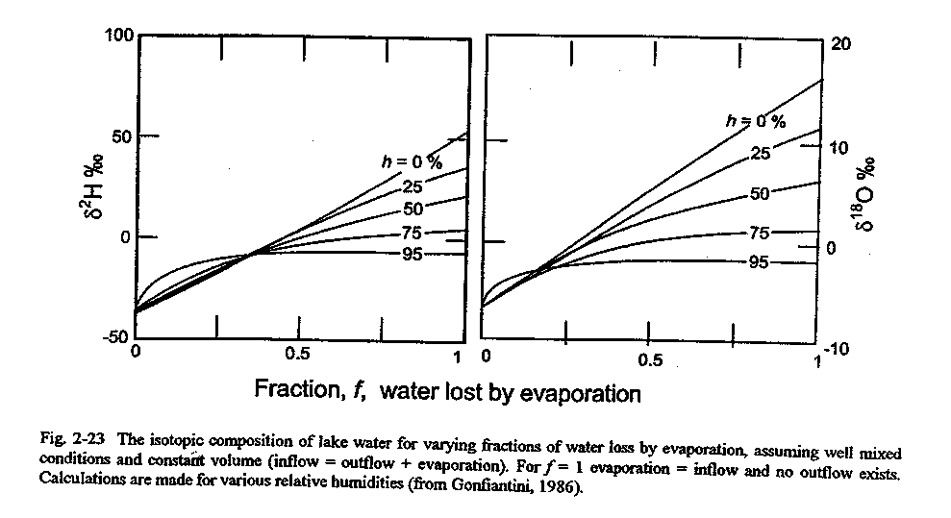
Effects of Extreme Evaporation
Evaporation in Lakes
Can be used in the mass balance study of lakes → Pan test is critical

Slide 16
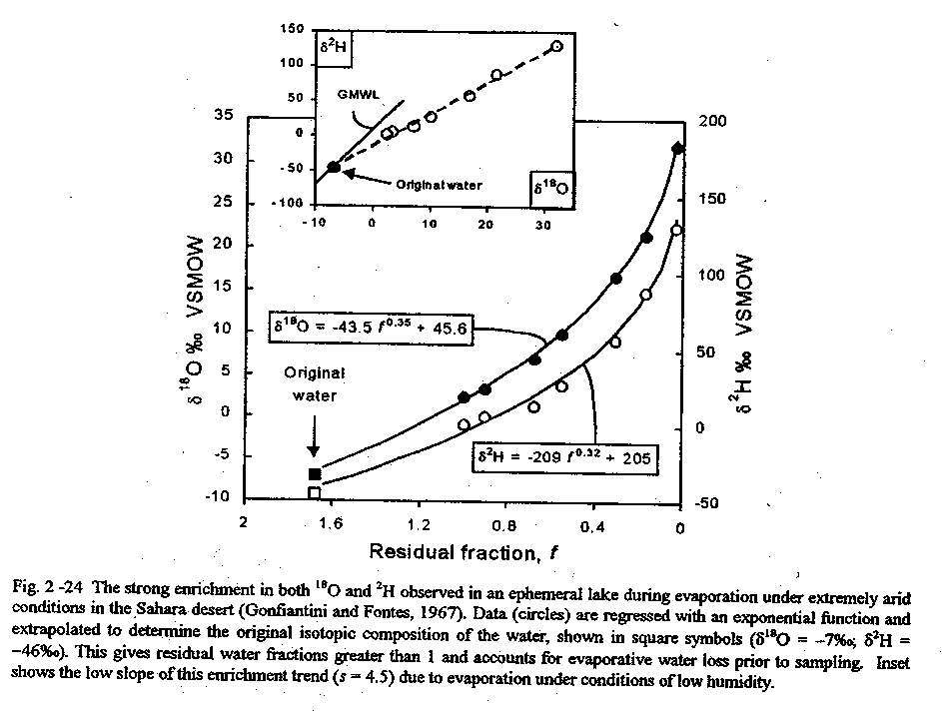

Slide 17
Evaporation of brines
The effect of solutes – decreasing activity → decrease water saturation in the boundary layer
Ion hydration
Mineral precipitation

Slide 18
