Slide 1
Ch.3. Precipitation
The significance of precipitation data?
Basis for all the hydrological evaluation
The T-δ¹⁸O Correlation in Precipitation
For global average (Dansgaard, 1964),
δ¹⁸O = 0.695T – 13.6‰ VSMOW
δD = 5.6T-100 ‰ VSMOW
δ¹⁸O = (0.338 ± 0.028) T_{monthly} – 11.99 ‰ VSMOW Yutsever and Gat (1981)
The deviation from it caused by local geographic effect

Slide 2
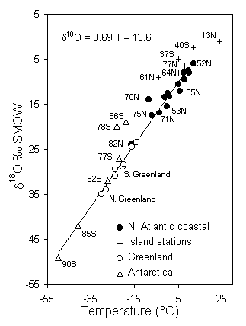
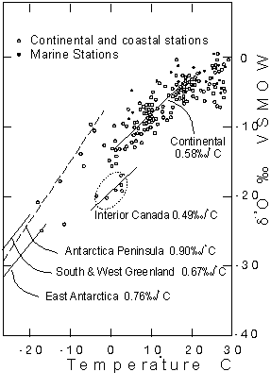
Fig. 3-1 The mean annual d18O-values for precipitation as a function of theglobal T–d18O relationship for precipitation, modified from Dansgaard, 1964 (left). Temperature is mean annual air temperature (MAAT) of the sampling station (modified from Dansgaard, 1964at the station. Data from the extensive IAEA Global Network for Isotopes in Precipitation (GNIP) shows this relationship to be a combination of regional T–d18O lines, with strong differences between marine, continental and interior stations, from Rozanski et al., 1993 (diagram on right).

Slide 3
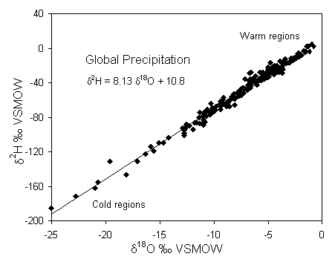

Slide 4
Latitude effect
Due rain out w/ Rayleigh distillation
The gradient become increasingly steep as latitude increases
Very shallow gradients in lower latitude
Note the ocean current and ‘continental effect’.

Slide 5
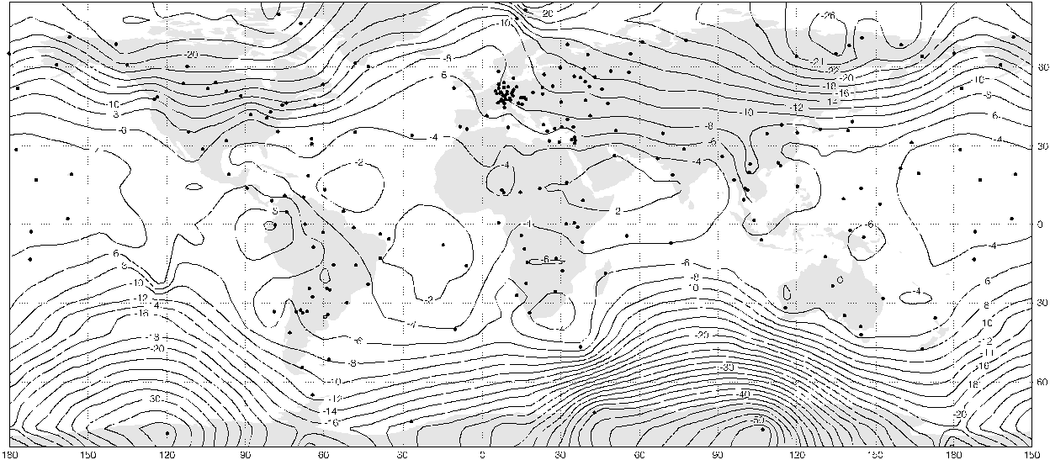
Fig. 3-2 Mean d¹⁸O distribution in precipitation on a global basis, for stations with at least 24 months of records. (based on IAEA World Meteorological Precipitation monitoring data summarized by Rozanski et al., 1992).

Slide 6
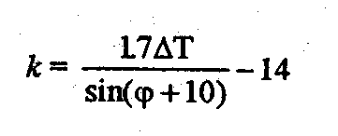
Continental effect
Due to regional topographic and climatic effect
Depleted as going from coast to the inland area
Strong seasonal variation
Continentality (Berry & Chorley, 1987), k: To measure the regional geographic parameters influencing rainout

Slide 7
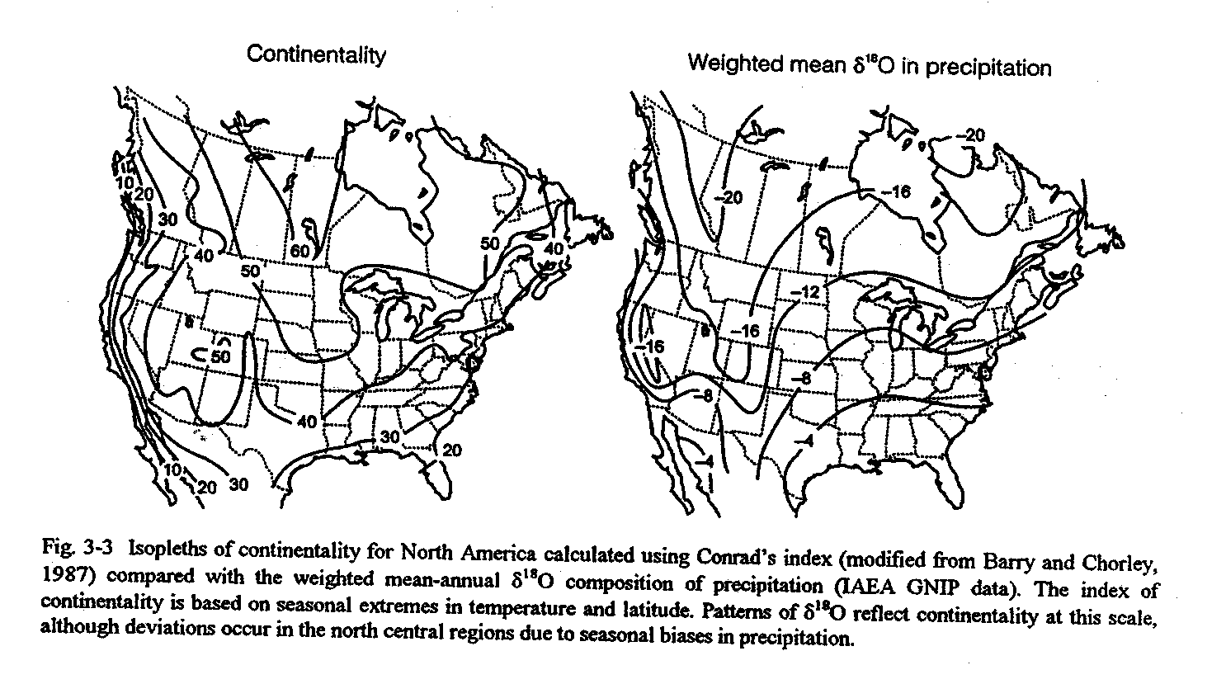

Slide 8
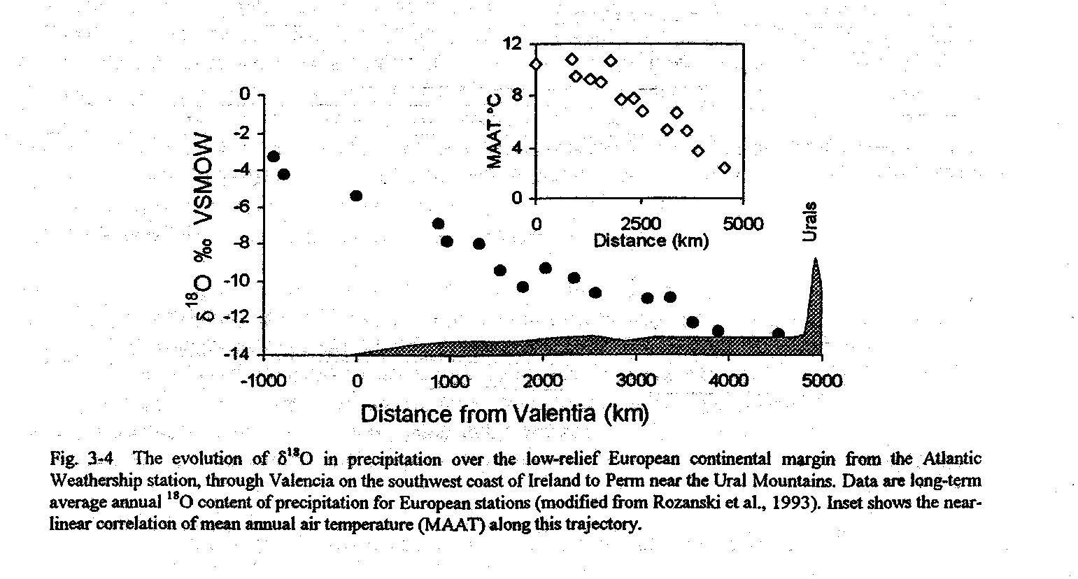

Slide 9
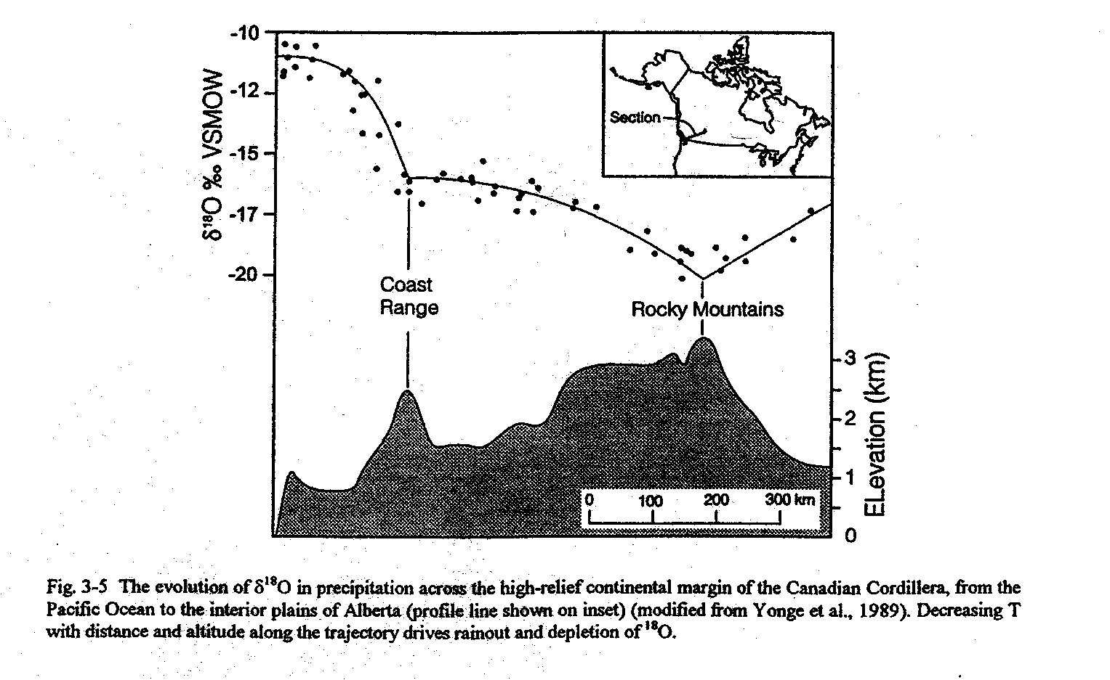

Slide 10
Local Effects on T-δ¹⁸O
Dependent on the local physiographical setting, including local topography, proximity to surface water bodies, seasonal changes etc.
Altitude effects

Slide 11
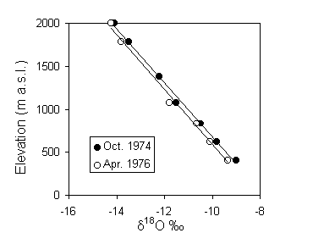
Fig. 3-6 The relationship between altitude and d ¹⁸O in precipitation in Val Corsaglia, maritime piedmont of the Italian Alps (Bortolami, 1978). Samples were collected in October 1974 and April 1976, representing months of the fall and spring seasons with similar mean monthly temperatures. The mean gradient for these data is –0.31 ‰ d¹⁸O per 100-m rise.

Slide 12
Table 3-1 Range of values for the δ¹⁸O-elevationaltitude gradient in different studies
Site | Region | Altitude (m asl) | Gradient (‰ per 100 m) |  | Reference
 |  |  | d¹⁸O | d²H
Jura Mountains | Switzerland | 500-1200 | –0.2 |  | Siegenthaler et al.,, 1983
Black Forest | Switzerland | 250-1250 | –0.19 |  | Dubois and Flück, 1984
Mont Blanc | France | 2000-5000 | –0.5* | –4 | Moser and Stichler, 1970
Coast Mountains | British Columbia | 250-3250 | –0.25 |  | Clark et al., 1982
Piedmont | Western Italy | 500-2000 | –0.31 | –2.5 | Bortolami, 1978
Dhofar Monsoon | Southern Oman | 0-800 | –0.10 |  | Clark, 1987
Saiq Plateau | Northern Oman | 400-2000 | –0.20 |  | Stanger, 1986
Mount Cameroun | West Africa | 0-4095 | –0.155 |  | Fontes et al., 1977

Slide 13
Seasonal effect
Due to the seasonal variation in T
Can be utilized for
Rates of gw circulation
Watershed respond to pptn
Time of most recharge

Slide 14
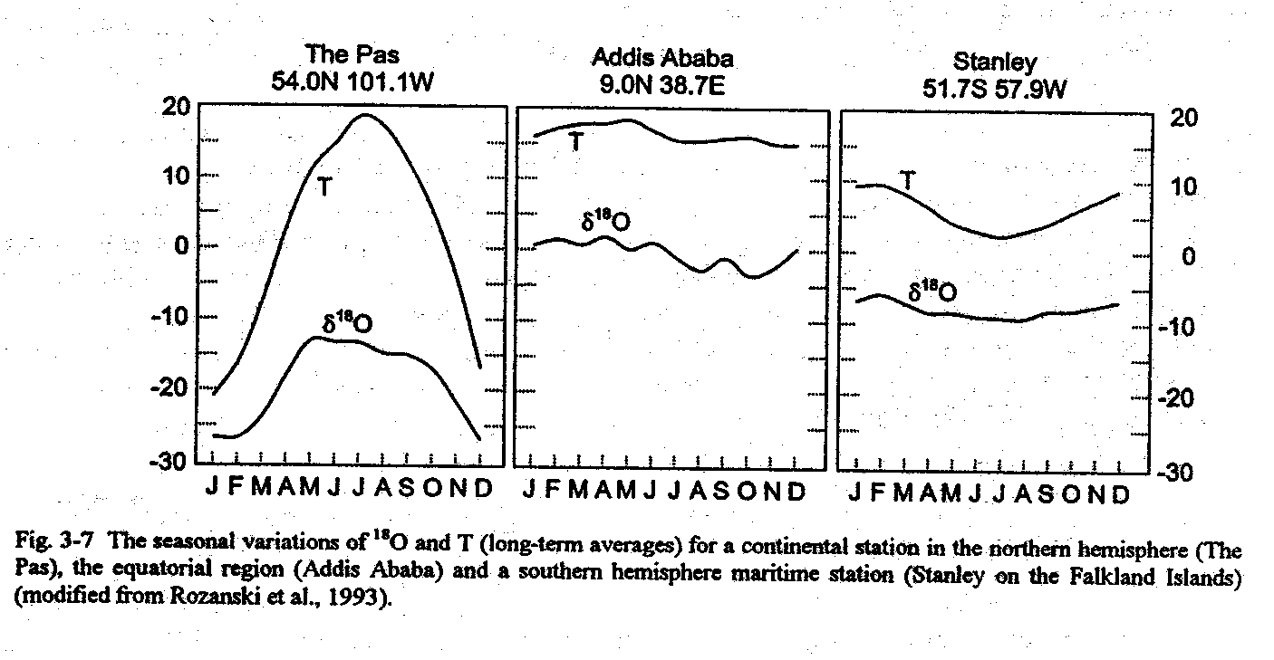

Slide 15
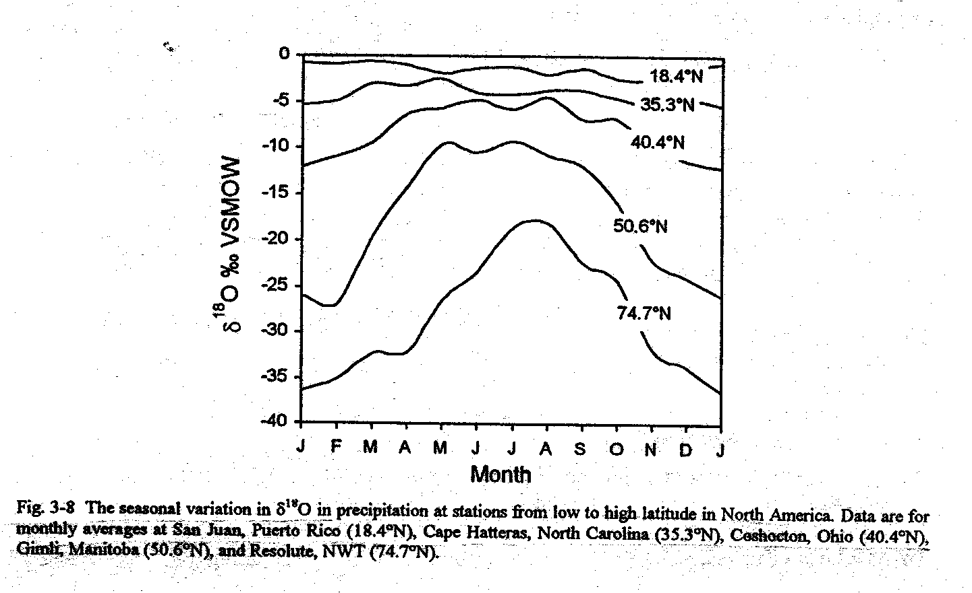

Slide 16
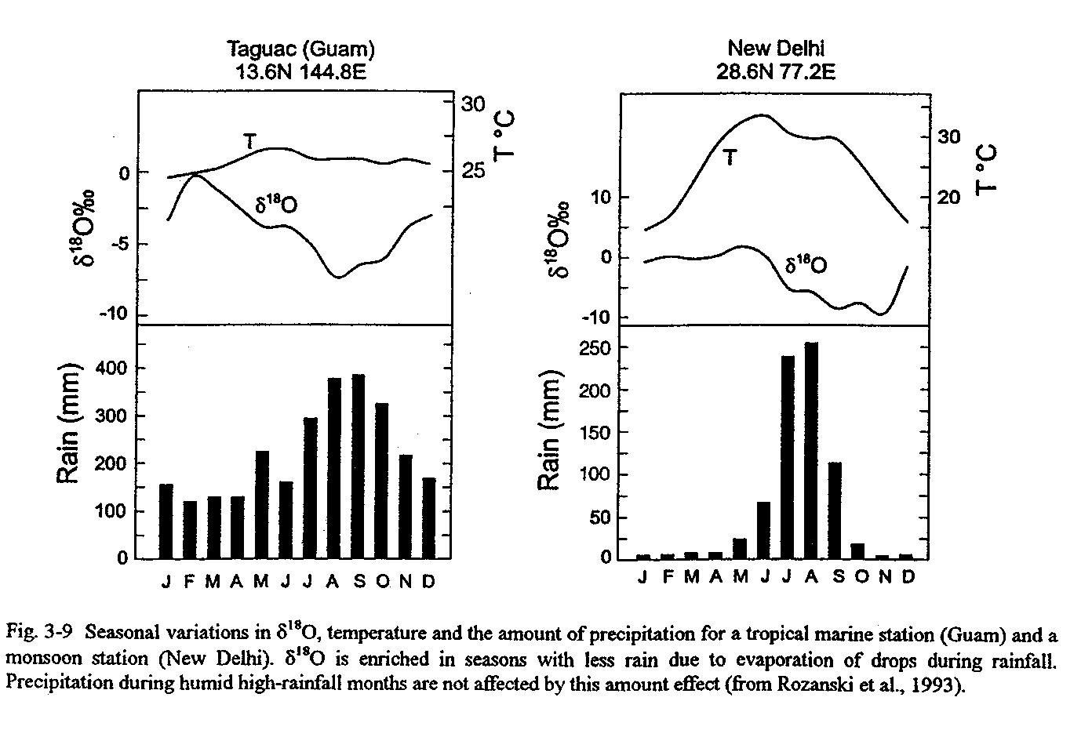

Slide 17
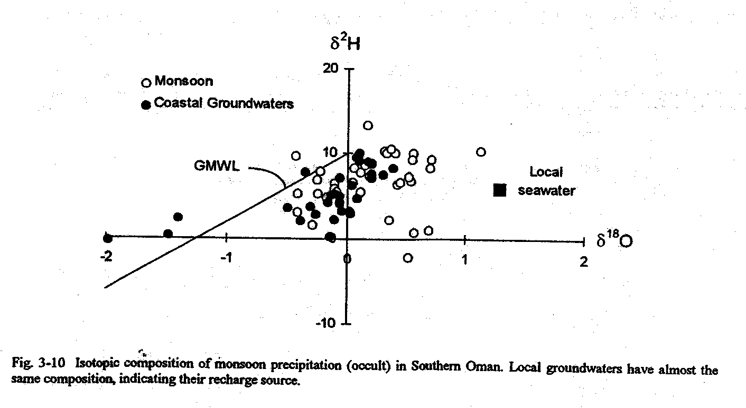
Condensation of coastal fog
The isotopic composition of the precipitation become quite close to that of sea water

Slide 18
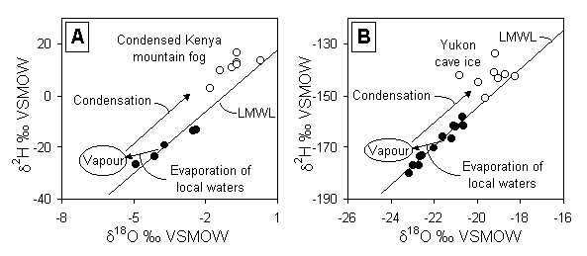
The kinetic effect of secondary evaporation
Surface water & groundwater above LMWL?
Fig. 3-12 Secondary evaporation effects causing meteoric waters to plot above the LMWL. A — Re-evaporation of local groundwaters in Kenya. (modified from Ingraham and Matthews, 1988). B — Evaporation of local surface waters in the northern Yukon condensing as cave ice in fossil karst terrain. In both cases, the condensed phase is in equilibrium with the vapour (equilibrium fractionation during condensation) and so plots on a line with slope ~ 8.

Slide 19
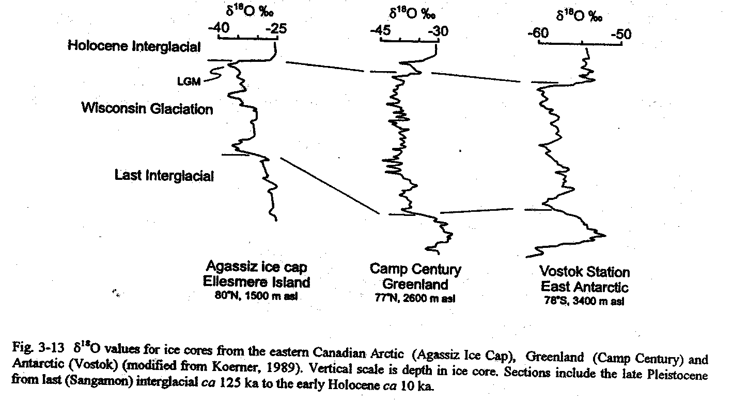
Ice cores & Paleotemperature

