Slide 1
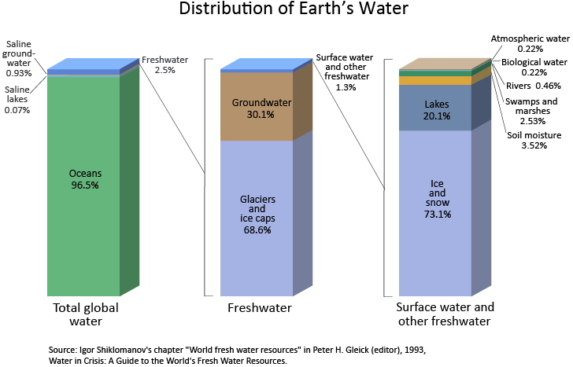
Ch.2.
수권: 지구의 물로 구성된 시스템
From http://ga.water.usgs.gov/edu/earthwherewater.html

Slide 2
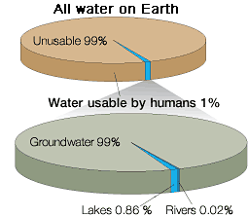
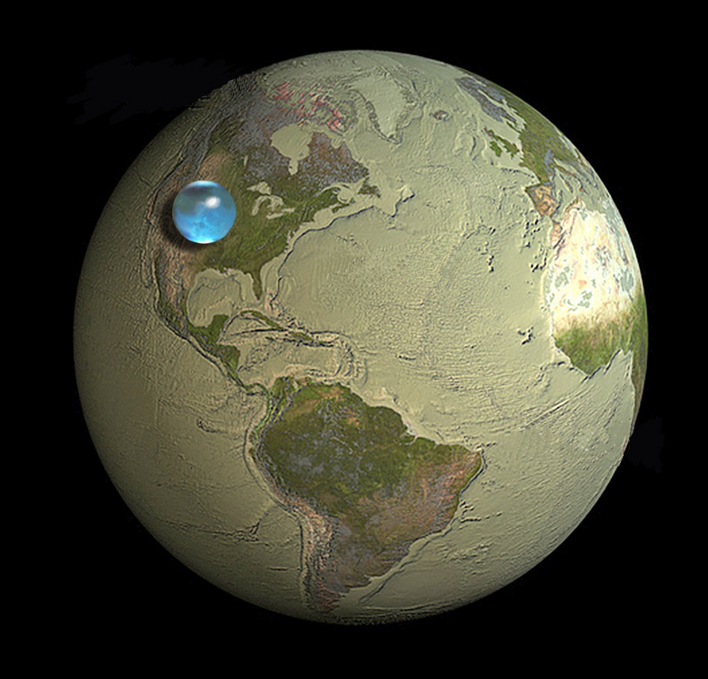
Picture of Earth showing if all Earth's water (liquid, ice, freshwater, saline) was put into a sphere it would be about 860 miles (about 1,385 kilometers) in diameter. Diameter would be about the distance from Salt Lake City, Utah to Topeka, Kansas, USA. Credit: Illustration by Jack Cook, Woods Hole Oceanographic Institution; USGS.
From http://ga.water.usgs.gov/edu/earthwherewater.html

Slide 3
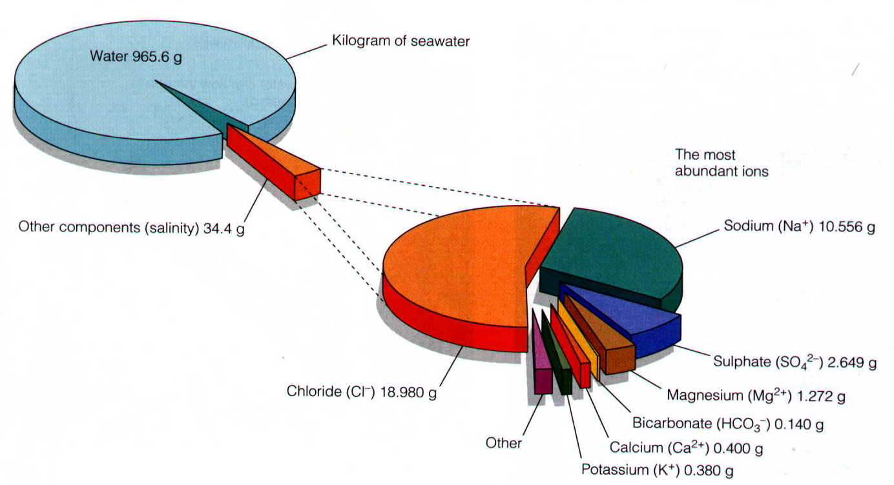
해수의 화학 조성
From http://earth.usc.edu/classes/geol150/stott/variability/deepocean.html

Slide 4
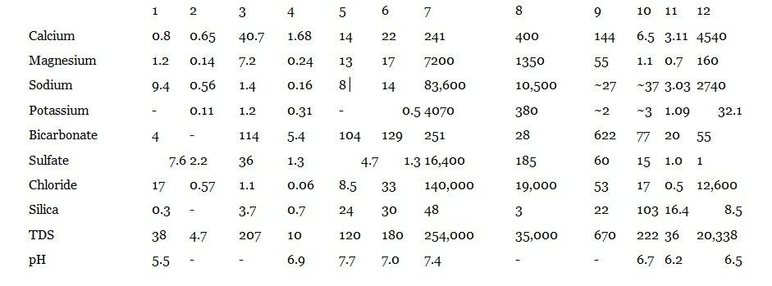
물 화학조성의 비교
Key to Analyses: (1) Rainwater from Menlo Park, California; (2) Average rainwater from sites in North Carolina and Virginia; (3) Composition of the Rhine River as it leaves the Alps; (4) Stream draining igneous rocks in the Washington Cascades; (5) Jump-Off Joe Creek, southwestern Oregon, wet season, November, 1990; (6) Jump-Off Joe Creek, southwestern Oregon, dry season, September, 1991; (7) Great Salt Lake, Utah; (8) Average seawater; (9) Groundwater from limestone of the Supai Formation, Grand Canyon; (10) Groundwater from volcanic rocks, New Mexico; (11) Groundwater from a spring, Sierra Nevada Mountains: short residence time; (12) Groundwater from metamorphic rocks in Canada: long residence time.

Slide 5
물의 중요성
기후의 조절자(온도의 극단적 변화를 방지하고, 적절히 조절)
생명체의 필수 구성 성분
꼭 필요한 자연 자원의 하나
지표(+지각)의 대부분(지구화학적) 작용에 관여

Slide 6
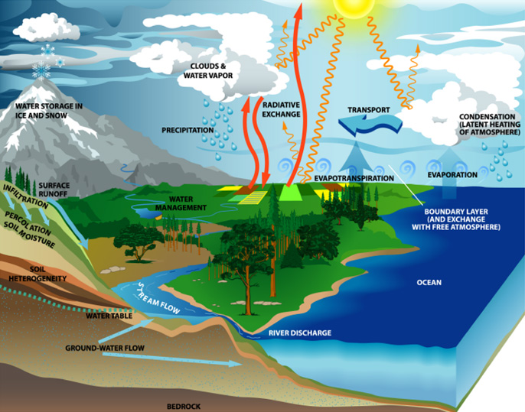
물과 기후
From http://www.mnforsustain.org/water_climate_global_water_cycle_study.htm

Slide 7
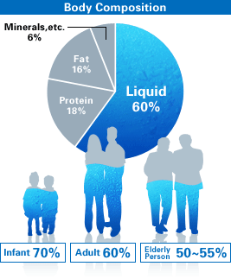
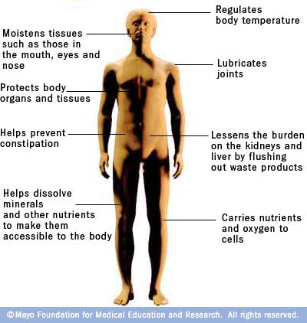
우리 몸의 물과 그 기능
From http://www.waterevolution.co/2011/functions-of-water-in-the-body/
From http://reminiscentray.tumblr.com/

Slide 8
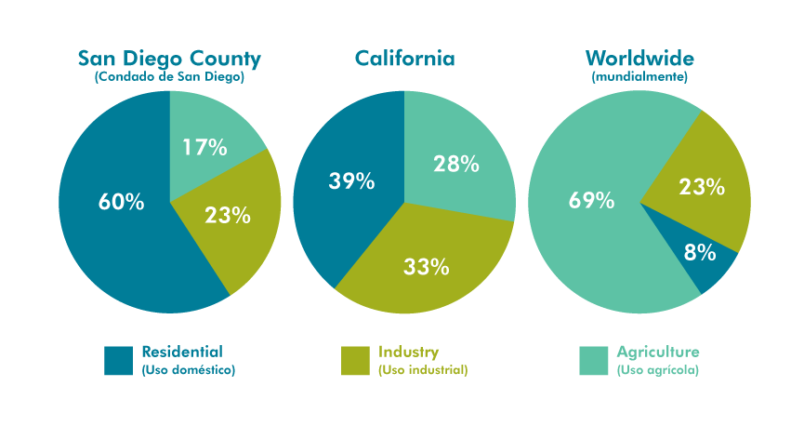
물의 사용
2010?
From http://www.wrsc.org/attach_image/water-usage-san-diego-compared-california-and-rest-world

Slide 9
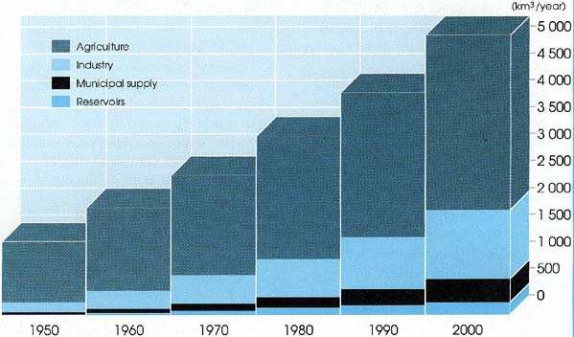
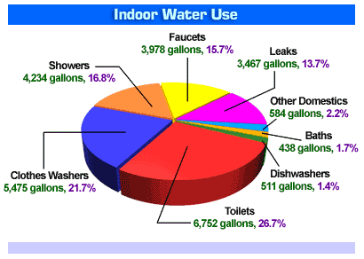
세계 물 소비
From http://www.fao.org/docrep/003/t0800e/t0800e0a.htm
From http://www.mrbobs.com/septic-services/water-usage-chart/

Slide 10
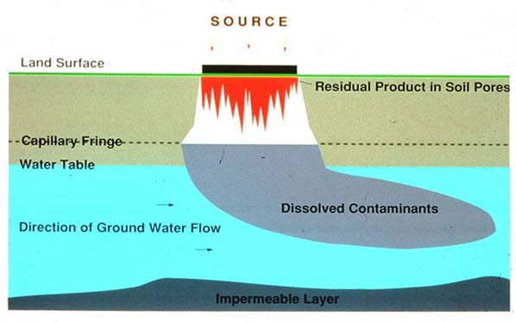
지하수 내 오염물의 이동
From http://www.wesleyan.edu/ctgeology/GroundwaterPollution/GroundwaterPollution.html

