Slide 1
4. Combinatorial Formula
Number of different combinations of m out of k (always k > or = m) is given by
w=k!/m!(k-m)!
Ex. 1. How many invariant points exist in a binary system with 7 possible phases?
Ex. 2. How many univariant lines converge at an invariant point in a ternary system?

Slide 2
5. Free Energy Surface
For a phase having a constant composition, its free energy surface may be given by
G(T,P),
Differentiation gives
dG=(∂G/∂T)_{P}dT+(∂G/∂P)_{T}dP
= -SdT + VdP

Slide 3
6. Morey-Schreinemaker’s Rule?
Or simply Schreinemaker’s Rule – Rules how to arrange univariant curves converging on an invariant point in a phase diagram
Refer http://en.wikipedia.org/wiki/Schreinemaker's_analysis
Clapeyron’s equation:
dP/dT = - ∆ S/ ∆ V

Slide 4
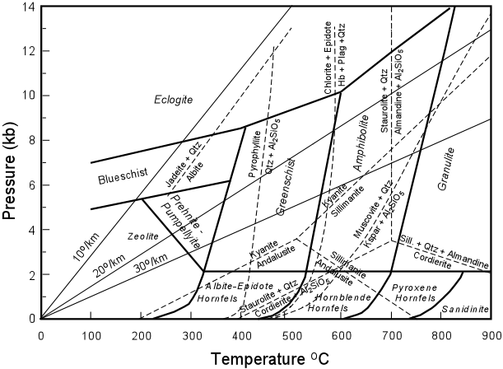
http://www.tulane.edu/~sanelson/eens212/metamorphreact.htm

Slide 5
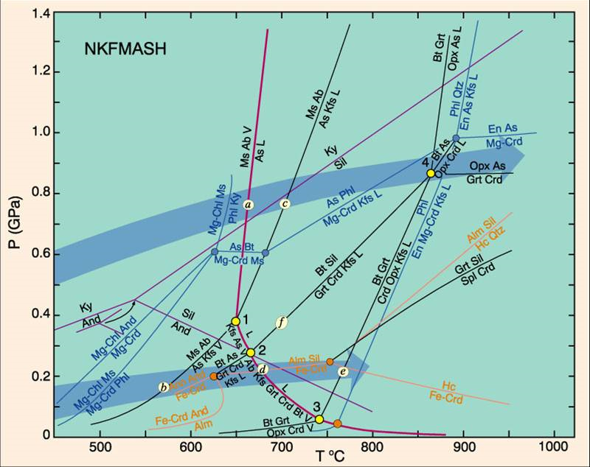
http://all-geo.org/metageologist/2011/09/what-you-ought-to-know-about-metamorphism/

Slide 6
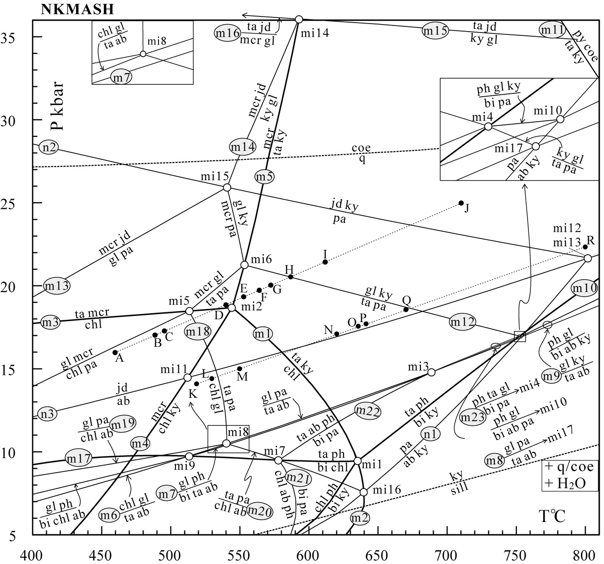
http://petrology.oxfordjournals.org/content/45/1/183/F1.expansion.html

