Slide 1
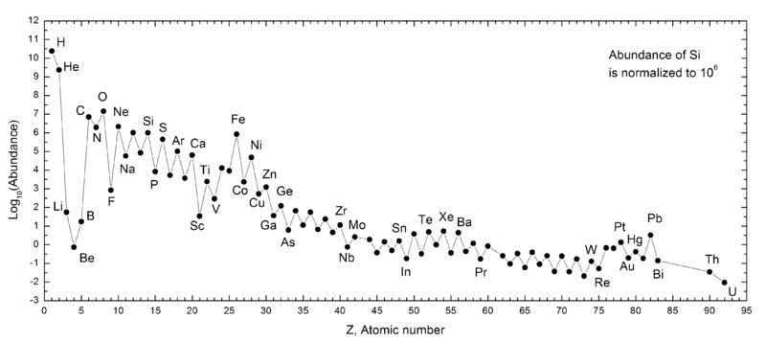
Ch.2.
Nucleosynthesis:
Elemental abundance in solar system
From http://en.wikipedia.org/wiki/File:SolarSystemAbundances.png

Slide 2
Characteristics of the elemental abundance
H & He are the two elements most abundant. H/He=12.5
The abundance decreases exponentially up to Z=50
Elements z>50 are very low, their abundance shows relatively little changee as a function of Z
“Oddo-Harkins rule” for Z>5
The abundances of Li, Be, & B are extremly low
Fe is prominently high w/r to other neighbors
₄₃Tc & ₆₁Pm are missing
Elements Z>83 (Bi) are very rare & unstable
→ All these characteristics can be xplained with nucleosynthesis

Slide 3
Nucleosynthesis
H-burning, T>10⁷ K, d> 100 g/cm³
¹H(p, e⁺ n)²D
(e⁺, e⁻) (annihilation)
²D(p, g)³He
³He(³He, 2p)⁴He
Synthesis with intermediate nuclei
⁷Be(e⁻, n)⁷Li
⁷Li(p, g)⁸Be
⁸Be --> 2⁴He
Or
⁷Be(p, g)⁸B
⁸B --> ⁸Be + e⁻ + n
⁸Be-->2⁴He

Slide 4
CNO cycle, T<10⁸ K
¹²C(p, g)¹³N --> ¹³C + e⁻ + n
¹³C(p, g)¹⁴N
¹⁴N(p, g)¹⁵O --> ¹⁵N + e⁻ + n
¹⁵N(p, a)¹²C
¹⁶O(p, g)¹⁷F --> ¹⁷O + e⁻ + n
¹⁷O(p, a)¹⁴N
Helium-burning, T~ 10⁸ K, d~ 10⁵ g/cm³
⁴He + ⁴He --> ⁸Be
⁸Be(a, g)¹²C
¹²C(a, g)¹⁶O
¹⁶O(a, g)²⁰Ne
²⁰Ne(a, g)²⁴Mg

Slide 5
C- & O-burning,
T>8*10⁸ K
¹²C(¹²C, p)²³Na
¹²C(¹²C, a)²⁰Ne
¹²C(p, g)¹³N --> ¹³C + e⁻ + n
¹³C(a, n*)¹⁶O
T>2*10⁹ K
¹⁶O(¹⁶O, n*)³¹S
¹⁶O(¹⁶O, p)³¹P
¹⁶O(¹⁶O, a)²⁸Si
T>2.5*10⁹ K
³¹P(g, p)³⁰Si
³⁰Si(g, n*)²⁹Si
²⁹Si(g, n)²⁸Si

Slide 6
E-process (equilibrium p-)
Silicon-burning
Equilibrium between P & N
Element 28<Z<57
S- & r-process (slow- & rapid-p-)
Neutron capture → isotopes
S-; Z<209 (Bi)
R-; Z>209
P-process: T>3*10⁹K
X-process: spallation of nucleus

Slide 7
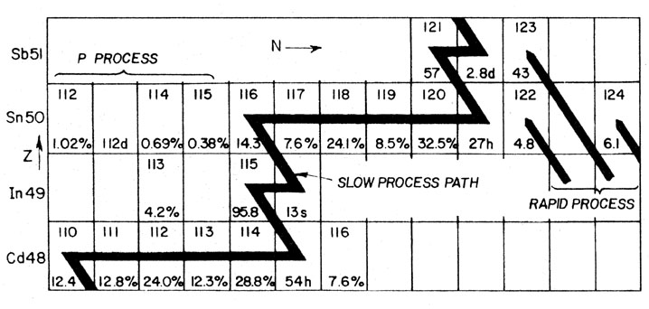
From http://ned.ipac.caltech.edu/level5/Pagel/Figures/figure1_5.jpeg

