Slide 1
Ch. 4. Measurements (on Site) in Field
pH와 E_{H}
Basic water quality parameters
Definitions
pH = -log₁₀a_{H+} (logarithmic value of the reciprocal of the proton activity in the solution)
E_{H}: Electrode potential against hydrogen reference electrode. Indicating the electrode concentration in a solution
Both measures electrode potential with probes
Preliminary knowledge on a electrochemical cell required
oxidation state: charges on an ion, assuming a perfect ionic bonding
oxidation-reduction: Increase-decrease of oxidation state
cathode-anode: electrode where reduction-oxidation occur

Slide 2
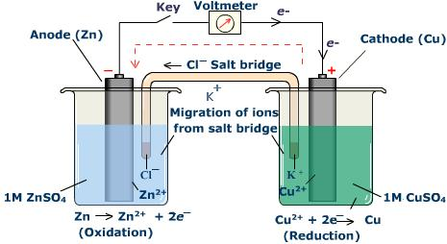
Ch. 4.
Typical electrochemical cell
http://chem-guide.blogspot.kr/2010/04/electrochemical-cell.html

Slide 3
Ch. 4.
Principles
For the following general redox reaction
aA + bB =cC + dD + ne⁻
Nernst equation
$E_{H}=E^{o}−\frac{RT}{nF}\ln{\frac{{[C]}^{c}{[D]}^{d}}{{[A]}^{a}{[B]}^{b}}}$
(G=-nFE)
E_{H}: electrode potential
Eº; standard electrode potential
R; ideal gas constant, 0.001987 kcal/K
T; absolute temperature
n; number of electrons transferred
F: Faraday constant, 23.06 kcal/V.mole

Slide 4
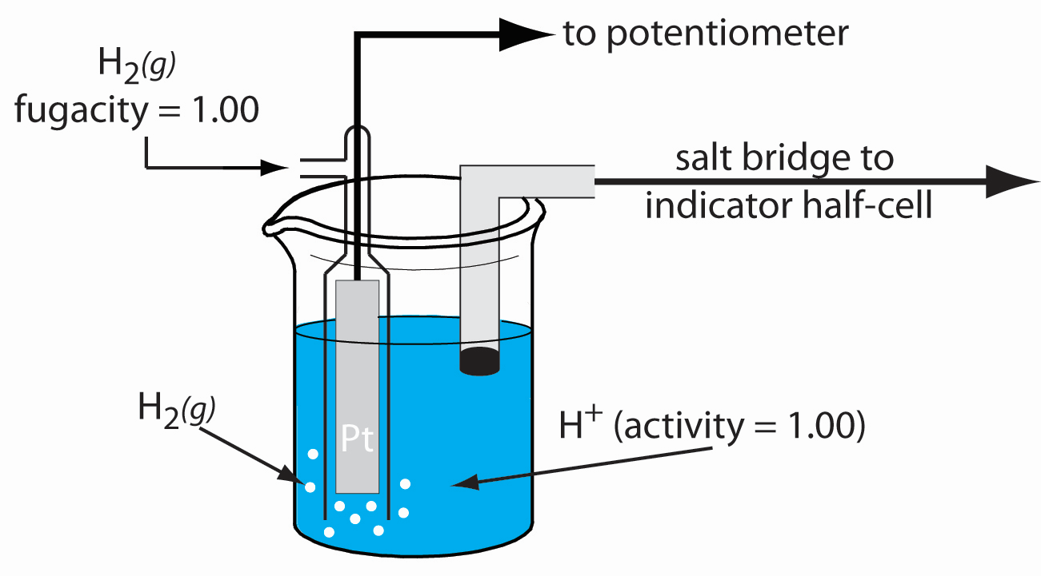
Ch. 4.
Hydrogen electrode
http://chemwiki.ucdavis.edu/Analytical_Chemistry/Analytical_Chemistry_2.0/11_Electrochemical_Methods/11B_Potentiometric_Methods

Slide 5
Ch. 4.
Reaction on the hydrogen electrode
0.5H²(g) = H⁺ + e-
$E_{H}=−\frac{RT}{F}\ln{\frac{[H^{+}]}{{[P_{H_{2}}]}^{0.5}}}$
If $P_{H_{2}}=1$ atm., $\left[H^{+}\right]=1$ m, $E_{H}=0$ V
If $\left[H^{+}\right]≠1$ m
$E_{H}=−\frac{RT}{F}\ln\left[H^{+}\right]=−\frac{RT}{2.303F}\log\left[H^{+}\right]=\frac{RT}{2.303F}pH$
$pH= \frac{2.303F}{RT}E_{H}$
→ pH is also a function of E_{H}

Slide 6
Ch. 4.
For the following half reaction in sample solution
Fe²⁺ = Fe³⁺ + e⁻
The electrode potential measurement with hydrogen electrode as a reference electrode is for the following reaction
0.5H₂(g)+Fe³⁺ = H⁺ + Fe²⁺
The electrode potential is given by
$E_{H}={E^{o}}_{{Fe}^{3+},{Fe}^{2+}}−\frac{RT}{F}\ln{\frac{\left[{Fe}^{2+}\right]}{\left[{Fe}^{3+}\right]}−}{E^{o}}_{H_{2},H^{+}}+\frac{RT}{F}\ln{\frac{\left[P_{H_{2}}\right]}{\left[H^{+}\right]}}$
$={E^{o}}_{{Fe}^{3+},{Fe}^{2+}}−\frac{RT}{F}\ln{\frac{\left[{Fe}^{2+}\right]}{\left[{Fe}^{3+}\right]}}$
* In most cases, hydrogen electrode is not actually used in real measurements

Slide 7
Ch. 4.
Methods of measurement
Colorimetric method: Measuring pH and E_{H} from color change of the solution having and indicator → used no more.
Electrometric method →commonly used nowadays
Potentiometer:
Reference electrode: electrode used as a reference when the potential is measured
Calomel elctrode (HgCl₂-Hg)
AgCl-Ag electrode
Indicator electrode
pH: glass electrode
E_{H}: platinum electrode
Temperature compensator
Automatic (ATC)
Manual

Slide 8
Ch. 4.
Notables at pH measurement
Stablized only in a well buffered solution
Difficult to obtain accurate values when T is lower than 25ºC, concentrations of HCO₃⁻ is below 50mg/L, and pH is either lower than 4.5 or higher than 8.2
The sample should be stationary during the measurement
[Glass electrode]
Note the asymmetric potential (Due to the difference between the inner and outer wall of the glass electrode, the potential become nonzero for the same concentrations)
Calibration with buffere solutions
Temperature compensation
Measurement may become inaccurate, if the ionic strength of the sample solution is very different from that of the buffer solution
Use a special elctrode when pH is lower than 1 or higher than 9
Presoak in water for an hour before use
The older the electrode, the slower and more inaccurate the response
Careful not to scratch the surface of the electrode

Slide 9
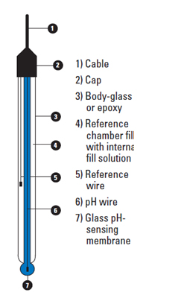
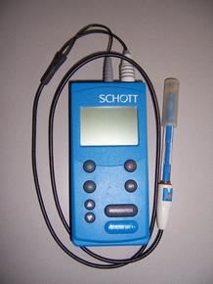
Ch. 4.
General structure of glass electrode.
(combination electrode)
http://www.ti.com/ww/en/industrial/sensors/pH/learn.html
* Protect the instrument from the direct sunlight

Slide 10
Ch. 4.
Notables at E_{H} measurement
Meaningul only when DO is lower than 0.01ppm (Most surface waters have higher DO concentrations than this, and DO measurement instead is advised in this case)
Most redox reactions in nature are irreversible
If there are a lot of active organic material, this will dominate in E_{H} determination and makes the reading unstable
Stable E_{H} values are possible only in “well poised systems”
Measured E_{H} values in nature are the results from several redox reactions combined
Redox reactions of C, N, and S in the samples with abundant Fe are so slow that they cannot affect significantly on E_{H} values.
[Platinum electrode]
Platinum hydroxide can form on the surface of the electrode in an oxygen-rich environmen
H₂S, H₂, CH₄, organic matter, and Fe hydroxide can interfere the measurement
Frequently check the validity with Zobell solution
“Poisoning”: Remove with the mixture of pyrex glass power and glyceline
The minimum measured value would be the closest to the true value
Mind flowing & suspension effect

Slide 11
Ch. 4.
Conductivity
Ability of having electric current – function of ionic concentrations, mobilities, charges, and temperature
Definition
Conductance: G – reciprocal values of resistivity, proportional to the area and inversely proportional to the length
G = 1/R = k(A/L)
k = specific conductivity
Always report the values at 25ºC.
Unit
Old unit: mhos/cm
Modern unit: S/m (Siemen)
$μ$S/cm = $μ$mhos/cm

Slide 12
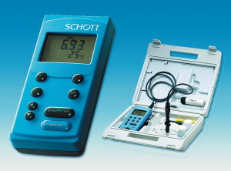
Ch. 4.
Notables at measurement
Calibrate with conductivity reference solutions
Temperture compensation
refer “platinum electrode” section in the previous slide

