Slide 1
Thermal maturity of OM
  (원소) 조성
  Vitrinite reflectance
  동위원소
  색
  형광
  ESR

Slide 2
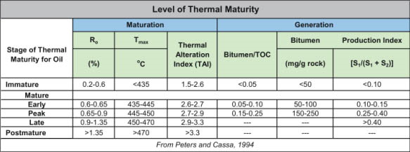
Stage of Thermal Maturity | Temperature | Process | Product
Immature | <60 o C | Bacterial and plant organic matter converted to kerogens and bitumen | Methane generated by microbial activity
Mature | 60 o C -160 o C | Rock generates and expels most of it's oil | Oil
Postmature | >160 o C | Postmature for oil/mature for gas | Gas
http://www.dcnr.state.pa.us/topogeo/econresource/oilandgas/marcellus/sourcerock_index/sourcerock_maturation/index.htm

Slide 3
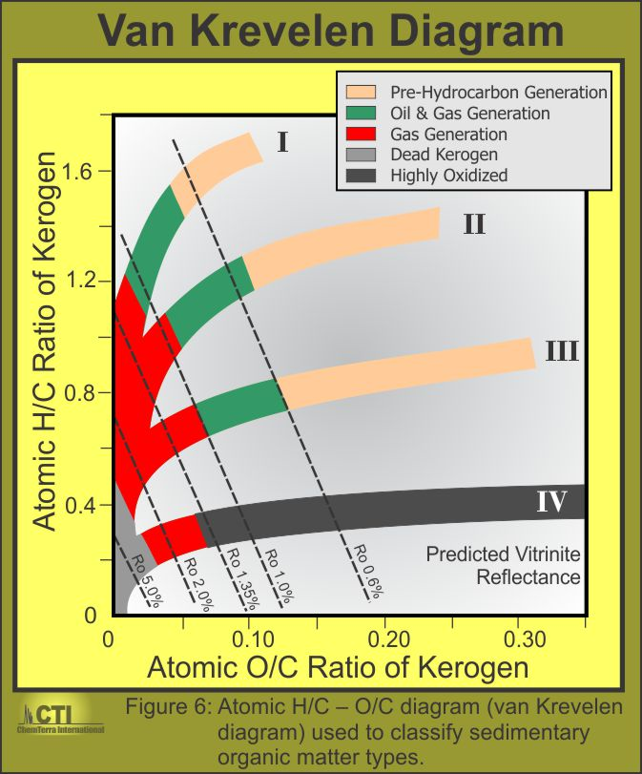
http://www.chemterra.com/resource-play-consulting/

Slide 4
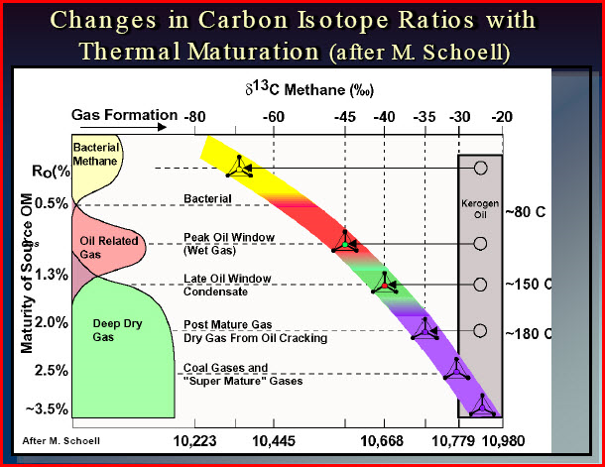
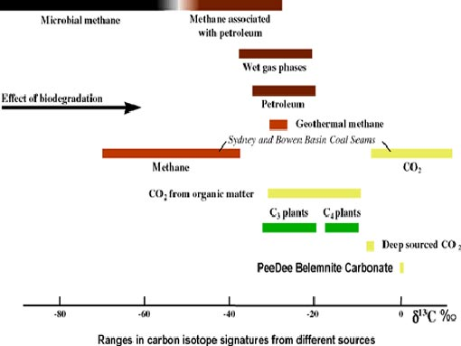
http://www.ngdir.ir/geolab/GeoLabExp.asp?PExpCode=3216&PID=931

Slide 5
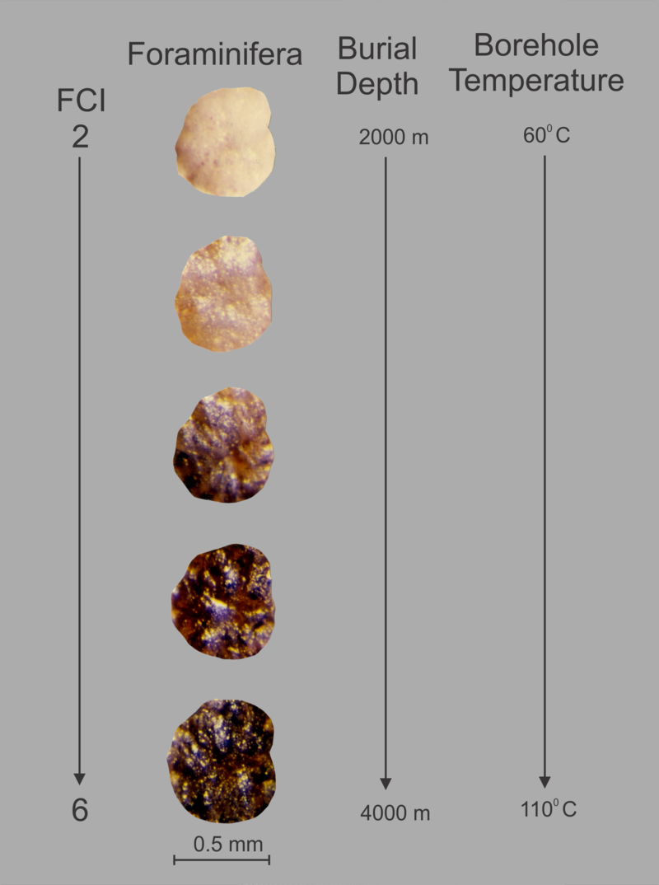
Foraminiferal Colouration Index (FCI) - Example of thermal alteration colours (FCI 2 - 6) in agglutinated foraminifera from an oil well.
http://en.wikipedia.org/wiki/Foraminiferal_Colouration_Index

Slide 6
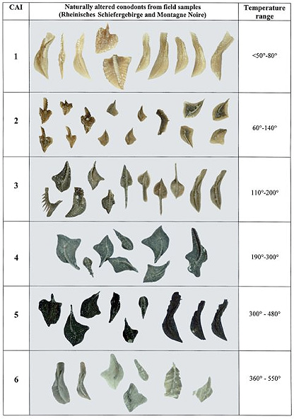
http://www.geol.umd.edu/~jmerck/geol342/lectures/22.html

Slide 7
Fluorescence (%FI)
“Fluorescence (%FI) is the ability of the organic constituents to produce luminancence
(visible light) when irradiated with Blue Light and UV excitation. Fluorescence is
visibly intense (bright) in immature, oil prone, kerogens and declines as the organic
constituents increase in maturity. Fluorescence become difficult to see (visually) when
the level of thermal maturity progresses to about 1.15 %Ro and is essentially gone
(or so weak as to appear absent) at a reflectance of 1.35 %Ro (at and/or near the "oil"
death line).”
from Organic Matter and Thermal Maturity Analyses of the Upper Cretaceous Sediments between 3,267 and 3,365 feet in the 1 Alpine Federal Well, Apache County, Arizona by Karl W. Schwab, ARIZONA GEOLOGICAL SURVEY CONTRIBUTED REPORT CR-96-B (1996)

Slide 8
From Tissot and Welte, 1984

