Slide 1
Korean Holidays

Slide 2
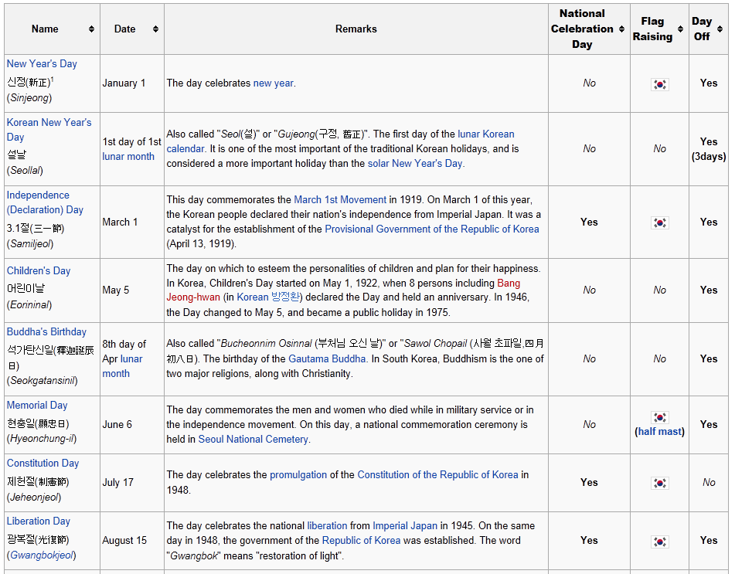

Slide 3
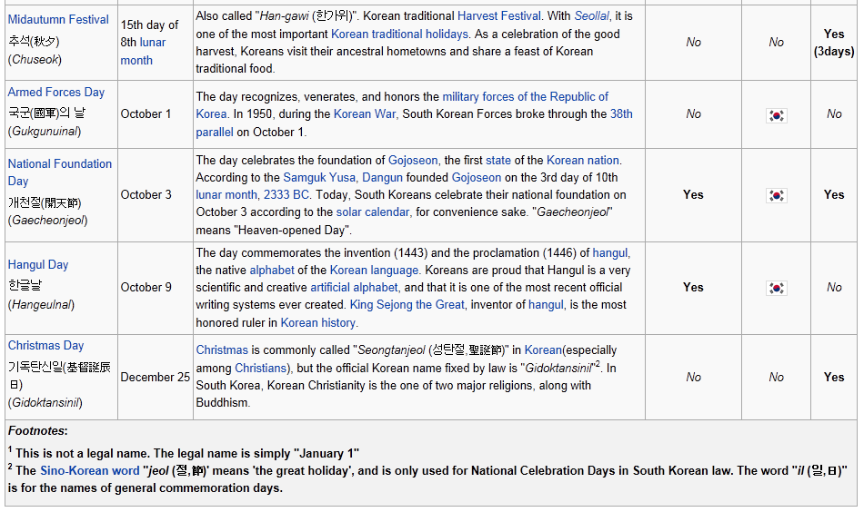
http://en.wikipedia.org/wiki/Public_holidays_in_South_Korea

Slide 4
설날 Korean New Year’s Day
Jan. 1 on lunar calendar
Traditional & family holiday → due to the family and relatives gathering, a country-wide traffic jam commonly occur
Having rituals for the ancestors and wishing for good luck for the whole year
Special food: 떡국 (Rice cake soup)
Special greeting: 세배, 세뱃돈
Plays: 윷놀이, 연날리기, 제기차기, 투호, 팽이치기

Slide 5
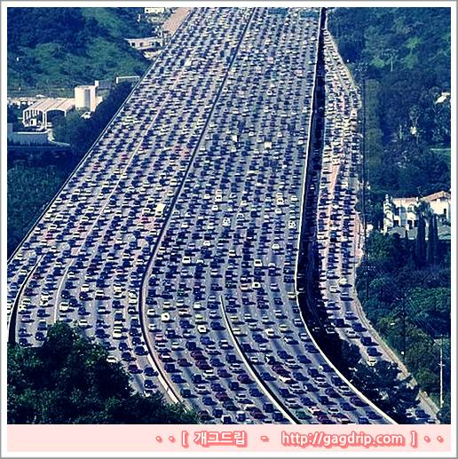
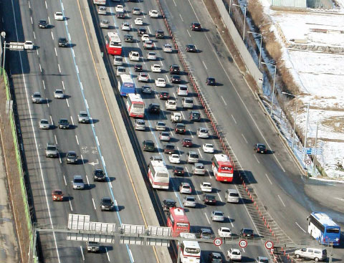
Traffic Jam During the Seolnal Break
http://www.asiatoday.co.kr/news/view.asp?seq=205825

Slide 6
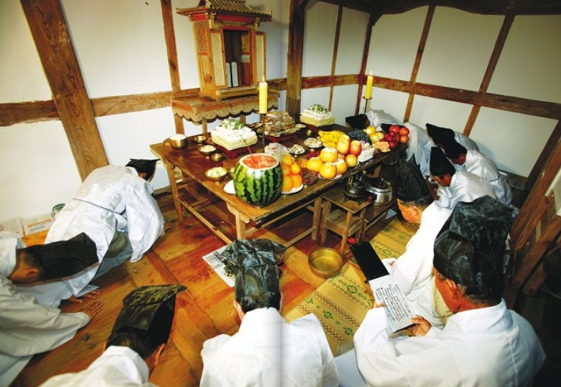
차례
http://www.haenamyun.com/zbxe/index.php?mid=ja6&listStyle=gallery&document_srl=23594

Slide 7
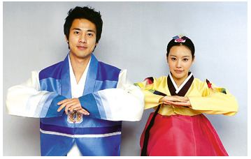
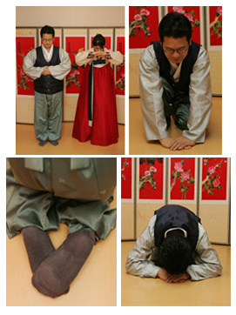
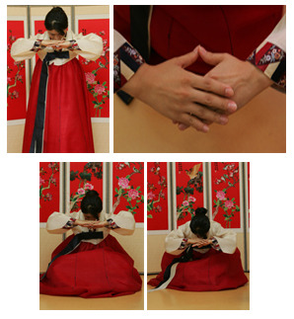
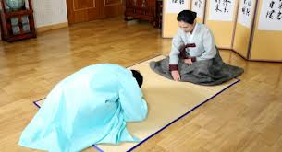
세배
http://yedamhanbok.tistory.com/
http://youtu.be/KJUzBUHuW3g

Slide 8
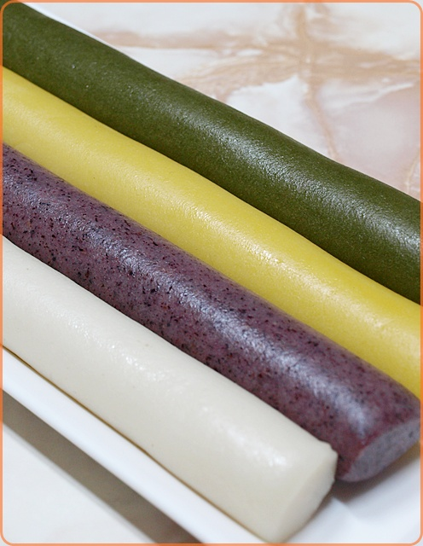
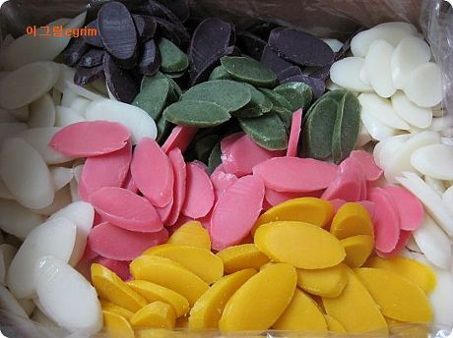
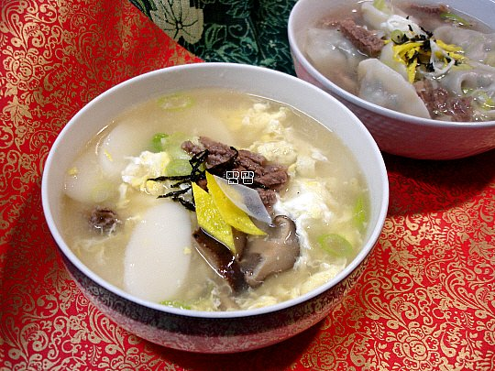
http://blog.daum.net/_blog/tagArticleList.do?blogid=0HBGd&tagName=%EB%B0%B1%EB%A0%A8%EC%B4%88%EB%96%A1%EA%B5%AD#ajax_history_home
떡국
http://moai-food.com/726
http://matzzang.net/152

Slide 9
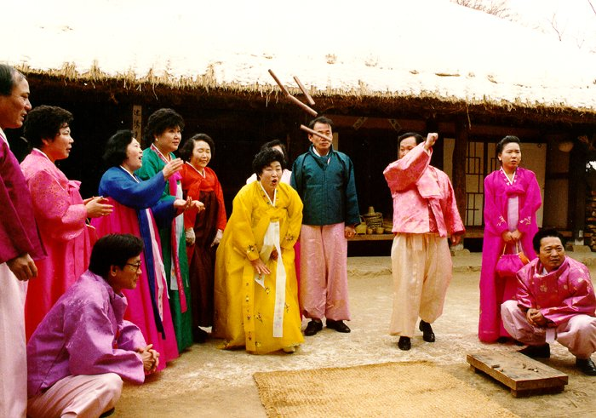
윷놀이
http://dzzesu.hp8989.com/

Slide 10
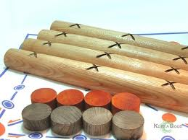
http://www.greenkorean.co.kr/iss/view.php?&bbs_id=korealife&page=5&doc_num=15

Slide 11
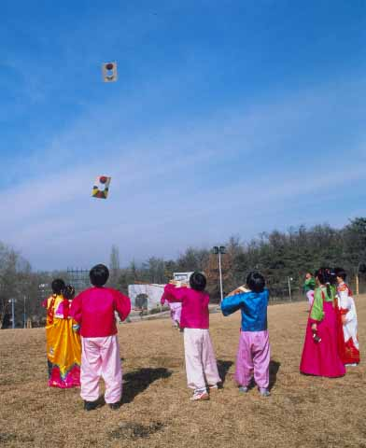
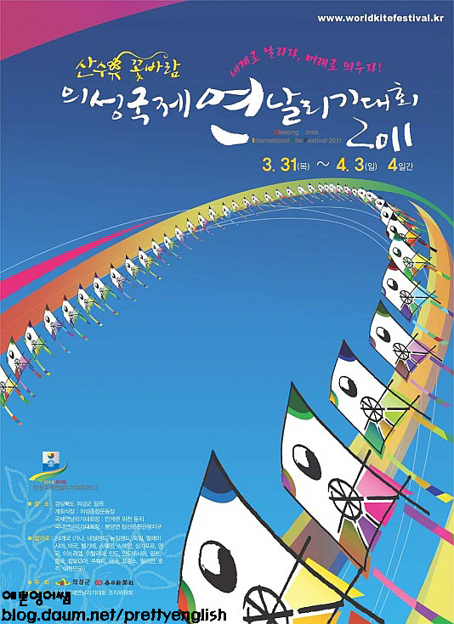
연날리기
http://youtu.be/cM4tS5Y999E
http://youtu.be/EzPflj_lRpE
http://v.daum.net/link/15248968

Slide 12
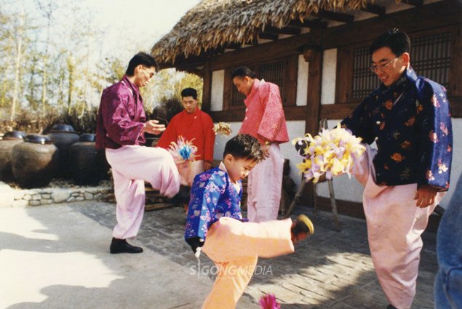
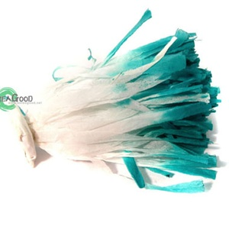
제기차기
http://it.news.danawa.com/News_List_View.php?nModeC=10&nCateC1=1985&nCateC2=11910&sGNBUrl=Y&nPoolList=1&nSeq=1409198&nBoardSeq=60&auth=1
http://www.inven.co.kr/board/powerbbs.php?come_idx=2608&l=23021
http://youtu.be/kpqYzMWNabs

Slide 13
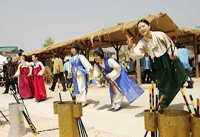
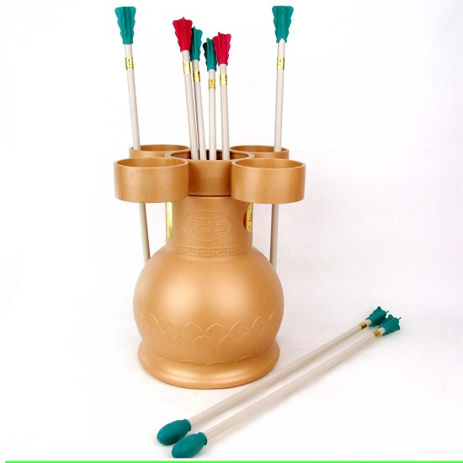
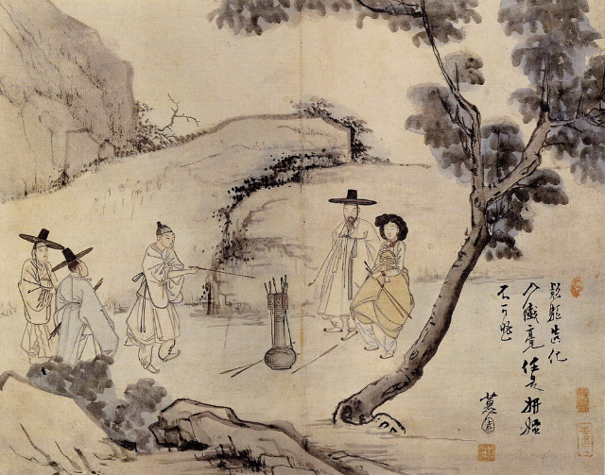
http://blog.naver.com/PostView.nhn?blogId=bluebird5519&logNo=120123300410
http://www.happyday.kr/shop/shopdetail.html?branduid=5434&xcode=079&mcode=004&scode=&type=X&search=&sort=price
http://blog.naver.com/PostView.nhn?blogId=hwd3527&logNo=111746541&redirect=Dlog&widgetTypeCall=true

Slide 14
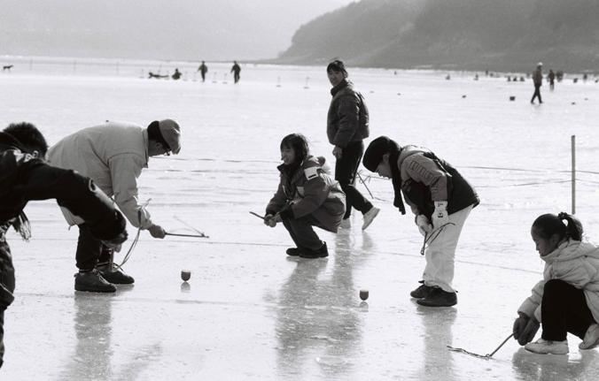
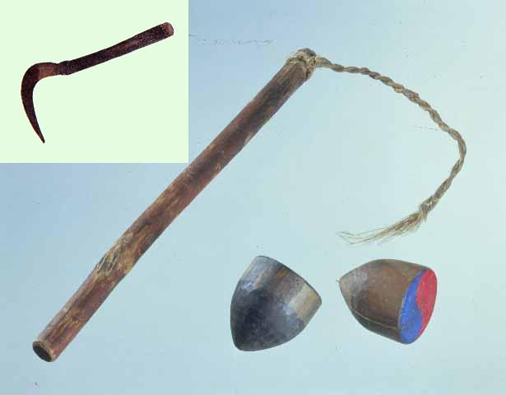
팽이치기
http://youtu.be/7-MKGUaDBuI
sickle
http://ask.nate.com/qna/view.html?n=6303742
http://youtu.be/O1yBDlrsoxk
http://joupia.net/bbs/zboard.php?id=par_06&page=1&sn1=&divpage=1&sn=off&ss=on&sc=on&select_arrange=headnum&desc=asc&no=11

Slide 15
추석 Midautumn (Harvest) Festival
Aug. 15 on lunar calendar
Traditional & family holiday → due to the family and relatives gathering, a country-wide traffic jam commonly occur (again !! ㅠ.ㅠ)
Having rituals for the ancestors and thanks giving for the harvest
Special food: 송편 (a rice cake steamed on a layer of pine needles, having black bean, mung-bean, & sesami in it)
Special greeting: 성묘 (visiting ancestral grave)
Plays: 설날 놀이들, 강강수월래, 씨름, 자치기

Slide 16
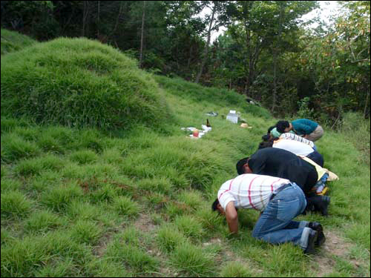
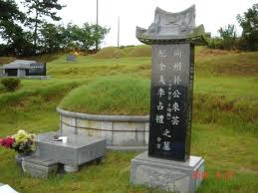
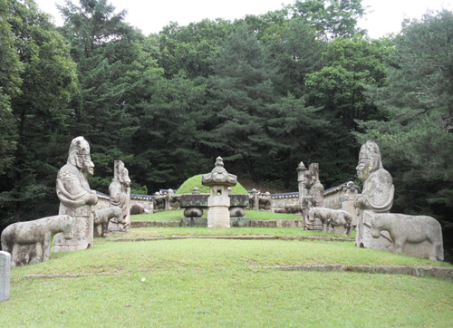
성묘
http://blog.naver.com/PostView.nhn?blogId=kjpark1016&logNo=50096599724&viewDate=&currentPage=1&listtype=0&from=postList
http://www.ohmynews.com/NWS_Web/View/at_pg.aspx?CNTN_CD=A0000979380

Slide 17
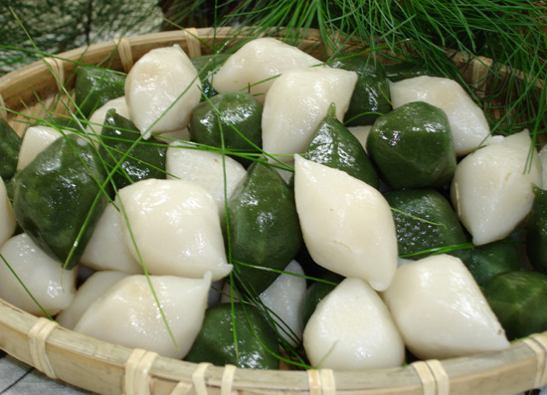
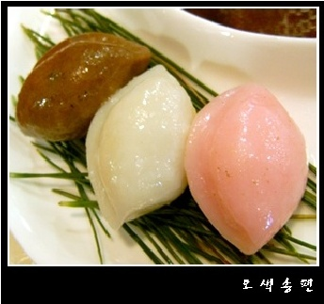
송편
http://coldice.egloos.com/2656991
http://ask.nate.com/qna/view.html?n=6417333

Slide 18
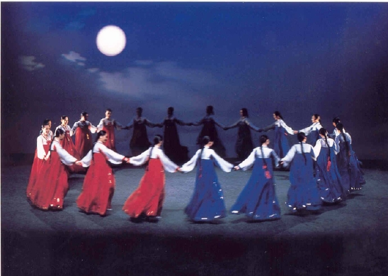
강강수월래
http://blog.naver.com/PostView.nhn?blogId=kimsdong&logNo=70093979234&redirect=Dlog&widgetTypeCall=true
http://youtu.be/tn_SOOa6XlI

Slide 19
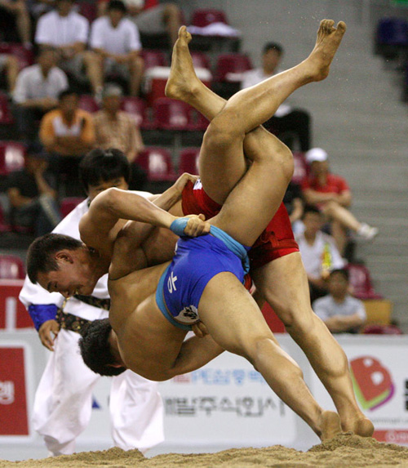
씨름
http://www.mykoreapost.com/print_paper.cgi?action=print_paper&number=7848&title=%C7%C1%B8%B0%C6%AE

Slide 20
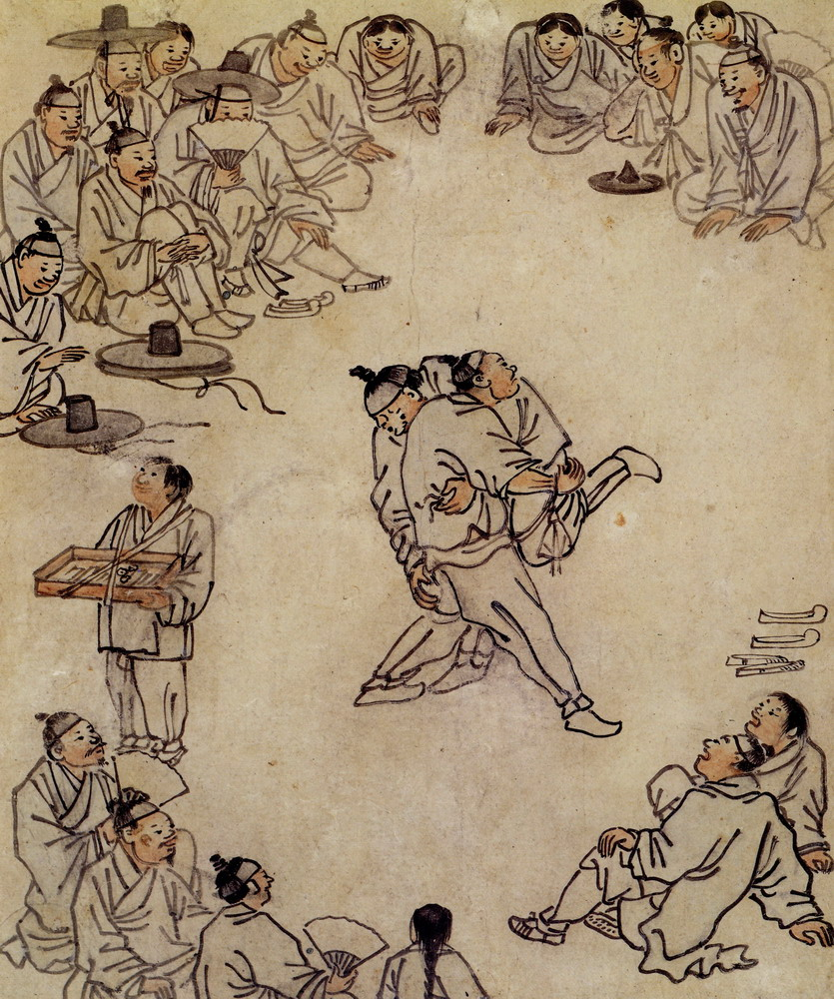
http://blog.naver.com/PostView.nhn?blogId=ptaesoon2&logNo=10070461880&viewDate=&currentPage=1&listtype=0
씨름, 김홍도
http://youtu.be/uMZ2ADum_Yo

