Slide 1
Applied Geochemistry & Lab Ch.7 Redox Reactions
Part 1
JYU

Slide 2
1. Definitions
Oxidation state: the hypothetical charge that an atom would have if all bonds to atoms of different elements were 100% ionic
Oxidation: Increase in oxidation state (of an atom, molecule, or ion)
Reduction: Decrease in oxidation state
Redox reactions: Reactions involving oxidation and reduction among the reactants due to electron transfer

Slide 3
2. Theories
Relation between Gibbs free energy and Electrochemical energy:
$∆G=nFE$ (1)
where n= # of e transferred, F=Faraday constant (23.06kcal/Vmole), and E=electrode potential
From the law of mass action,
$∆G=∆G^{o}+RTln\prod_{i}{a_{}^{vi}}$ (2)
where R=ideal gas constant (0.001987kcal/mole), T=absolute temp., a=activity, and v=stoichiometric coefficient
Combining eq. (1) and (2),
$E=E^{o}−\frac{RT}{nF}ln\prod_{i}{a_{}^{vi}}$(Nernst Equation)
$E=E^{o}−\frac{0.0592}{n}log\prod_{i}{a_{}^{vi}}$ at 25C and 1bar
Sometimes pe (-log[e⁻])is used instead of E

Slide 4
3. pH-E_{H} Diagram
Significance
Prediction of the stable redox species
Procedures
Calculation of water stability limits
Setting up the system
Construction redox reactions among the possible species
Application of the Nernst equation → obtaining the relation between pH and E_{H} for each reaction
Plot the pH-E_{H} relation and define the stability field for each of the species on the diagram

Slide 5
Water stability limits
Upper limit
0.5O₂ + 2H⁺ + 2e⁻ = H₂O
E=Eº + 0.059/2 log [H+]2P_{o2}^{0.5}
E=1.23-0.059pH (P_{o2}=1 atm)
Lower limit
2H ⁺ + 2e⁻ = H2
E=Eº + 0.059/2 log [H+]2/P_{H2}
E=-0.059pH (P_{H2}=1 atm)

Slide 6
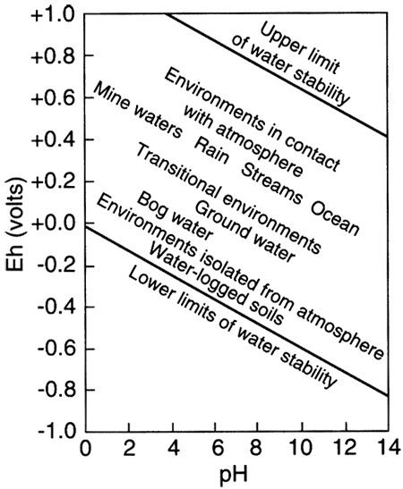
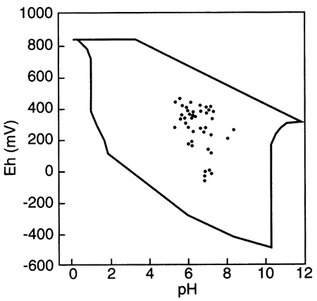
Outlined area shows the region delineated by Bass Becking et al. (1960) for a large number of measurements of natural waters. Small circles are ground-water samples (from Fish, 1993).
http://www.kgs.ku.edu/Publications/Bulletins/239/Macpherson/

Slide 7
Fe-O-H system
Possible species
Fe²⁺, Fe³⁺, FeOH⁺, FeOH²⁺, Fe(OH)₂⁺, Fe(OH)₃⁰, Fe(OH)₄⁻, (FeOOH(am), Fe(OH)₃)
Data
Species | ΔGº_{f} at 298K & 1bar
Fe²⁺ | -18.85
Fe³⁺ | -1.12
FeOH²⁺ | -54.83
Fe(OH)₂⁺ | -106.4
Fe(OH)₃⁰ | -156.6
Fe(OH)₄⁻ | -201.32
FeOH⁺ | -63.262
H₂O | -56.687

Slide 8
Reactions
Fe³⁺ - Fe²⁺
Fe³⁺ + e⁻ = Fe²⁺ b
ΔGº_{f} = -18.85+1.12=-17.73 (kcal/mole) →
Eº = 17.73/23.06=0.769 (v)
E=0.769-0.059log([Fe²⁺]/[Fe³⁺])=0.769
FeOH²⁺- Fe²⁺
FeOH²⁺ + H⁺ + e⁻ = Fe²⁺ + H₂O
ΔGº_{f} = -18.85-56.687+54.83=-20.707 (kcal/mole) →
Eº = 20.707/23.06=0.898 (V)
E=0.898-0.059pH

Slide 9
Fe(OH)₂⁺- Fe²⁺
Fe(OH)₂⁺ + 2H⁺ + e⁻ = Fe²⁺ + 2H₂O
ΔGº_{f} = -18.85-2*56.687+106.4=-25.824 (kcal/mole) →
Eº = 25.824/23.06=1.120 (V)
E=1.120-0.118pH
Fe(OH)₃⁰- Fe²⁺
Fe(OH)₃⁰ + 3H⁺ + e⁻ = Fe²⁺ + 3H₂O
ΔGº_{f} = -18.85-3*56.687+156.6=-32.311 (kcal/mole) →
Eº = 32.311/23.06=1.401 (V)
E=1.401-0.177pH

Slide 10
Fe(OH)₄⁻- Fe²⁺
Fe(OH)₄⁻ + 4H⁺ + e⁻ = Fe²⁺ + 4H₂O
ΔGº_{f} = -18.85-4*56.687+201.32=-44.278 (kcal/mole) →
Eº = 44.278/23.06=1.920 (V)
E=1.920-0.236pH
Fe³⁺ - FeOH²⁺
Fe³⁺ + H₂O = FeOH²⁺ + H⁺
ΔGº_{f} = -54.83+1.12+56.687=2.977 (kcal/mole) = -2.303*0.001987*298.15 log[H⁺]=1.364pH
pH=2.183

Slide 11
FeOH²⁺ - Fe(OH)₂⁺
FeOH²⁺ + H₂O = Fe(OH)₂⁺ + H⁺
ΔGº_{f} = -106.4+54.83+56.687=5.117 (kcal/mole) = -2.303*0.001987*298.15 log[H⁺]=1.364pH
pH=3.751
Fe(OH)₂⁺ - Fe(OH)₃⁰
Fe(OH)₂⁺ + H₂O = Fe(OH)₃⁰ + H⁺
ΔGº_{f} = -156.6+106.4+56.687=6.487 (kcal/mole) = -2.303*0.001987*298.15 log[H⁺]=1.364pH
pH=4.756

Slide 12
Fe(OH)₃⁰ - Fe(OH)₄⁻
Fe(OH)₃⁰ + H₂O = Fe(OH)₄⁻ + H⁺
ΔGº_{f} = -201.32+156.6+56.687=11.967 (kcal/mole) = -2.303*0.001987*298.15 log[H⁺]=1.364pH
pH=8.773
Fe²⁺ - FeOH⁺
Fe²⁺ + H₂O = FeOH⁺ + H⁺
ΔGº_{f} = -63.262+18.85+56.687=12.275 (kcal/mole) = -2.303*0.001987*298.15 log[H⁺]=1.364pH
pH=8.999

Slide 13
Fe(OH)₄⁻ - FeOH⁺
Fe(OH)₄⁻ + 3 H⁺ + e⁻ = FeOH⁺ + 3H₂O
ΔGº_{f} = -63.262-3*56.687+201.32=-32.003 (kcal/mole) →
Eº = 32.003/23.06=1.388 (V)
E=1.388-0.177pH

Slide 14
