Slide 1
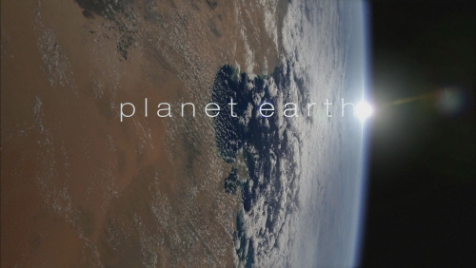
RESOURCEs & Environment Ch. 1. planet earth

Slide 2
1-1. Origin of the universe
Universe?
Star + Planets + Satellites + Comets + (Asteroids) + Meteorites + Dusts + Gases . . .
→ Star system
Star system + Star system + … → Galaxy
Galaxy + Galaxy + … → Local group + Local group + …→ Universe

Slide 4
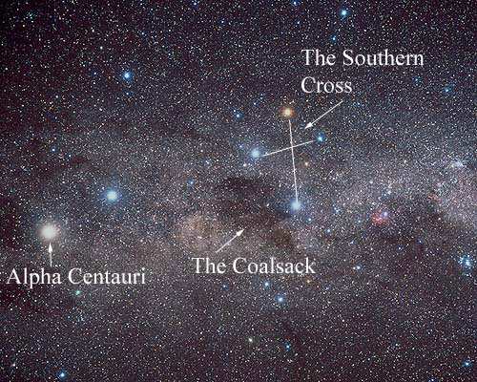
Alpha Centauri, the closest star to us (4.37 LY (light year) away: 1 LY = 10¹³ km)
http://heasarc.gsfc.nasa.gov/docs/cosmic/nearest_star_info.html.

Slide 5
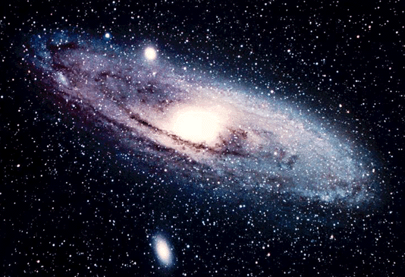
Andromeda, the closest galaxy to us (2.5 MLY away)
http://www.definity-systems.net/~apw/astro/galaxies.html

Slide 6
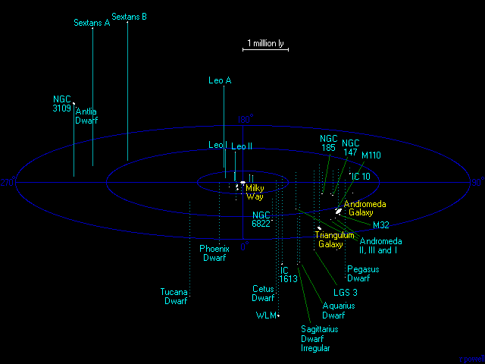
Galaxies around us. The ‘local group’.
http://www.definity-systems.net/~apw/astro/galaxies.html.

Slide 7
Theories of the Origin of the Universe
Stationary Cosmology
Expanding Universe Theory
Steady State Cosmology
Big-Bang Theory
Evidences
RED SHIFT
CMBR (COSMIC MICROWAVE BACKGROUND RADIATION)

Slide 8
