Slide 1
Ch.4. Crystal Chemistry
Ionic (Atomic) Radii & Coordination Number (CN)
Ionic radius:
Hypothetical radius (size) of an ion (cation or anion)
Calculated values from the bonding distances
CN
Number of one kind of the bond forming ions (atoms) surrounding the other, which are forming the first direct bonding
Determined by radius ratio (r₊/r₋)

Slide 2
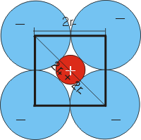
l = 2r₋ d = 2r₋ + 2r₊
d = √2 l
r₊/r₋ = 0.414
Why is CN so significant?
Would the ratio calaculated by the above way be maximum or minimum
for the given CN?

Slide 3
Can you calculate the following radius ratios for the given CN?
Radius ratio | CN | Geometry
<0.155 | 2 | linear
0.155 – 0.225 | 3 | Triangular (trigonal)
0.225-0.414 | 4 | tetrahedral
0.414-0.732 | 4 | tetragonal
0.414-0.732 | 6 | octahedral
0.732-1.0 | 8 | cubic
>1.0 | 12 | cubic (face centered)

Slide 4
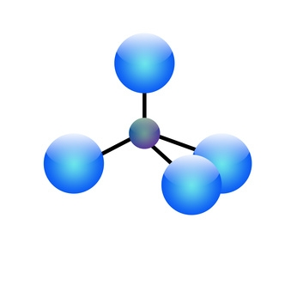
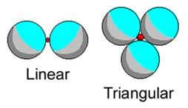
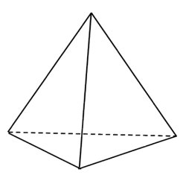
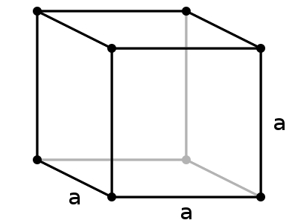
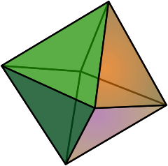
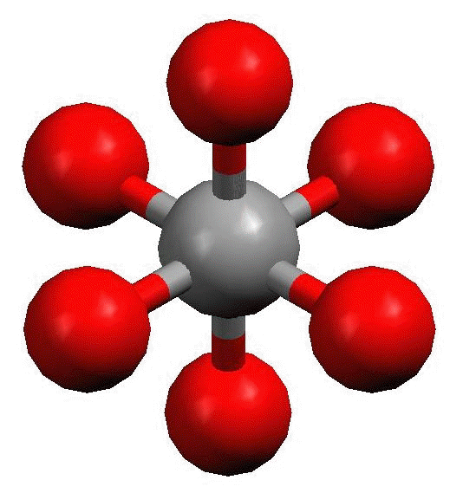
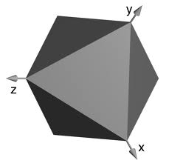
Tetrahedral

Slide 5
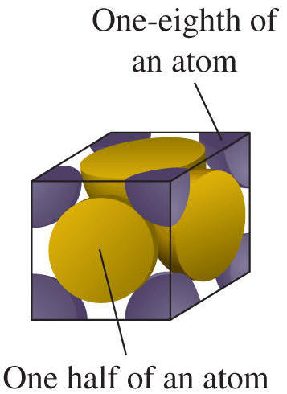
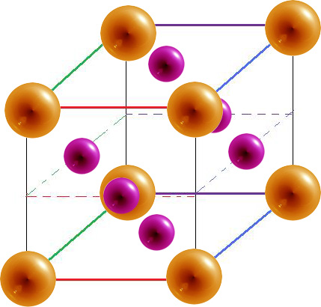

Slide 6
Ch.4. Crystal Chemistry
Chemical Bonding and Physicochemical Properties of a Mineral
Chemical bonding:
Holding constituents with forces (energies)
Types of chemical bonding
Ionic: electron transfer, Coulombic (electrostatic) force
Covalent: sharing electrons, covalency
Metalic: sharing free electron (delocalized)
Van der Waals: bonding due to other weak forces (Keesom, Debye, London forces)

Slide 7
In minerals, often
Covalent > ionic > metallic > van der Waals
Bonding strengths (& it’s heterogeity) controls
Hardness
Cleavage
Fracture
Texture (crystal form)
Etc.

Slide 8
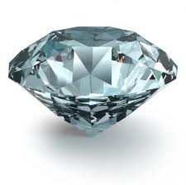
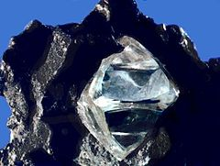
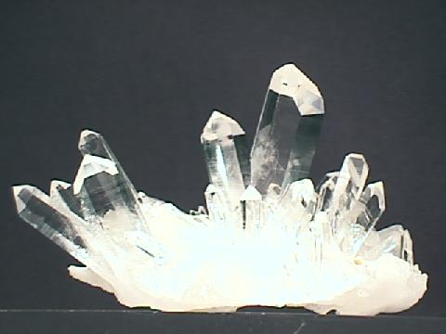
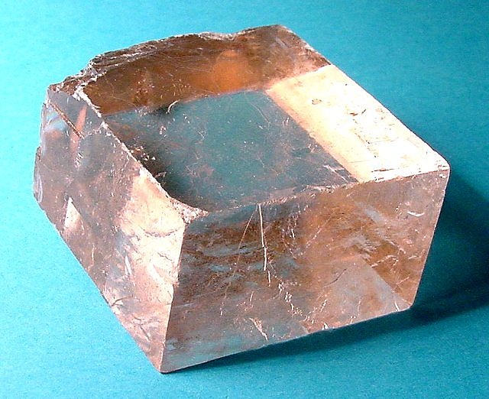
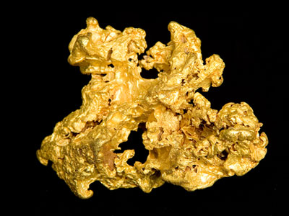
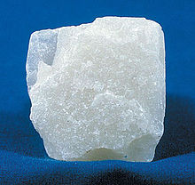
Chemical Bonding & Hardness
C: Diamond – perfectly covalent
(What about graphite?)
SiO2; quartz –
partly covalent,
partly ionic
Covalent>>ionic
CaCO3; calcite
Partly covalent,
Partly ionic
Ionic>>covalent
Au; gold
metallic
Mg3Si4O10(OH)2;
Talc
Covalent + ionic +
Van der Waals

Slide 9
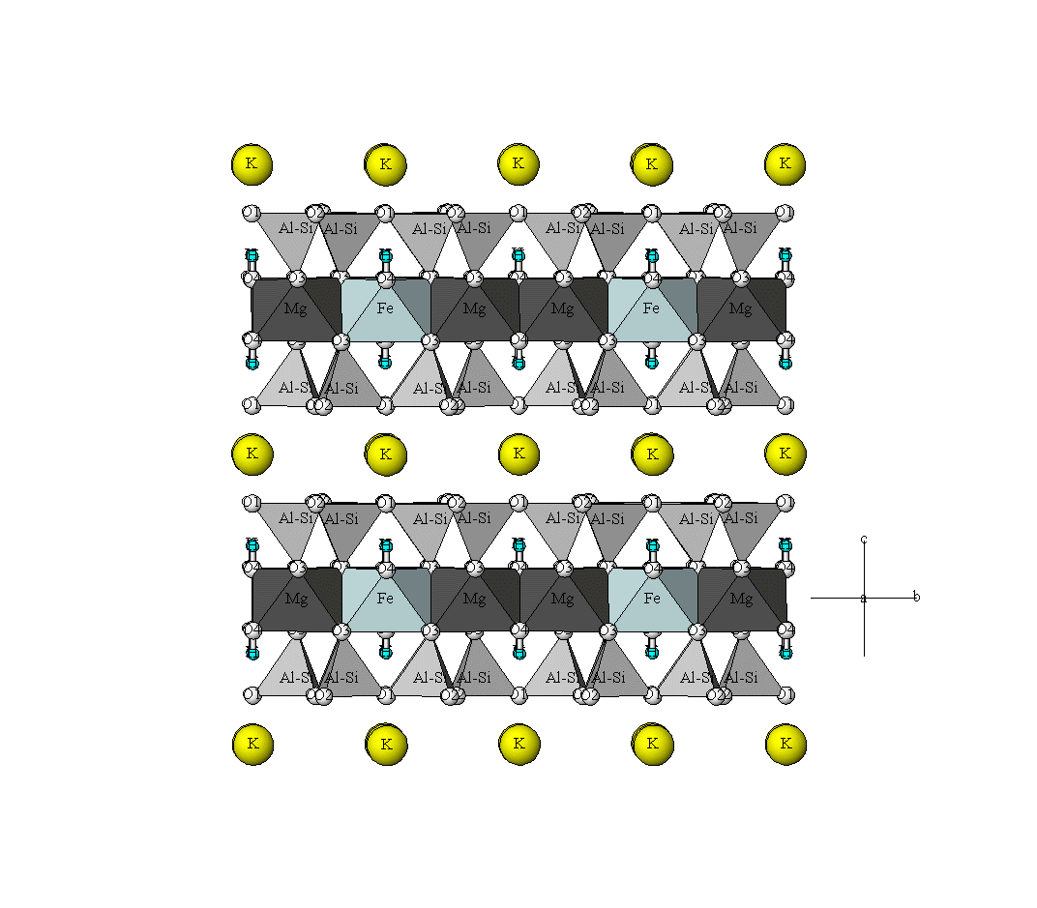
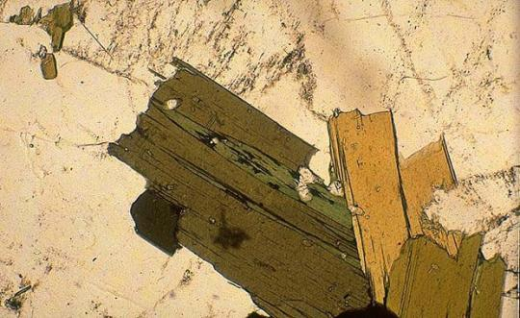
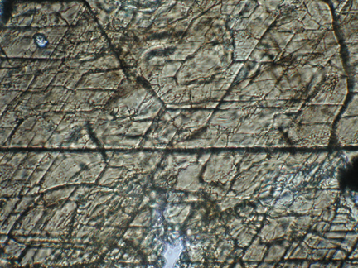
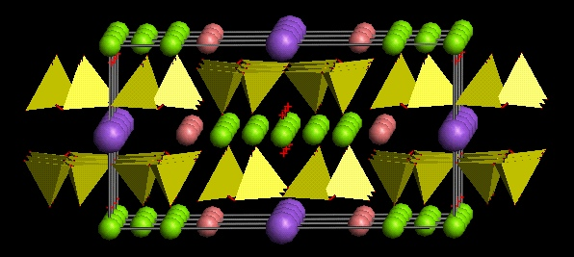
Chemical Bonding & Cleavage
From http://staff.aist.go.jp/nomura-k/english/itscgallary-e.htm
Biotite
From http://www.earth.ox.ac.uk/~davewa/pt/pt02_amp.html
Amphibole (hornblende)

Slide 10
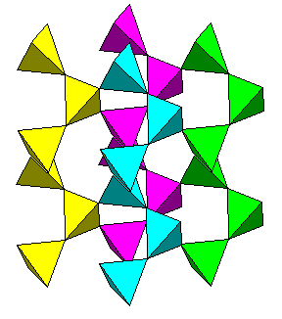
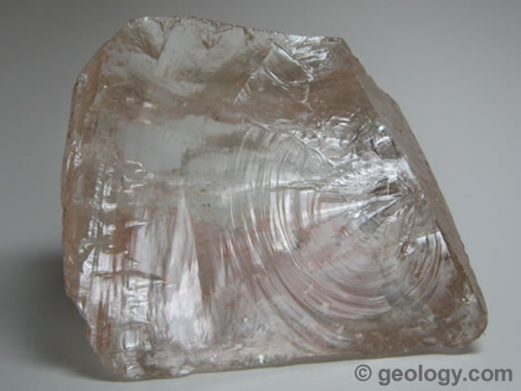
Chemical Bonding & Fracture
Structure of quartz
Conchoidal fracture of quartz
From http://www.uwgb.edu/dutchs/Petrology/QuartzStruc.HTM
From http://geology.com/minerals/quartz.shtml

Slide 11
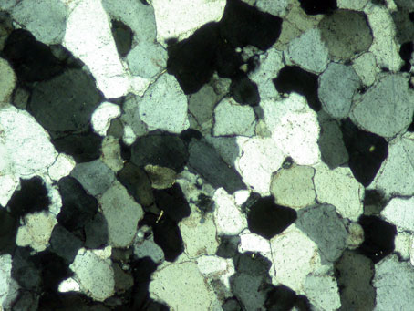
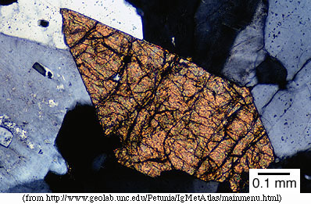
Chemical Bonding & Textures (forms)
Quartzite
Sphene
From http://www.uwgb.edu/dutchs/Petrology/QuartzStruc.HTM

Slide 12
Ionicity of bonding

