Slide 1
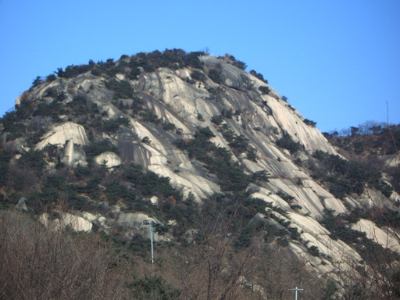
RESOURCEs & Environment
Ch. 2. Minerals & rocks
Granite of Inwang Mountain
http://kr.blog.yahoo.com/jjagida/1176844

Slide 2
2-1. Minerals
2-1-1. How does the mineral form?
Definition of Minerals
  Abiogenic
  Naturally occurring
  Fixed (or given) chemical formula
  Ordered structure (atomic arrangement)
  Solid

Slide 3
Mineral Formation
  Crystallization from melts (magma)
  Metamorphic crystallization
  Precipitation from water (or water vapour)
  Biogenic productions
  Other chemical reactions

Slide 4
2-1-2. Mineral Classes
Silicates: SiO₄ tetrahedron + other cations & anions (Orthoclase, pyroxenes, amphiboles)
Nonsilicates
  Oxides: Fe₂O₃ (hematite)
  Hydroxides: Gibbsite (Al(OH)₃)
  Sulfates: Gypsum (CaSO₄.2H₂O)
  Carbonates: Calcite (CaCO₃)
  Phosphates: Apatite (Ca₅(PO₄)₃(F,Cl,OH))
  Halides: Halite (NaCl)
  Sulfides: Pyrite (FeS₂)
  Natural Elements: Gold (Au)
  etc

Slide 5
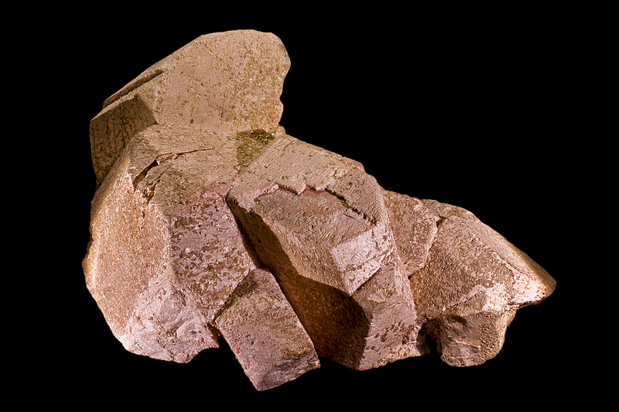
Orthoclase. Minas Gerais, Southeast Region, Brazil
http://en.wikipedia.org/wiki/File:OrthoclaseBresil.jpg

Slide 6
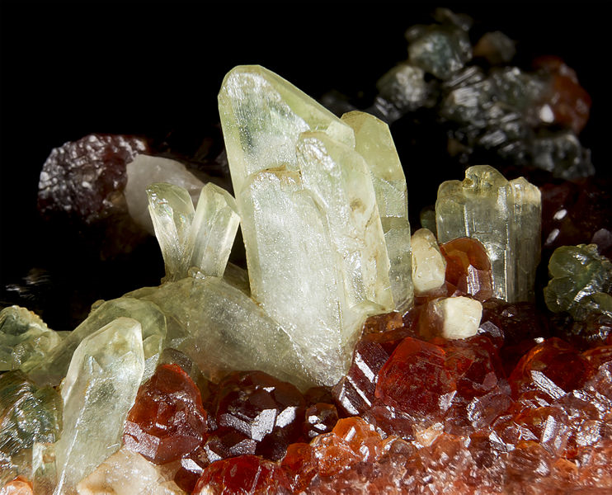
Diopside. Bellecombe, Châtillon, Aosta Valley, Italy
http://en.wikipedia.org/wiki/File:Diopside_Aoste.jpg

Slide 7
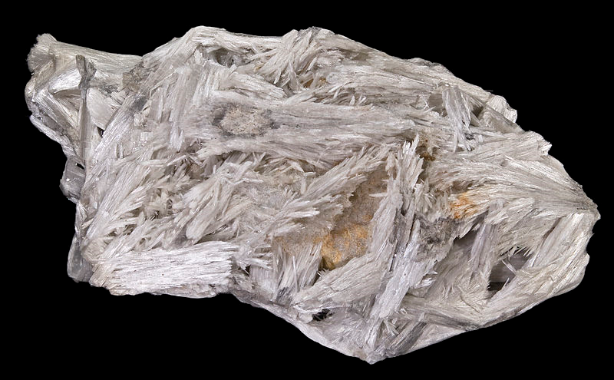
Tremolite. Campolungo, Piumogna Valley, Leventina, Ticino (Tessin), Switzerland
http://en.wikipedia.org/wiki/File:Tremolite_Campolungo.jpg

Slide 8
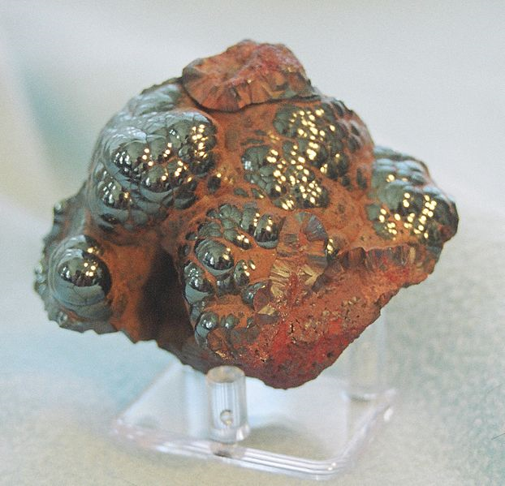
Hematite. Michigan, USA
http://en.wikipedia.org/wiki/File:Hematite.jpg

Slide 9
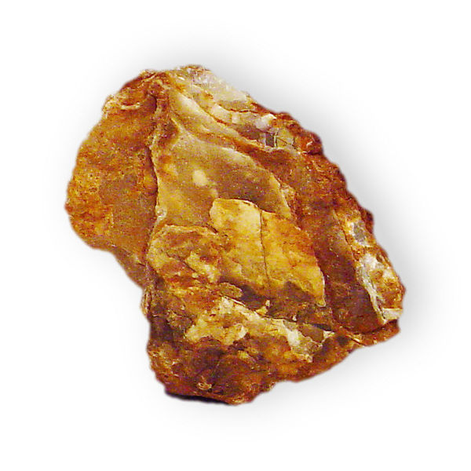
Gibbsite. Brazil
http://en.wikipedia.org/wiki/File:Gibbsite

Slide 10
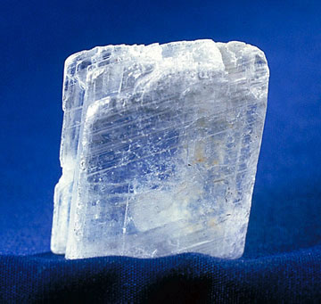
Gypsum.
http://en.wikipedia.org/wiki/Gypsum

Slide 11
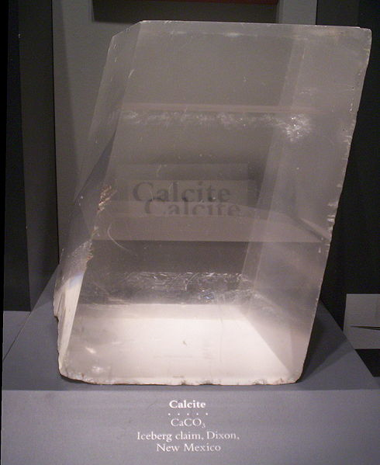
Calcite. National Museum of Natural History in Washington, DC
http://en.wikipedia.org/wiki/File:Calcite-HUGE.jpg

Slide 12
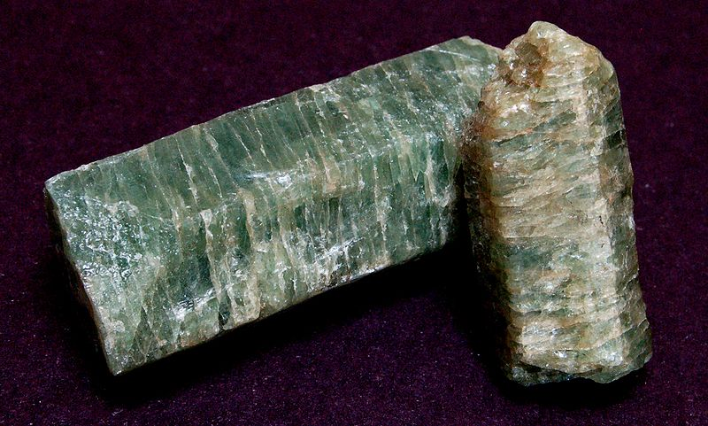
Apatite. Quebec, Canada
http://en.wikipedia.org/wiki/File:Apatite_crystals.jpg

Slide 13
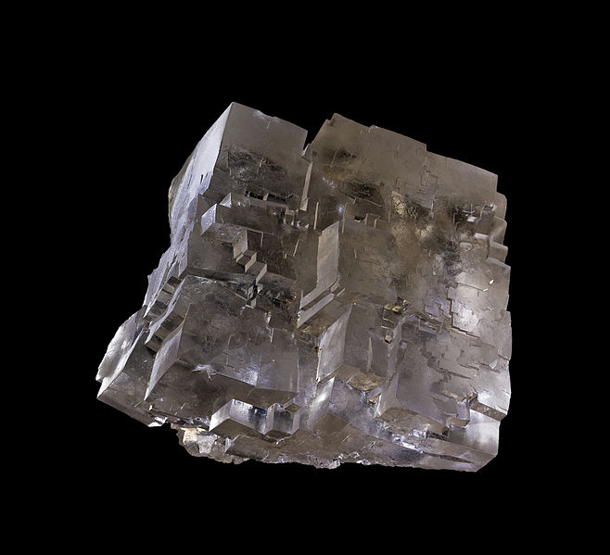
Halite. Wieliczka Salt Mine, UNESCO World Heritage Site, Wieliczka, Małopolskie, Poland
http://en.wikipedia.org/wiki/File:Selpologne.jpg

Slide 14
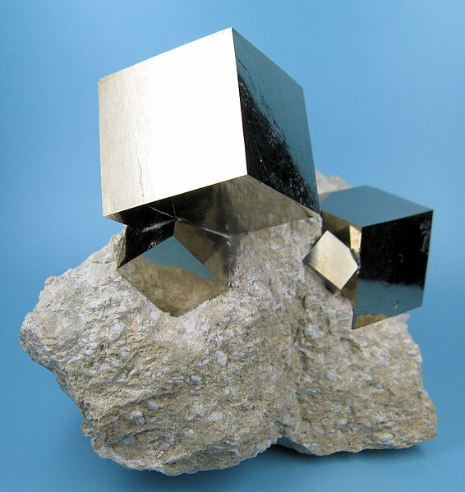
Pyrite. Navajún, Rioja, Spain
http://en.wikipedia.org/wiki/File:2780M-pyrite1.jpg

Slide 15
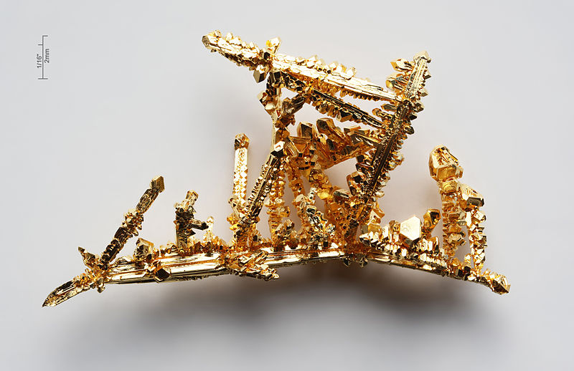
Gold. Navajún, Synthetic
http://en.wikipedia.org/wiki/Gold

Slide 16
2-1-3. Mineral Usages
Industrial
  Metal, Plating & Smelting – All the metals
  Paper – Calcite, talc
  Glassware & Ceramics – Quartz, feldspars
  Chemical – Metals and nonmetals
  Automobile & other transportation – Mineral fibres & others
Agricultural
  Fertilizers – Apatite and others
Environmental
  Remediation/Protection – Clay minerals, oxides, gypsum etc.
Home
  Detergent - Zeolites
  Cosmetics – Talc, mica
  Tiles & bricks – Clay minerals, feldspars
  Jewlery

Slide 17
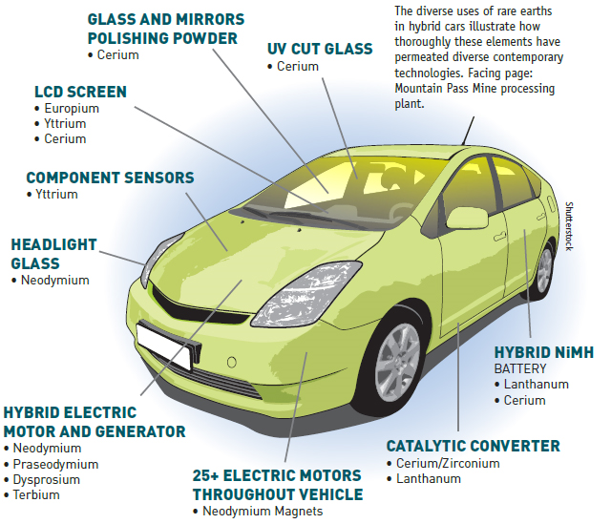
Rare Earth Element Minerals
http://minesmagazine.com/1737/

Slide 18
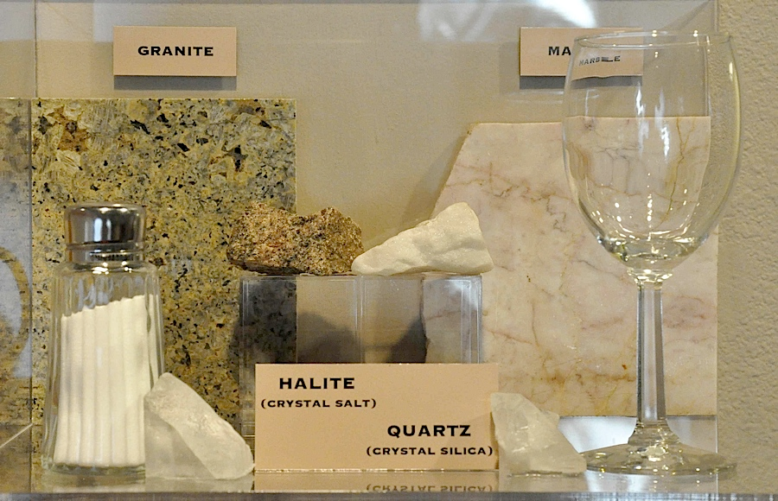
Everyday Uses of Rocks and Minerals
http://natural-history.uoregon.edu/everydayuses-shelf03

Slide 19
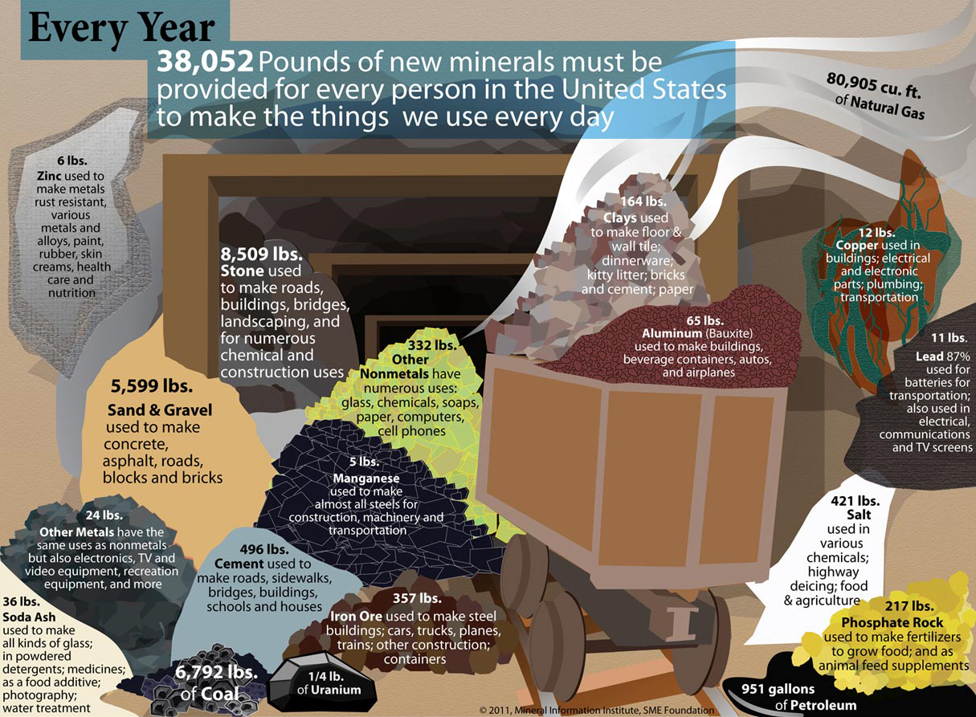
http://arizonaexperience.org/land/rock-products-building-arizona

Slide 20
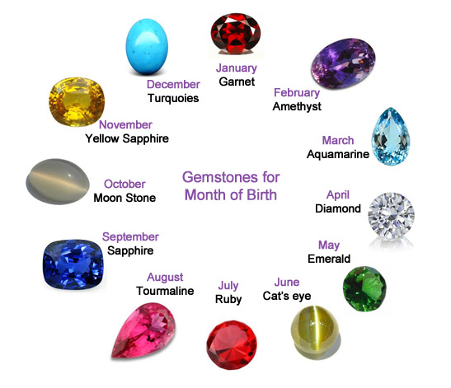
http://www.lankagembureau.lk/Gemstones-for-Month-of-Birth.php

