Slide 1
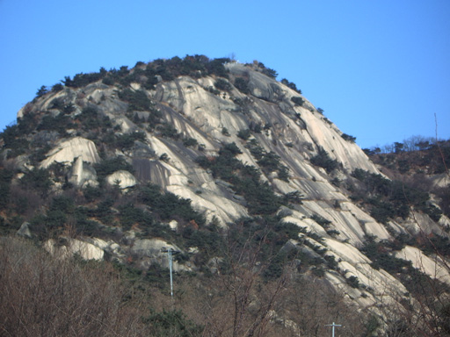
RESOURCEs & Environment Ch. 2. Minerals & rocks
Granite of Inwang Mountain
http://kr.blog.yahoo.com/jjagida/1176844

Slide 2
2-1. Minerals
2-1-1. How does the mineral form?
Definition of Minerals
Abiogenic
Naturally occurring
Fixed (or given) chemical formula
Ordered structure (atomic arrangement)
Solid

Slide 3
Mineral Formation
Crystallization from melts (magma)
Metamorphic crystallization
Precipitation from water (or water vapour)
Biogenic productions
Other chemical reactions

Slide 4
2-1-2. Mineral Classes
Silicates: SiO₄ tetrahedron + other cations & anions (Orthoclase, pyroxenes, amphiboles)
Nonsilicates
Oxides: Fe₂O₃ (hematite)
Hydroxides: Gibbsite (Al(OH)₃)
Sulfates: Gypsum (CaSO₄.2H₂O)
Carbonates: Calcite (CaCO₃)
Phosphates: Apatite (Ca₅(PO₄)₃(F,Cl,OH))
Halides: Halite (NaCl)
Sulfides: Pyrite (FeS₂)
Natural Elements: Gold (Au)
etc

Slide 5
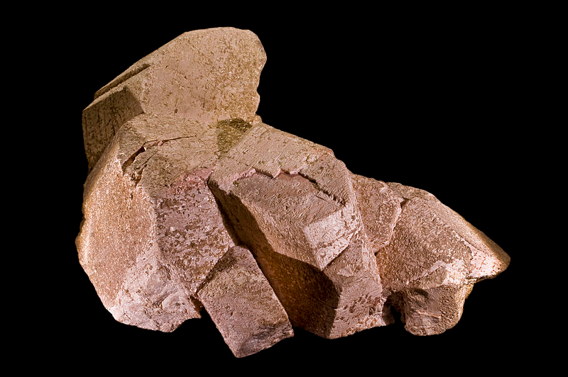
Orthoclase. Minas Gerais, Southeast Region, Brazil
http://en.wikipedia.org/wiki/File:OrthoclaseBresil.jpg

Slide 6
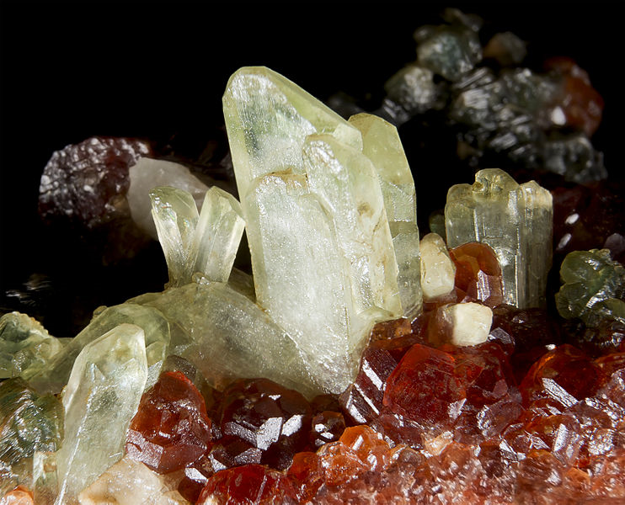
Diopside. Bellecombe, Châtillon, Aosta Valley, Italy
http://en.wikipedia.org/wiki/File:Diopside_Aoste.jpg

Slide 7
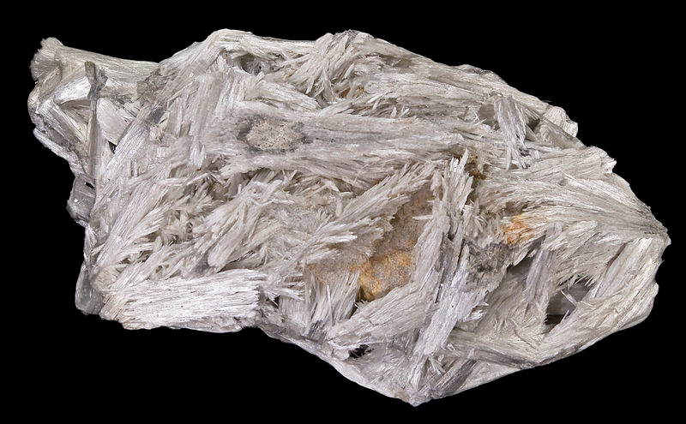
Tremolite. Campolungo, Piumogna Valley, Leventina, Ticino (Tessin), Switzerland
http://en.wikipedia.org/wiki/File:Tremolite_Campolungo.jpg

Slide 8
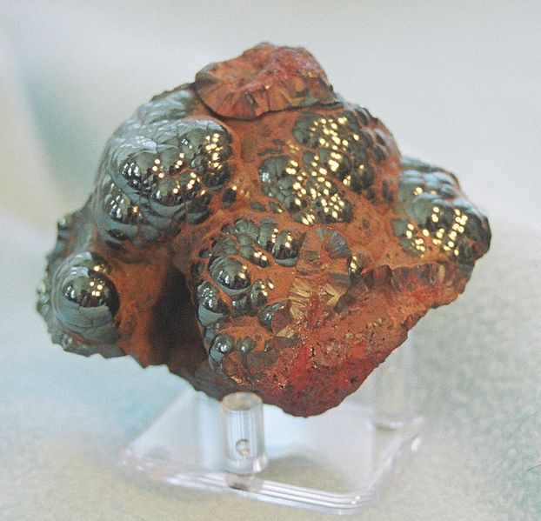
Hematite. Michigan, USA
http://en.wikipedia.org/wiki/File:Hematite.jpg

Slide 9
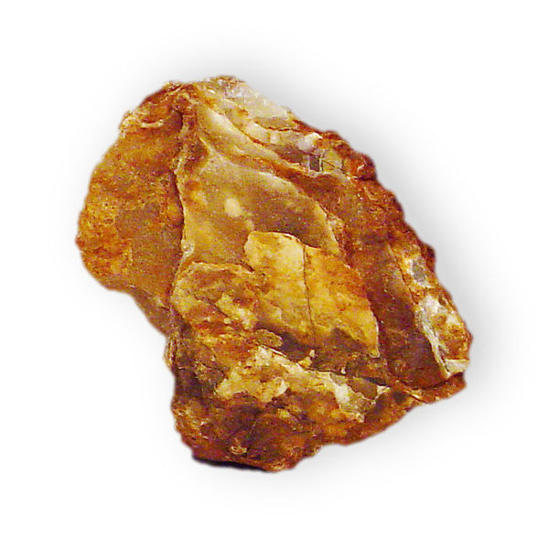
Gibbsite. Brazil
http://en.wikipedia.org/wiki/File:Gibbsite

Slide 10
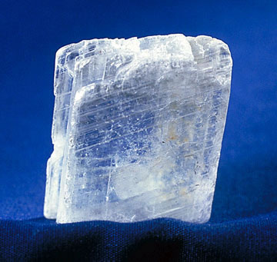
Gypsum.
http://en.wikipedia.org/wiki/Gypsum

Slide 11
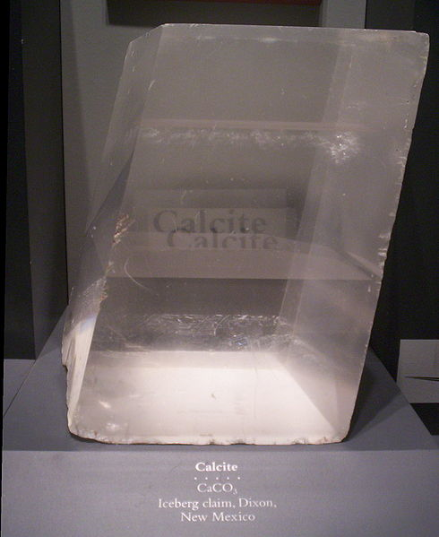
Calcite. National Museum of Natural History in Washington, DC
http://en.wikipedia.org/wiki/File:Calcite-HUGE.jpg

Slide 12
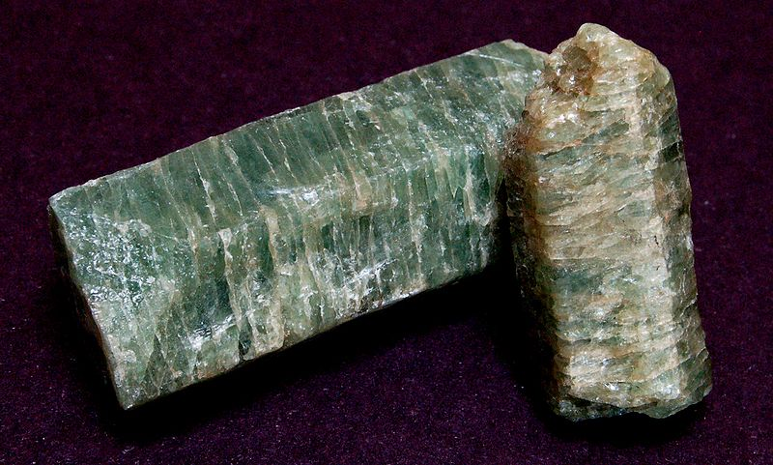
Apatite. Quebec, Canada
http://en.wikipedia.org/wiki/File:Apatite_crystals.jpg

Slide 13
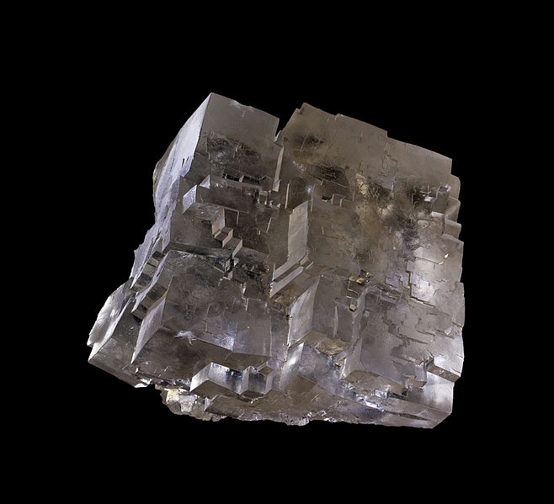
Halite. Wieliczka Salt Mine, UNESCO World Heritage Site, Wieliczka, Małopolskie, Poland
http://en.wikipedia.org/wiki/File:Selpologne.jpg

Slide 14
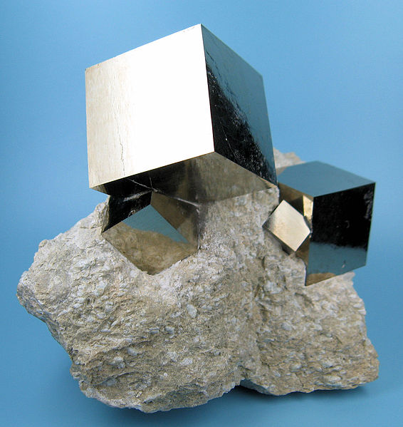
Pyrite. Navajún, Rioja, Spain
http://en.wikipedia.org/wiki/File:2780M-pyrite1.jpg

Slide 15
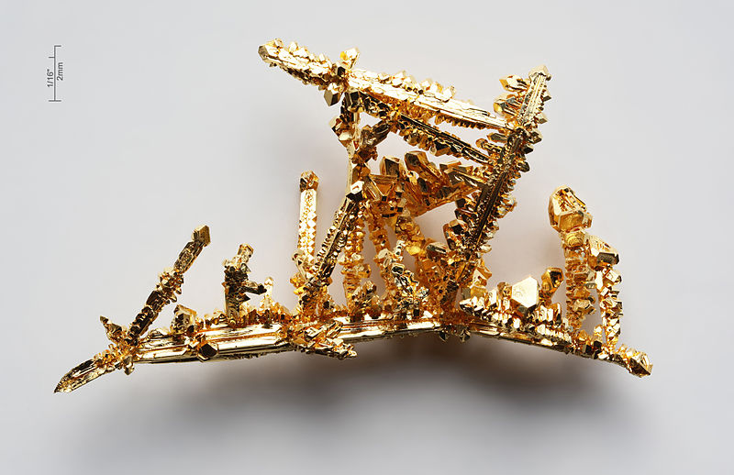
Gold. Navajún, Synthetic
http://en.wikipedia.org/wiki/Gold

Slide 16
2-1-3. Mineral Usages

