Slide 1
Ch.3.
Potential health effects from ingestion of water
Radionuclides: Increased risk of cancer, kidney toxicity. Erosion of natural deposits of certain minerals that are radioactive and may emit a form of radiation known as alpha radiation
Alpha particles
Beta partciles
226Ra, 228Ra
U
Will be discussed in much more detail later with “radioactive wastes”

Slide 2
Disinfectants
Chloroamin: Eye/nose irritation; stomach discomfort, anemia.
Chlorine: Eye/nose irritation; stomach discomfort
Chlorine dioxide: Anemia; infants & young children: nervous system effects
Disinfection byproducts
Bromate: Increased risk of cancer
Chlorite: Anemia; infants & young children: nervous system effects
Haloacetic acids (HAA5): Increased risk of cancer
Total Trihalomethanes (TTHMs): Liver, kidney or central nervous system problems; increased risk of cancer

Slide 3
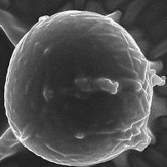
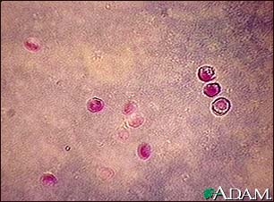
Microorganisms
Cryptosporidium: Gastrointestinal illness (e.g., diarrhea, vomiting, cramps). Human and animal fecal waste
From http://www.waterfilterreview.com/info_h2o/contaminants/cryptosporidium_water.html
From http://www.nlm.nih.gov/medlineplus/ency/imagepages/1395.htm
Cryptosporidium is a protozoan parasite found in contaminated water. It has been increasingly recognized as the cause of outbreaks of diarrhea when water supplies become contaminated. In normal individuals, it is a self-limited disease. Among immunocompromised individuals with AIDS, cryptosporidium can cause severe diarrheal disease, gallbladder disease (cholecystitis), and inflammation of the pancreas (pancreatitis).

Slide 4
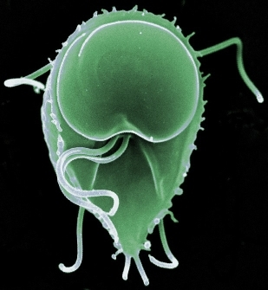
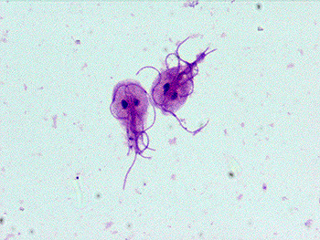
Giardia lamblia: Gastrointestinal illness (e.g., diarrhea, vomiting, cramps). Human and animal fecal waste
From http://microbiology.mtsinai.on.ca/pig/protozoa4.shtml
From http://www.biotech-weblog.com/50226711/giardia_lamblia_genome_sequenced.php
Giardia lamblia, a common protozoan parasite causing gardiasis, an intestinal infection considered to be one of the most common causes of waterborne (drinking and recreational) disease. The genome, reported in the recent issue of Science, is expected to lead to the development of new drugs against the infection.

Slide 5
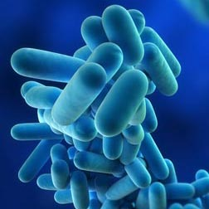
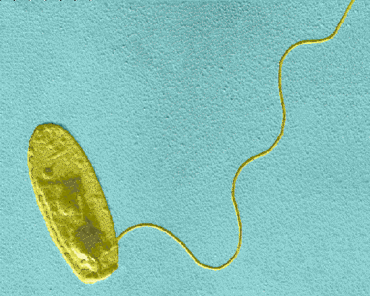
Legionella: Legionnaire's Disease, a type of pneumonia. Found naturally in water; multiplies in heating systems
From http://www.rpsgroup.com/Britain/Capabilities/Legionella.aspx
From http://microbiology.mtsinai.on.ca/pig/protozoa4.shtml
Legionella pneumophila is a thin, pleomorphic, flagellated Gram-negative bacterium of the genus Legionella. L. pneumophilia is non-acid-fast, non-sporulating, and morphologically a non-capsulated rod-like bacteria. Aerobic and unable to hydrolyse gelatin or produce urease, they are also non-fermentative. L. pneumophila is neither pigmented nor does it autofluoresce. It is oxidase- and catalase-positive, and produces beta-lactamase . L. pneumophilia is the primary human pathogen in this group and is responsible for legionellosis or Legionnaires' disease.

Slide 6
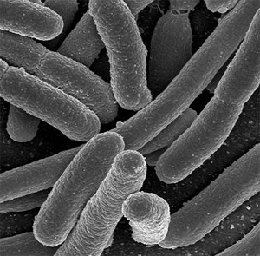
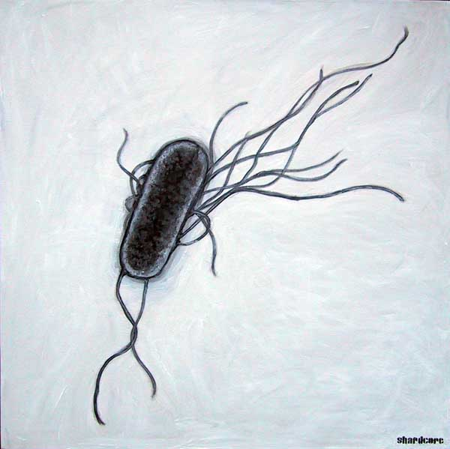
Total Coliforms (including fecal coliform and E. Coli): Not a health threat in itself; it is used to indicate whether other potentially harmful bacteria may be present. Coliforms are naturally present in the environment; as well as feces; fecal coliforms and E. coli only come from human and animal fecal waste.
From http://ginosblog.com/2011/06/11/5-reasons-why-e-coli-are-our-friend/
From http://www.freedrinkingwater.com/water-contamination/ecoli-bacteria-removal-water.htm
E. coli is a type of fecal coliform bacteria commonly found in the intestines of animals and humans. E. coli is short for Escherichia coli. The presence of E. coli in water is a strong indication of recent sewage or animal waste contamination. Sewage may contain many types of disease-causing organisms.

