Slide 1
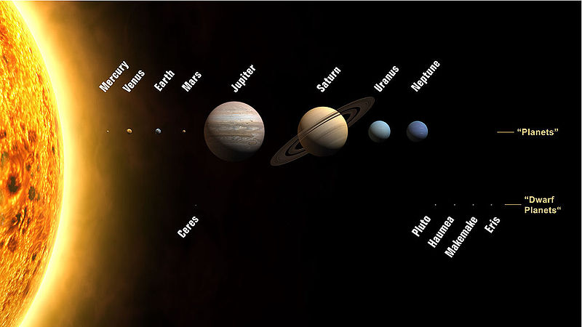
Ch.2.
Solar System
  Cositing of the Sun, planets, satelites, asteroids, plutoid (dwarf planet), comets &others.
From http://sse.jpl.nasa.gov/planets/index.cfm

Slide 2
  The characteristics of the solar system
    The sun occupies 99.8% of the total mass, but only 2% of the angular momentum
    Seen from the sky far above the north pole, all the planets revolve around the Sun anticlockwise on the same plane.
    They turn on their axis in the same direction with the revolution (exception, Venus & Uranus)
    The planet’s arrays around Sun according to ‘Titius-Bode rule’ (D = 4 + 3*2^{n}, where n is the order #)
    The planets can be divided into two groups; inner (or terretrial) planets (from mercury to Mars) and outer (or major) planets (from Jupiter to Neptune). The two groups have definitely different sizes and compositions

Slide 3
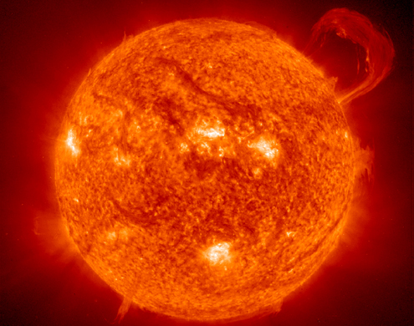
The Sun

Slide 4
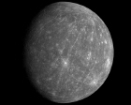
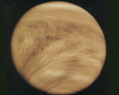
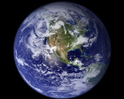
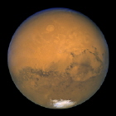
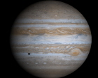
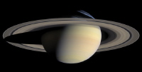
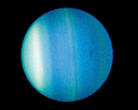
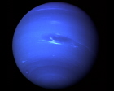
The Planets
Inner or terrestrial planets: From left to right, mercury, Venus, Earth, and Mars
Outer or major planets: From left to right, Jupiter, Saturn, Uranus, & Neptune,

Slide 5
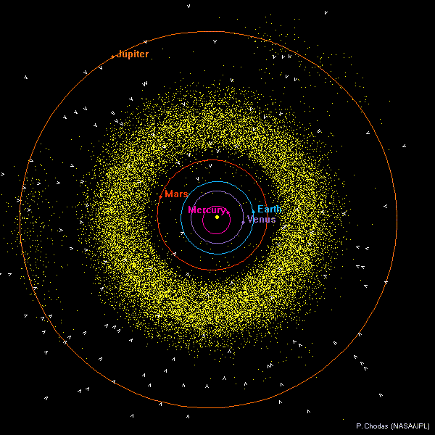
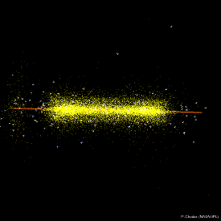
The Asteroids
From http://www.lpl.arizona.edu/undergrad/classes/spring2009/Hubbard_206-2/Lectures4/asteroid_folder_DMinton/Apr21.htm

Slide 6
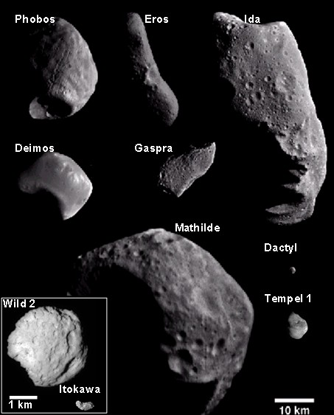
From http://www.lpl.arizona.edu/undergrad/classes/spring2009/Hubbard_206-2/Lectures4/asteroid_folder_DMinton/Apr21.htm

Slide 7
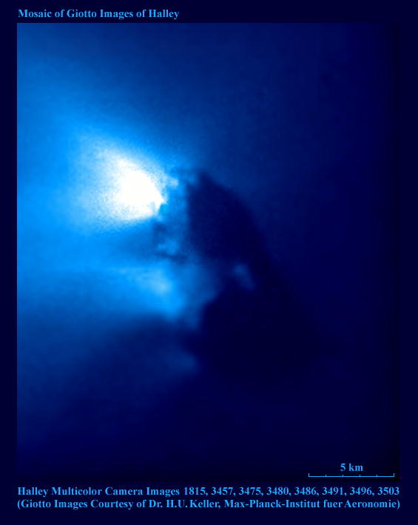
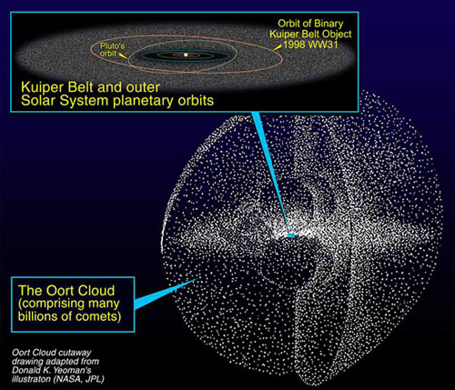
The Comets
The nucleus of Halley's Comet as imaged by the Giotto spacecraft
Illustration of the Oort cloud and Kuiper Belt. NASA/JPL
From http://www.mira.org/fts0/planets/102/text/txt001x.htm

Slide 8
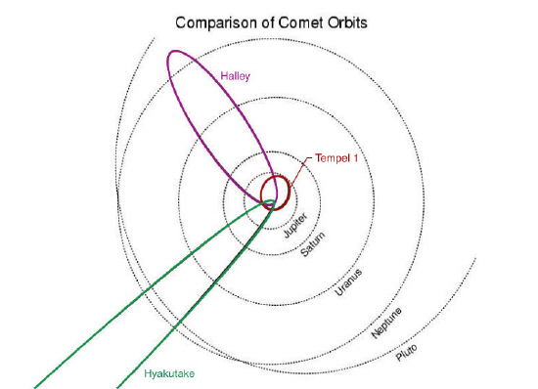
From http://deepimpact.umd.edu/gallery/orbits3.html

Slide 9
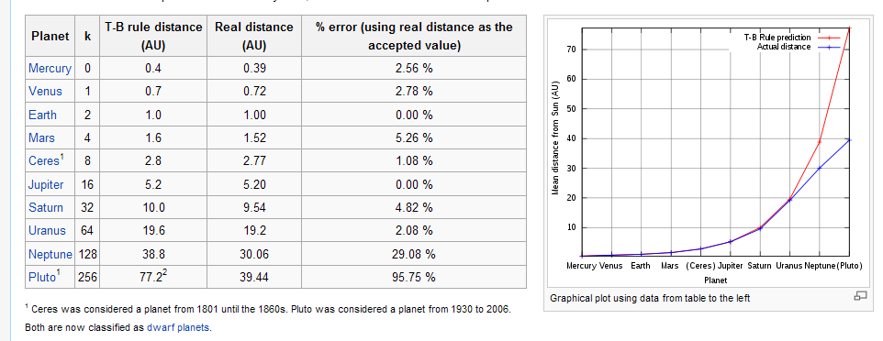
Titius-Bode rule
From http://en.wikipedia.org/wiki/Titius%E2%80%93Bode_law

Slide 10
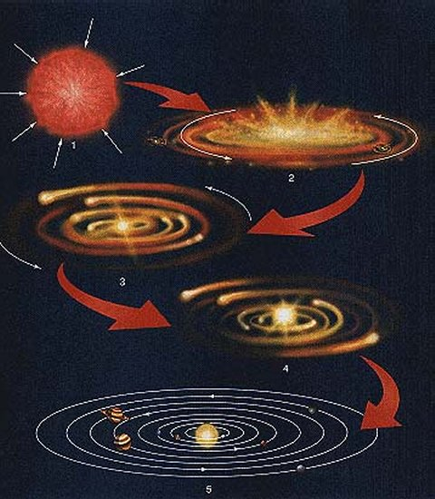
  The origin of the solar system
    Nebula theory
    External force theory
    → Neonebula theory

Slide 11
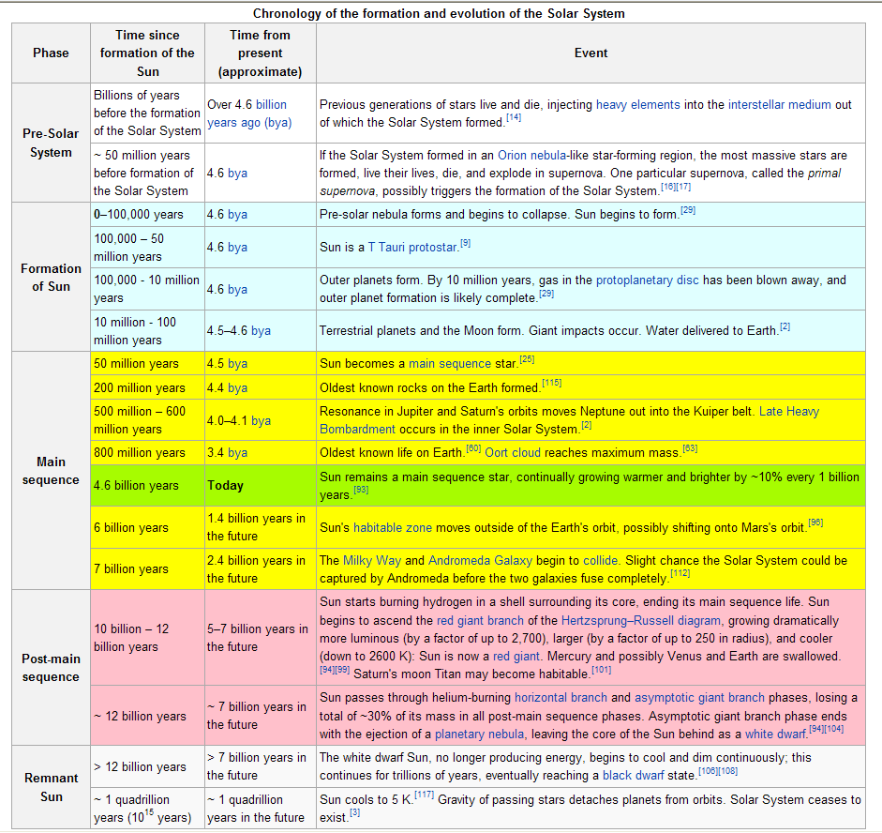
From http://en.wikipedia.org/wiki/Origin_of_the_solar_system

