Slide 1
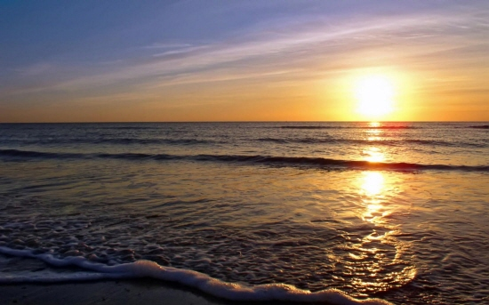
Ch.2.
Earth: The planet of water & life
From http://1.bp.blogspot.com/_Y9ucDp_oGA8/SAejGbW-_eI/AAAAAAAABjA/F3rAo_hX1vI/s1600-h/Sunset-on-Seascale-Beach.jpg

Slide 2
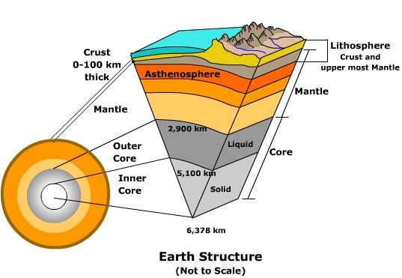
The Earth’s structure
From http://www.uwsp.edu/geo/faculty/ritter/glossary/a_d/asthenosphere.html

Slide 3
The Earth’s evolution
Homogeous Earth vs. squential aggregation
Origin of water and air
Appearance of life
Oxygen
Present Earth

Slide 4
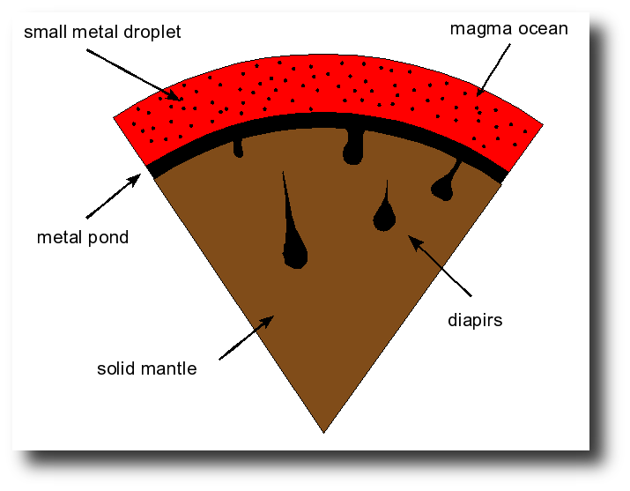
From http://geodynamics.rice.edu/tobias.hoeink/index.php?page=research

Slide 5
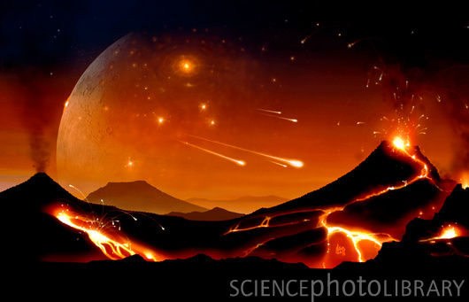
From http://www.sciencephoto.com/media/168543/enlarge

Slide 6
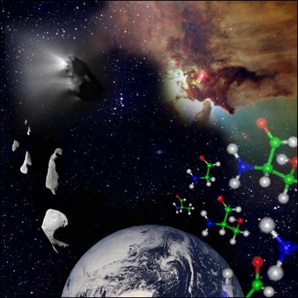
The origin of life?
Figure: Amino acids, the 'building blocks' of life, may form in dust grains in the space between the stars. (c) ESA 2002.
From http://www.astrobiologia.pl/eana/originoflife.html

Slide 7
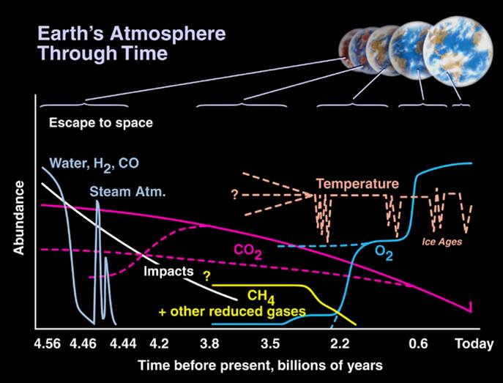
From http://www.astro.wisc.edu/~townsend/static.php?ref=diploma-9

