Slide 1
Ch.3. Thermodynamics for Geochemistry
Thernodynamics?
Therma (heat) + Dynamics (study of the causes of motion and changes in motion)
Heat = energy (1st law?)
Wiki: the branch of physical science concerned with heat and its relation to other forms of energy and work
Definition: a field of study describing (predicting) the system having ultimately the most stable state in terms of energy

Slide 2
Kinetics?
Wiki: The study of rates of chemical processes
Definition: A field of study dealing with reaction pathways and progresses as a function of time.
For a infinite time given, the prediction by kinetics would ne identical with that by thermodynamics.

Slide 3
Thermodynamics vs. Kinetics
Advantages
Thermodynamics: Simple, excellent data base – large amount of data accumulated
Kinetics: showing the details of the processes, including steps and pathways as well as rates
Disadvantages
Thermodynamics: no information on the pathways (mechanisms), inability of finding metastability
Kinetics: Complicated, lack of data (parameters)

Slide 4
Definition of the terms
System: A part of universe of your interest.
Open: Both matter and energy flow in & out
Closed: Only energy in & out
Isolated: No exchange w/ surroundings
Parameter: Variable determining the state of the system
Extensive: Variable along with system size
Intensive: not variable
Function:
Path dependent: Having different values for different path
Path independent (State): Independent on the path

Slide 5
Types of thermodynamic system

Slide 6
Time dependency of system state.
Transient: Evolving (changing) along with time
Steady: Maintaining it’s state against time, but unsatble (under disequilibrium), temporary
Equilibrium: no further change, stable

Slide 7
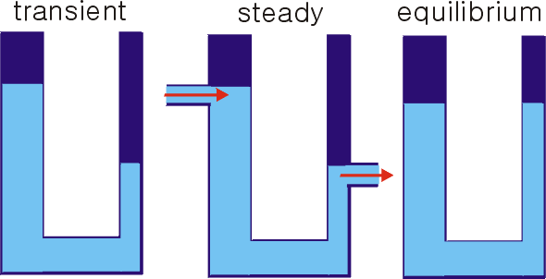
States of the system

Slide 8
Phases, components, and phase rule
Phase (P): Part of the system, having homogesous physicochemical properties, mechanically separable
Components (C): The operators (chemical formulae) of minimum possible, representing the compositions of all the phases in the system with their combinations.
Degree of freedom (F): The number of variables to be determined to define the state of the system exactly
Gibbs phase rule: P + F = C + 2

Slide 9
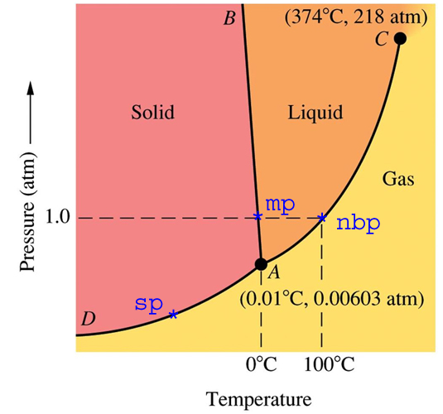
Phase diagram of water
Divariant field, F=2
Univariant curve, F=1
Invariant point, F=0
From http://math.nyu.edu/~gladish/teaching/eao/week2.html

