Slide 1
Applied Geochemistry & Lab Ch.3 Geothermobarometry
Part 1
JYU

Slide 2
1. Geothermobarometry?
Geothermometry+Geobarometry
Geothermometry: measuring (deducing) the temperature condition of any geological process with a tool (so called ‘geothermometer’)
Geobarometer: measuring the pressure condition of any geological process with a ‘geobarometer’

Slide 3
2. Assumptions & Cautions
All the calculations valid? – esp. check the reversibility:
Sensitive enough? – little deviation cause a huge error?
Chemically too sensitive? – inappropriate for the system chemically variable
Polymorphic phase transition? – indicate different T & P
Any extrapolation out of the range? – often not valid
Reset at a later stage?

Slide 4
3. Exchange Thermometer
Using elemental distribution over the stucural sites among different phases or within a same phase as a function of temperature – excellent T. because of the little volume and entropy change due to exchange (esp. unaffected by retrograde metamorphism)
Intracrystalline exchange: within a phase
Intercrystalline exchange: among the different phases

Slide 5
Intracrystalline exchange
Feldspar: Al distribution between T1 vs T2 sites
Pyroxene: Cation (Mg, Fe etc.) distribution between M(1) and M(2) sites – Reset at 600ºC

Slide 6
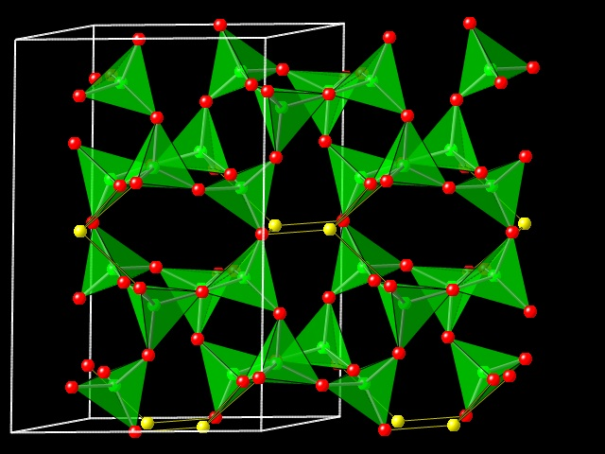
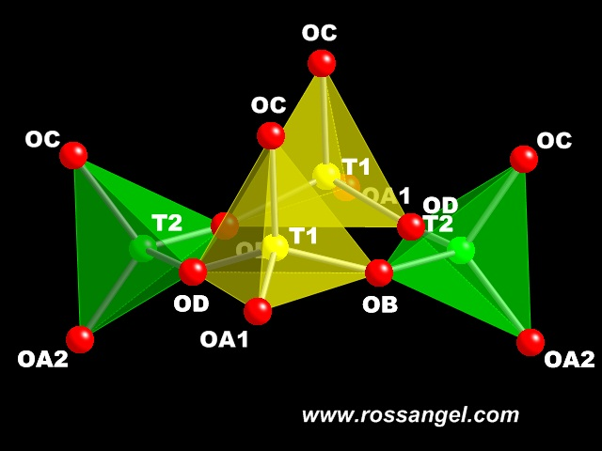
Structure of feldspar
http://www.rossangel.com/text_feldspars.htm

Slide 7
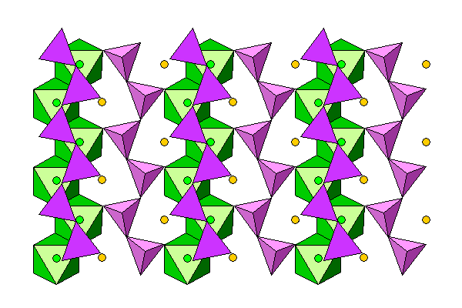
Structure of pyroxene: green-M1, orange-M2
http://www.uwgb.edu/dutchs/Petrology/Pyroxene%20Structure.HTM

Slide 8
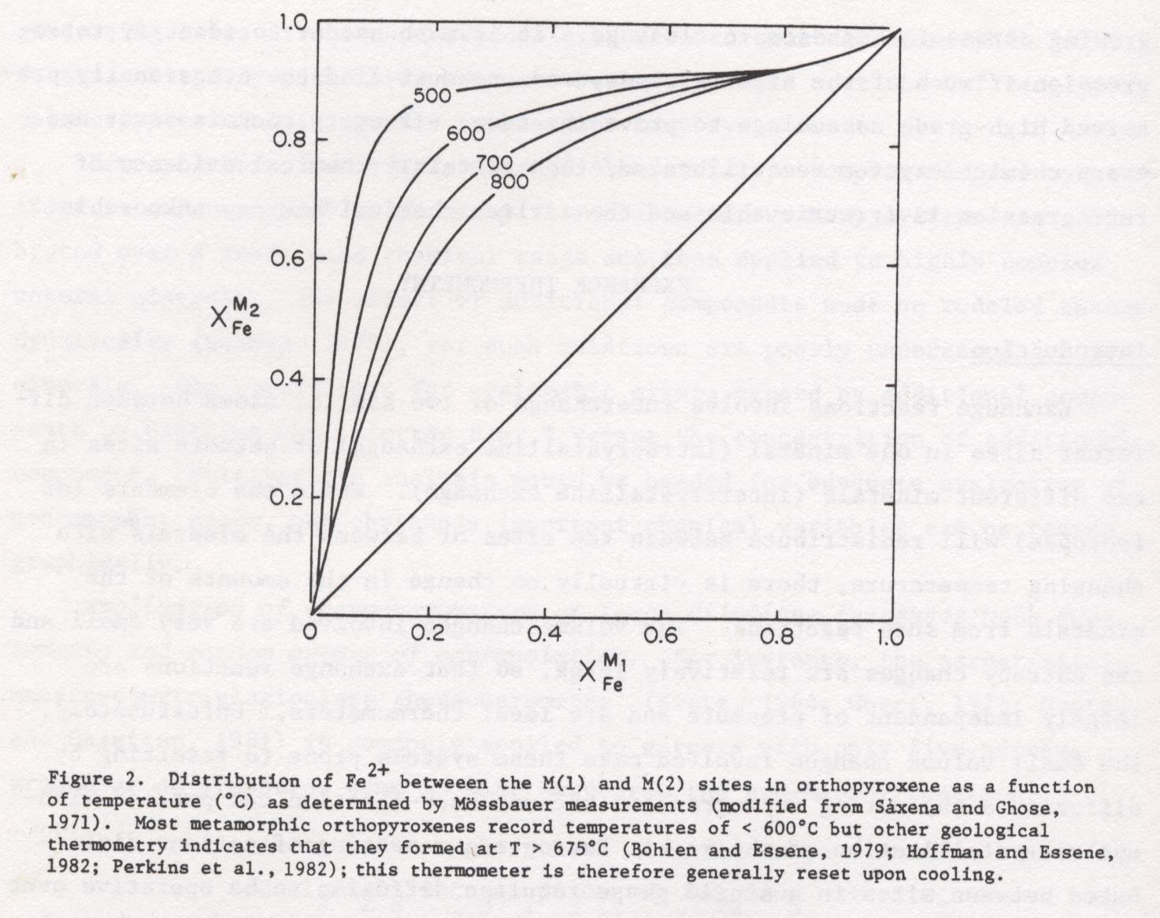

Slide 9
Intercrystalline exchange
For an exchange equilibria
$∆\overline{H^{o}}−T∆\overline{S^{o}}+\left(P−1\right)∆\overline{V^{o}}+RTlnK_{D}+RTlnK_{γ}=0$
Where $K_{D}=\frac{{(\frac{a}{b})}^{C}}{{(\frac{a}{b})}^{D}}$ , (a,b=mole fractions of the exchanger, C, D=phases doing exchange)
Mostly applied to very high T(>900ºC)

Slide 10
Garnet-clinopyroxene
0.33Mg3Al2Si3O12 (pyrope) + CaFeSi2O6 (hedenbergite) = 0.33Fe3Al2Si3O12 (almandine) + CaMgSi2O6 (diopside)
$K_{D}=\frac{{(\frac{Fe}{Mg})}^{gn}}{{(\frac{Fe}{Mg})}^{cpx}}$
In granulite, T(ºK)=(3104X_{Ca}^{gn}+3030+10.86P)/(lnK_{D}+1.9039) (Ellis and Green, 1979)
Garnet-biotite
Fe3Al2Si3O12 (almandine) + KMg3AlSi3O10(OH)2 (phlogopite) = Mg3Al2Si3O12 (pyrope) + KFe3AlSi3O10(OH)2 (annite)
$K_{D}=\frac{{(\frac{Fe}{Mg})}^{bt}}{{(\frac{Fe}{Mg})}^{gt}}$
Due to the presence of other cations, it can be quite errortic
Appropriate to apply to lower grade metamorphic rocks

Slide 11
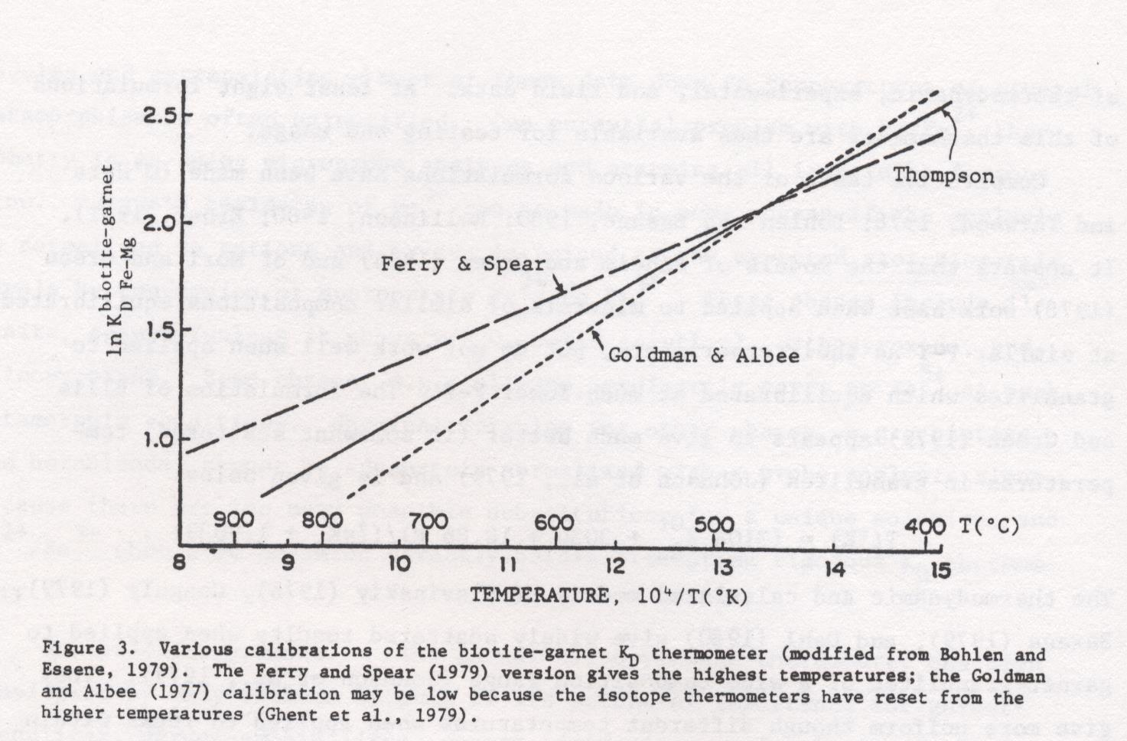

Slide 12
Isotope thermometry
Using stable isotope fractionation as a function of T
E.g. ¹⁸O/¹⁶O fractionation between calciate-quartz, magnetite-quartz, magnetite-feldspar, rutile-feldspar etc.
Refer a stable isotope geochemistry textbook for details

