Slide 1
Applied Geochemistry & Lab Ch.3 Geothermobarometry
Part 1
JYU

Slide 2
1. Geothermobarometry?
Geothermometry+Geobarometry
Geothermometry: measuring (deducing) the temperature condition of any geological process with a tool (so called ‘geothermometer’)
Geobarometer: measuring the pressure condition of any geological process with a ‘geobarometer’

Slide 3
2. Assumptions & Cautions
All the calculations valid? – esp. check the reversibility:
Sensitive enough? – little deviation cause a huge error?
Chemically too sensitive? – inappropriate for the system chemically variable
Polymorphic phase transition? – indicate different T & P
Any extrapolation out of the range? – often not valid
Reset at a later stage?

Slide 4
3. Exchange Thermometer
Using elemental distribution over the stucural sites among different phases or within a same phase as a function of temperature – excellent T. because of the little volume and entropy change due to exchange (esp. unaffected by retrograde metamorphism)
Intracrystalline exchange: within a phase
Intercrystalline exchange: among the different phases

Slide 5
Intracrystalline exchange
Feldspar: Al distribution between T1 vs T2 sites
Pyroxene: Cation (Mg, Fe etc.) distribution between M(1) and M(2) sites – Reset at 600ºC

Slide 6
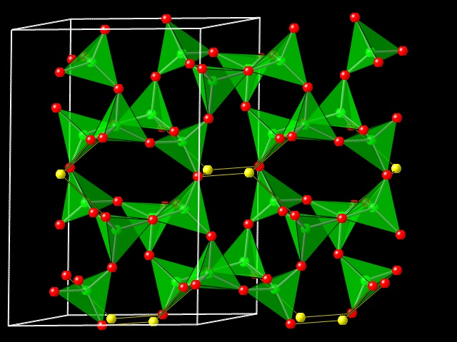
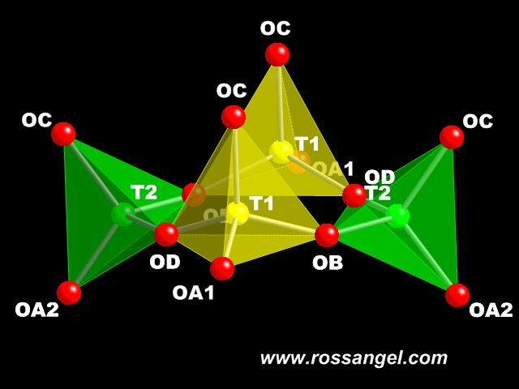
Structure of feldspar
http://www.rossangel.com/text_feldspars.htm

Slide 7
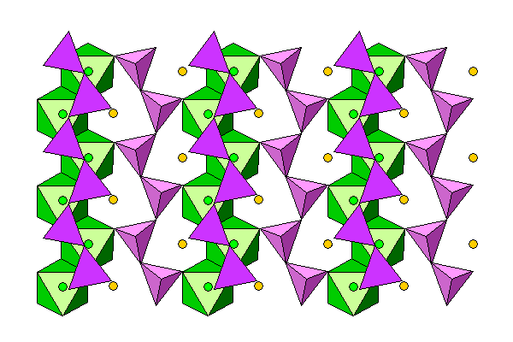
Structure of pyroxene: green-M1, orange-M2
http://www.uwgb.edu/dutchs/Petrology/Pyroxene%20Structure.HTM

Slide 8
Intercrystalline exchange
For an exchange equilibria
$∆\overline{H^{o}}−T∆\overline{S^{o}}+\left(P−1\right)∆\overline{V^{o}}+RTlnK_{D}+RTlnK_{γ}=0$
Where $K_{D}=\frac{{(\frac{a}{b})}^{C}}{{(\frac{a}{b})}^{D}}$ , (a,b=mole fractions of the exchanger, C, D=phases doing exchange)
Mostly applied to very high T(>900ºC)

Slide 9
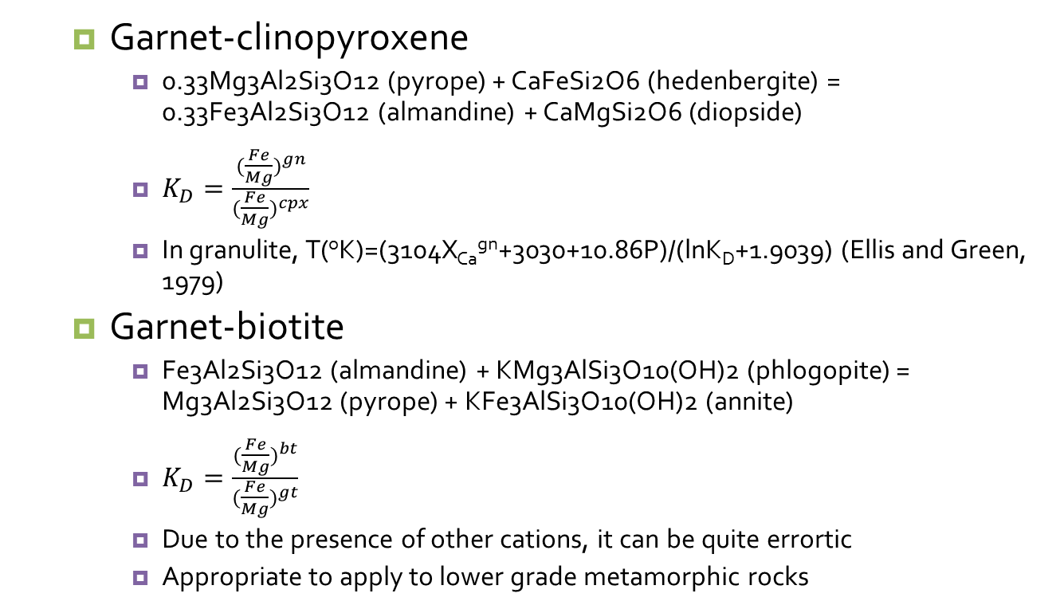
Garnet-clinopyroxene
0.33Mg3Al2Si3O12 (pyrope) + CaFeSi2O6 (hedenbergite) = 0.33Fe3Al2Si3O12 (almandine) + CaMgSi2O6 (diopside)
$K_{D}=\frac{{(\frac{Fe}{Mg})}^{gn}}{{(\frac{Fe}{Mg})}^{cpx}}$
In granulite, T(ºK)=(3104X_{Ca}^{gn}+3030+10.86P)/(lnK_{D}+1.9039) (Ellis and Green, 1979)
Garnet-biotite
Fe3Al2Si3O12 (almandine) + KMg3AlSi3O10(OH)2 (phlogopite) = Mg3Al2Si3O12 (pyrope) + KFe3AlSi3O10(OH)2 (annite)
$K_{D}=\frac{{(\frac{Fe}{Mg})}^{bt}}{{(\frac{Fe}{Mg})}^{gt}}$
Due to the presence of other cations, it can be quite errortic
Appropriate to apply to lower grade metamorphic rocks

Slide 10
Isotope thermometry
Using stable isotope fractionation as a function of T
E.g. ¹⁸O/¹⁶O fractionation between calciate-quartz, magnetite-quartz, magnetite-feldspar, rutile-feldspar etc.
Refer a stable isotope geochemistry textbook for details

