Slide 1
Ch.3. Thermodynamics for Geochemistry
The First Law
Energy conservation law
A type of energy can be transformed to another, but never disappear
Thermodynamically, the change in internal energy of a system is equal to the sum of all sorts of energy changes added to or substracted from the system.
Internal energy (U): Sum of all types of energy inside the system. Total energy inside.

Slide 2
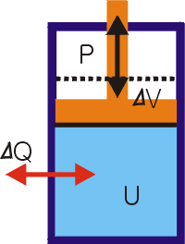
A piston system, working against a constant pressure and
exchanging heat with surroundings
The internal energy change may be given by
Internal energy change = heat change + work done
ΔU = ΔQ +ΔW
= ΔQ – PΔV
For an infinitesimal change
dU = dQ - PdV (1)

Slide 3
Entropy (S):
The energy not available for work, in the form of waste heat?
The measure of disorder (randomness)
Proportional to the heat change per temperature
ΔS = ΔQ/T
For an infinitesimal change
dS = dQ/T (2)
From equation (1) & (2)
dU = TdS –PdV (3)

Slide 4
Enthalpy (H):
The heat content of the system
The measure of heat exchanged under constant pressure
H = U+ PV
By taking differentiation for both sides
dH = dU + PdV + VdP
Inserting dU of equation (3) and rearranging it
dH = TdS + VdP (4)

Slide 5
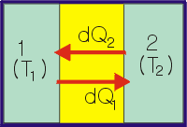
The Second Law
Entropy law
Spontaneous evolution of the universe is toward the direction of increasing randomness (disorder, chaos)
For an isolated system shown left,
T1>T2 → dQ = -dQ1 = dQ2
dS = dS1 + dS2
= dQ1/T1 + dQ2/T2
= dQ(-1/T1 + 1/T2) > 0
dS >0

Slide 6
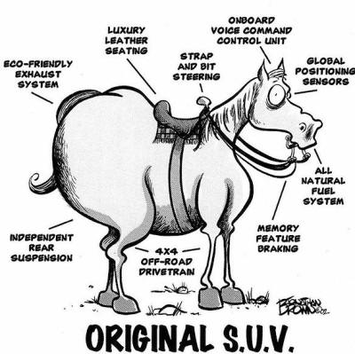
http://www.moniteausaddleclub.com/horse_humor.htm
You can not shovel manure into the rear end of a horse and expect to get hay out of its mouth"

Slide 7
dS =dQ(1/T2 – 1/T1)
dS >0; in an evolutionary phase. Spontaneous.
dS<0; the reverse process is spontaneous
dS=0; in equilibrium

Slide 8
Gibbs free energy (G):
A thermodynamic potential that measures the "useful" or process-initiating work obtainable from a thermodynamic system at a constant temperature and pressure
G = H - TS
By taking differentiation for both sides
dG = dH – TdS - SdT
Inserting dH of equation (4) and rearranging it
dG = VdP -SdT (5)

Slide 9
dG < 0; a spontaneous process
dG >0; the reverse process is spontaneous
dG=0; in equilibrium

Slide 10
The Third Law
The entropy has an absolute value, and it S=0 when T=0 K for a perfect (completely ordered) crystal.
Heat capacity (c):
The amount of heat necessary to raise a unit temperature
c = dQ/dT (6)
c_{p}: heat capacity under constant pressure.

Slide 11
From equations (2) and (6)
dS = dQ/T = (c/T)dT
Integration of both sides gives S_{T} - S₀ = ∫^{T}₀(c_{p}/T)dT
Since S₀ = 0
S_{T} = ∫^{T}₀(c_{p}/T)dT (7)
From equations (2), (4), and (6)
dH = TdS =c_{p}dT (8)

Slide 12
Calculation of Gibbs Free energy of a Reaction
For a reaction
aA + bB = cC + dD
The Gibbs free energy of the reaction at T & P becomes
ΔG_{r}^{T,P} = Σ_{i=products} ΔG_{f}^{T,P}(i) – Σ_{j=reactants} ΔG_{f}^{T,P}j)
ΔG_{r}^{T,P} = Σ_{i}ν_{i}ΔG_{f}^{T,P}(i) =(cΔG_{f}^{T,P}(C) + dΔG_{f}^{T,P}(D)) - (aΔG_{f}^{T,P}(A) + bΔG_{f}^{T,P}(B)).

