Slide 1
Ch.7. Identifying & Dating Modern Groundwaters
The “Age” of Groundwater
It’s not really age, rather it means “mean residence time (MRT)”
Types of GW (in terms of MRT)
Modern GW:
Recharged within past few decades
Containing T after thermonuclear bomb testing in the atmosphere (after 1945?)
Submordern GW: Recharged before the test

Slide 2
Tools for dating groundwater
Variations in the conc. of stable isotopes and other chemicals
Radioactive isotopes
T
¹⁴C
³⁶Cl
⁸⁵Kr

Slide 3
Stable Isotopes
Using the periodic seasonal fluctuation
For pptn; δ_{pptn}(t) = Asin2πt
For gw; δ_{gw}(t) = Bsin(2πt+α)
Damping; C=B/A
MRT = ½ π(1-C)^{1/2}/C or
MRT = tanα/2π
See Fig. 7-1 in the Text

Slide 4
Tritium in Precipitation
Cosmogenic tritium
¹⁴₇N + ¹_{o}n → ¹²₆C + ³₁H
³H + O₂ → ³HO₂ → ¹H³HO
³H → ³He + β–
1 TU = 1 ³H per 10¹⁸ hydrogen atoms
1 TU = 0.118 Bq·kg^{–1} (3.19 pCi·kg^{–1}) in water (IAEA 1983)

Slide 5
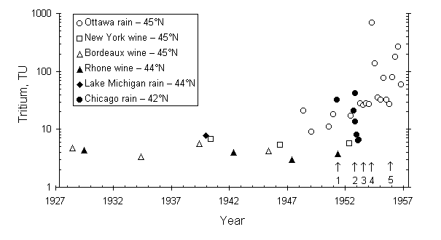
Fig. 7-2 Tritium levels in precipitation prior to and during the earliest atmospheric tests of thermonuclear devices. Atmospheric tests: 1 — George, 75 kilotons, U.S.A.; 2 — Ivy-Mike, 10 megatons, U.S.A.; 3 — RDS-6s, 400 kilotons, U.S.S.R.; 4 — Castle series, total 47 megatons, U.S.A.; 5 — second Soviet thermonuclear test, 2 megatons

Slide 6
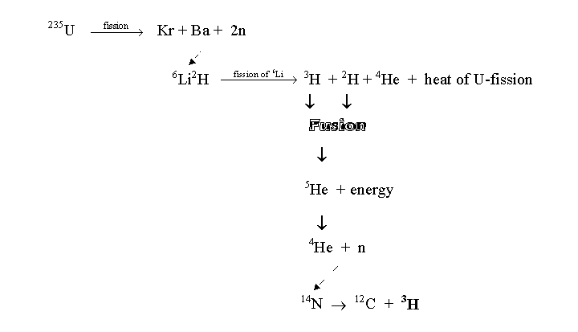
Thermonuclear (bomb) tritium

Slide 7
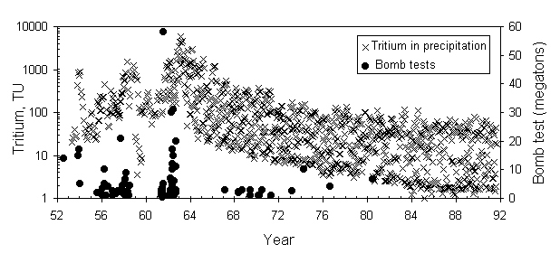
Fig. 7-3 Tritium in precipitation from thermonuclear bomb tests since 1952. Tritium data for selected stations in North America and Europe, from the IAEA GNIP data base. Bomb test data summarized from various sources by Rath (1988) and Gonfiantini (1996).

Slide 8
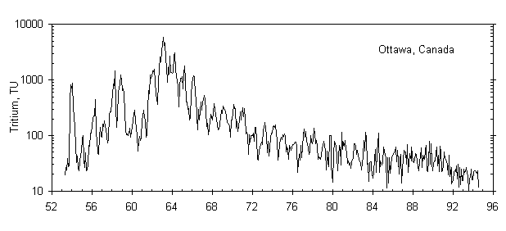
Fig. 7-4 Tritium in precipitation at Ottawa as measured in composite monthly samples (monitoring record established by R.M. Brown, AECL, Canada). Decreases from the peak in 1963 is due to attenuation in the oceans. The flattening of the decline after about 1980 and the sharp decline in 1990 likely reflect local activities in southern Ontario.
Also see Fig. 7-5.

Slide 9
Nuclear reactor tritium: minimal
Geogenic production of T: also minimal
⁶Li + n → ³H + α

Slide 10
Dating Groundwater with T
Velocity of the 1963 “bomb peak”
See Fig. 7-6 & 7-7.
Radioactive decay
a_{t} = a_{o} exp(-λt)
t_{1/2}=12.43
λ = ln2/t1/2
t = -17.93 ln (a_{t}/a_{o})
See Fig. 7-8. (How are going ro do with the seasonal variation)

Slide 11
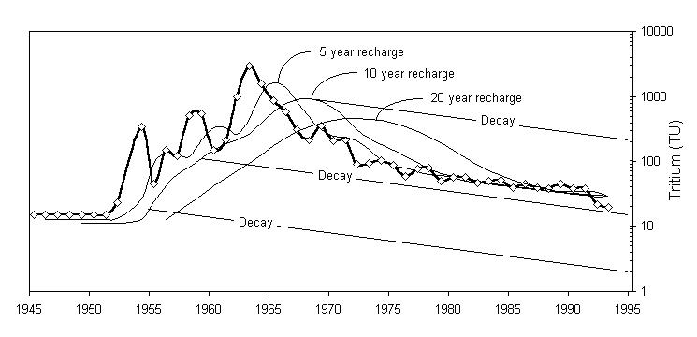
Input function for T in groundwater
Fig. 7-4 Tritium fallout (weighted annual average) in precipitation collected at Ottawa (heavy line), with decay models for initial tritium in groundwater. Models assume that recharge to a given parcel of groundwater takes place over 5, 10 and 20 year periods and are plotted for the year that the groundwater becomes closed to further contributions from precipitation. The decay lines are valid for "closed system conditions" following the movement of the groundwater beyond the recharge area.

Slide 12
Dating Groundwater with T – ³He
Helium-tritium systematics
³H_{t} = ³H_{o} e^{–λt}
³He_{t} = ³H_{o}(1– e^{–λt})
³He_{t} = ³H_{t}(e^{–λt} –1)
Have to cpnsider
Atmospheric ⁴He concentration is 5.24 ppmv (Glueckauf, 1946)
Atmospheric ³He/⁴He ratio is 1.384 · 10^{–6} (Clarke et al., 1976)
The solubility of atmospheric helium is temperature dependent, and for 10°C is 4.75 · 10^{–8} cm³ STP/cm³ H₂O (Fig. 7-11).
⁴He is slightly more soluble in water, with a fractionation factor, a ~ 0.983 (Benson and Krouse, 1980)
t = 12.43/ln2 · ln(1 + [³He_{t}]/[³H_{t}])

Slide 13
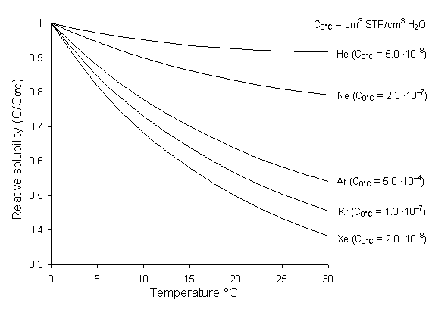
Fig. 7-11 Solubility of noble gases in water (Andrews, 1992).

