Slide 1
Ch.6. Radioactive Nuclides
Introduction
Radioactive nuclides? – Those nuclides having radioactive decay
Natural vs. anthropogenic
Single vs. chain decay
Decay mode? – α, positron, negatron, electron capture decay
The radiation from the decay is the primary environmental threat

Slide 2
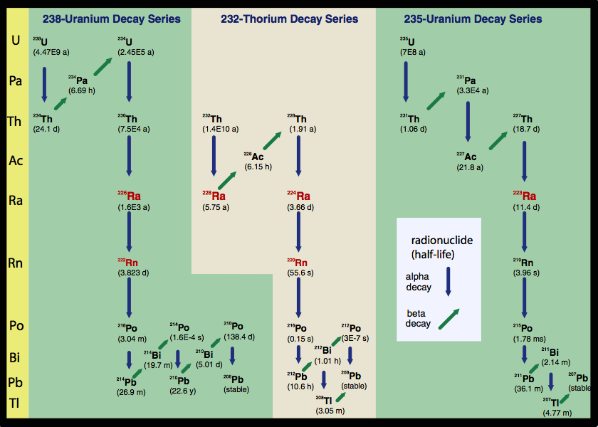
From http://gulfsci.usgs.gov/tampabay/data/2_biogeochemical_cycles/radionuclides.html

Slide 3
From http://en.ori-japan.com/news/other/fpp-research-discussion.html

Slide 4
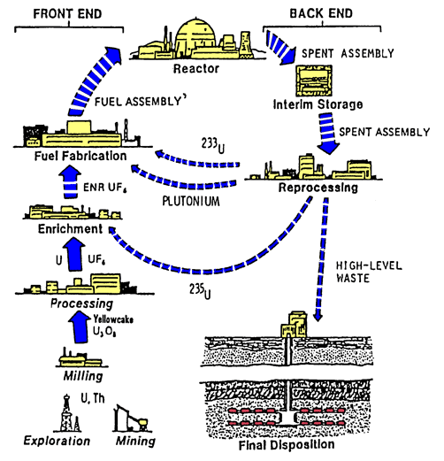

Slide 5
