Slide 1
Ch.4. Crystal Chemistry
Structure of an Atom
Nucleus: neutron + proton → determine the mass of an atom
Electron(s): Occupy atomic orbitals quantumized → determine the size (volume) of an atom
Atomic orbital? A function representing the probability of electron presence in space, satisfying Schrodinger equation

Slide 2
Quantum?
An electron occupying an atomic orbital has a quantumized (having a certain quantity of) energy level
Quantum numbers
The variables determining the energy level and shape of an atomic orbital (degeneracy)
Principal (n) – energy level (shell) – n= 1, 2, 3, …
Angular (azimuthal) (ℓ) – types of orbital (subshell) – 0 ≤ ℓ ≤ n − 1 (s, p, d, f,…)
Magnetic (m_{ℓ}) – shape of the subshell - −ℓ ≤ m_{ℓ} ≤ ℓ (p_{x}, p_{y}, p_{z})
Spin (m_{s}) – spin direction - +1/2, -1/2

Slide 3
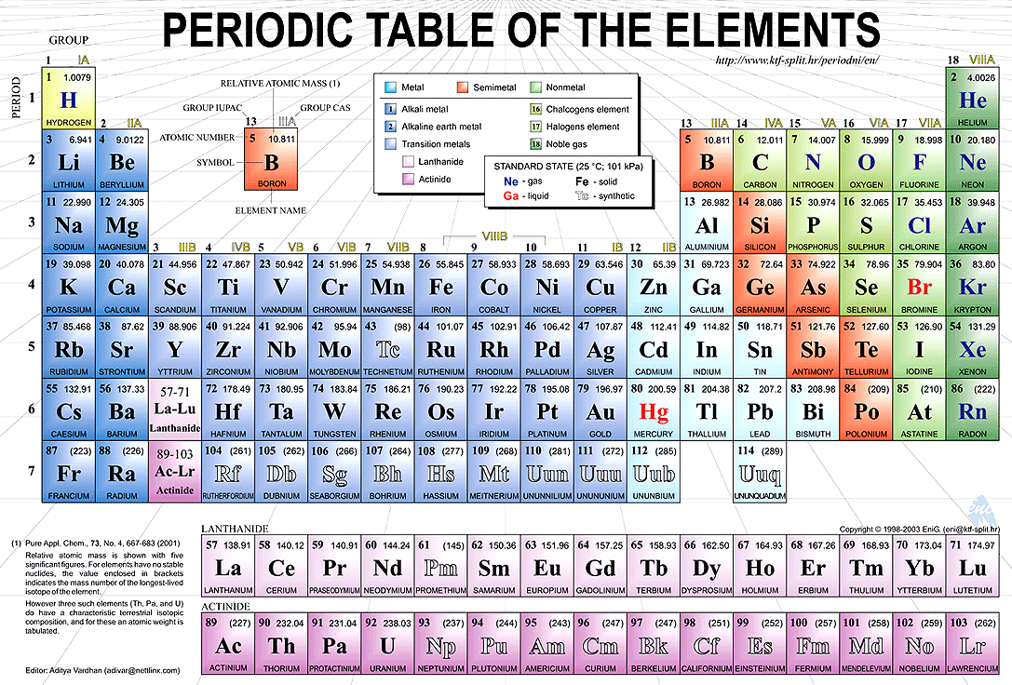
From http://djarn.edublogs.org/files/2011/01/periodic-table-2jh1745.gif

Slide 4
From the periodic table, can you tell
Principal quantum number
Angular quantum number
Magnetic quantum number
Spin quantum number
Number of valence electrons
Alkali metals
Alkaline earths
Halogens
Noble gases
Transient elements
Rare earth elelments (REE)

Slide 5
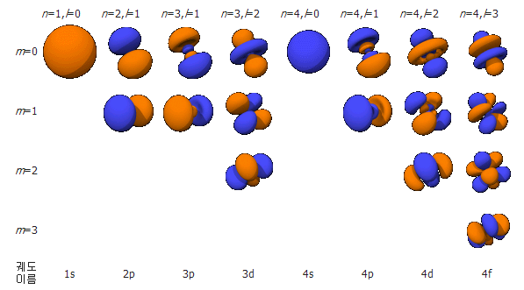
Shape of the atomic orbitals

Slide 6
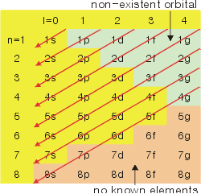
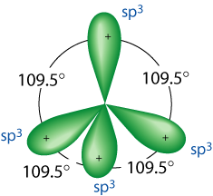
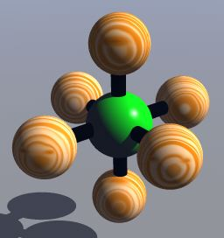
Aufbau principle
Al¹³: 1s² | 2s²2p⁶ | 3s²3p¹
Si¹⁴: 1s² | 2s²2p⁶ | 3s²3p²
K¹⁹: 1s² | 2s²2p⁶ | 3s²3p⁶ | 4s¹
Hybridization: Mixing of the orbitals as atoms being excited to form a bond
From http://www.science.uwaterloo.ca/~cchieh/cact/c120/hybrid.html
From http://www.grandinetti.org/Teaching/Chem121/Lectures/Hybridization

