Slide 1
4. Phase Equilibria for Petrogenetic Grid
Solvus thermometry
Albite-Alkali feldspar
Al-Si disorder & presence of Ca may cause some difficulties to apply
Ternary feldspar T. for better estimation
Ternary feldspars
Albie-K-feldspar-Anorthite
NaAlSi₃O₈-KAlSi₃O₈-CaAl2Si₂O₈
Calcite-dolomite
Exsolved magnesian calcite should be reintegrated to dolomite
Useful in low-grade metamorphic rocks and in contact metamorphic rocks

Slide 2
Enstatite-diopside
Mg₂Si₂O₆-CaMgSi₂O₆
Interferences from other components (end members)
May applicable for the ultramafic rocks formed at the T > 900ºC
Quadrilateral pyroxenes
Diopside-hedenbergite-enstatite-ferrosilite
CaMgSi₂O₆- CaFe²⁺Si₂O₆- Mg₂Si₂O₆- Fe²⁺₂Si₂O₆-

Slide 3
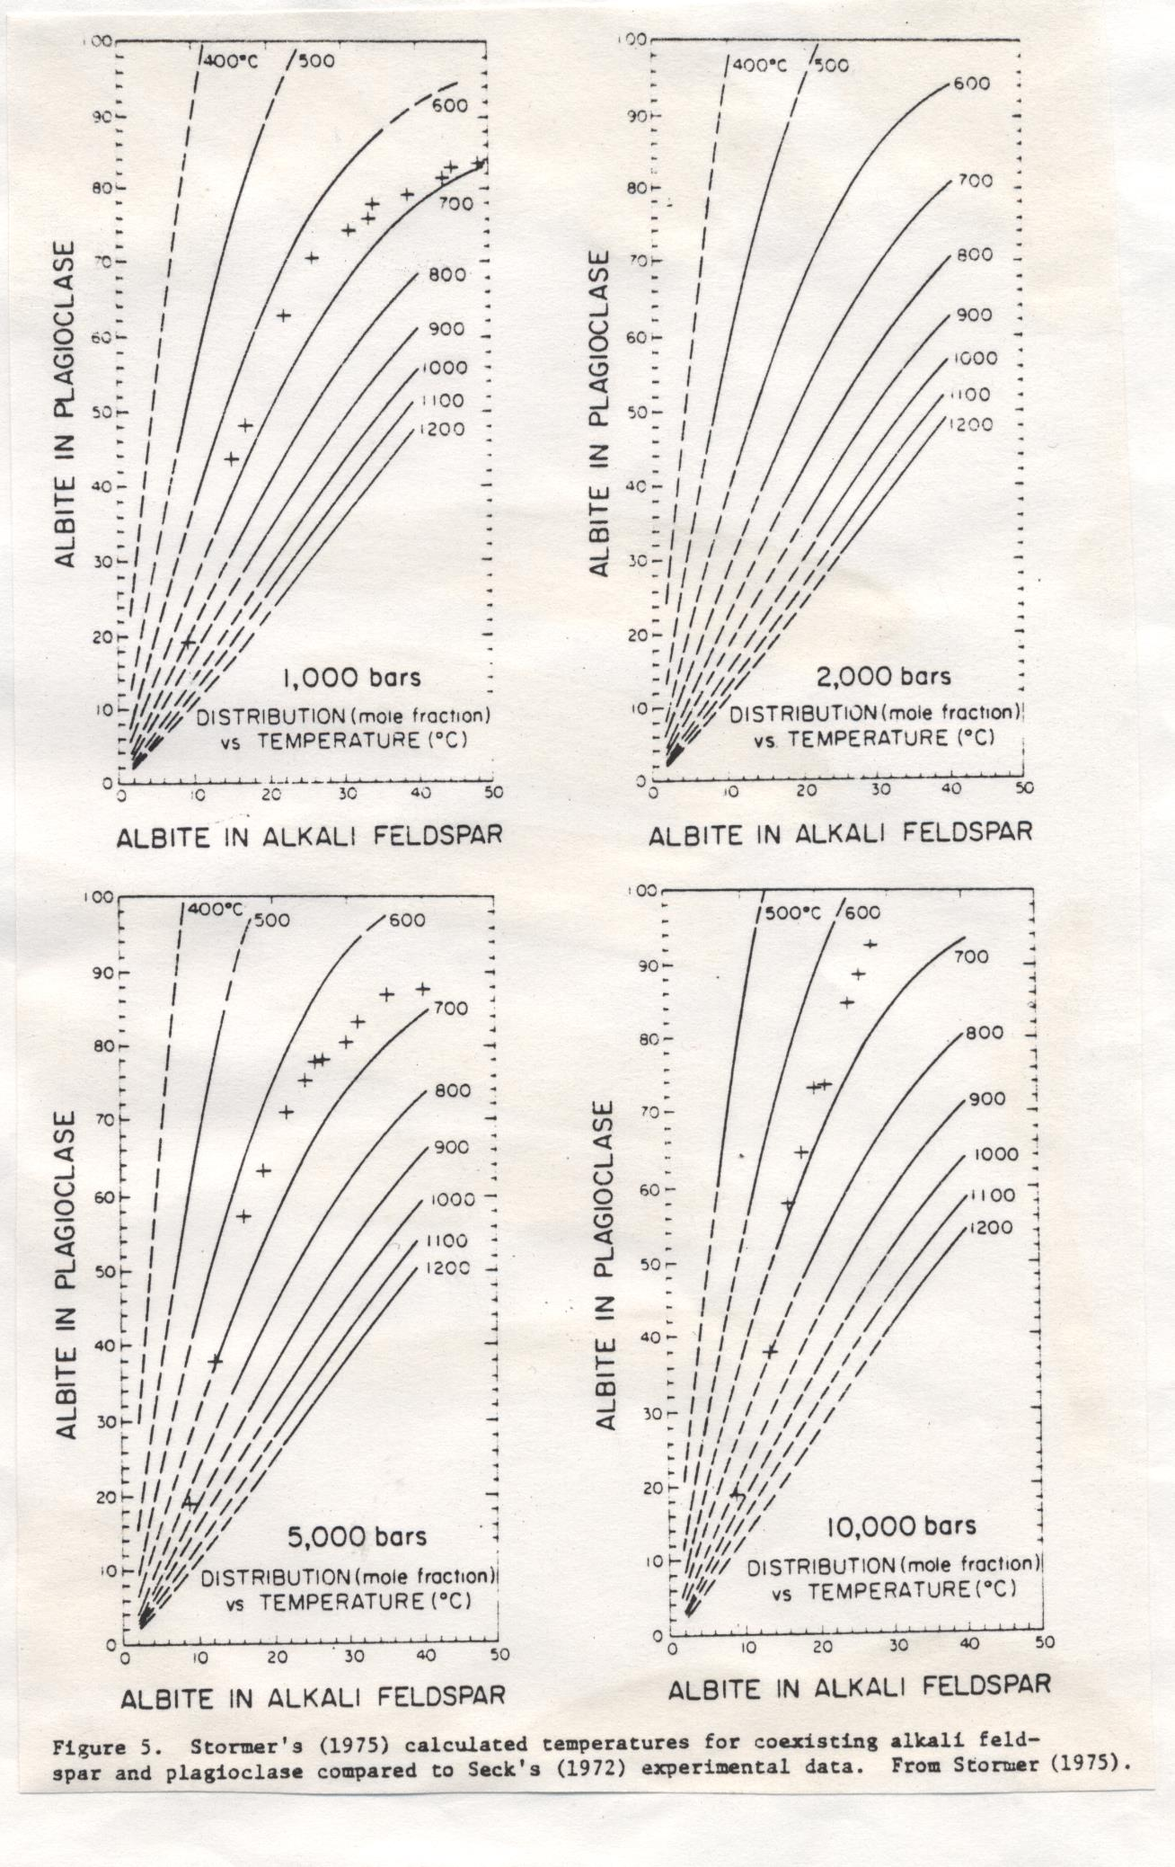
From E.J. Essene (1986) Ch.5 Geologic thermometry and barometry. In Reviews in Mineralogy , Vol.10 (Ed. JM Ferry). Mineral. Soc. Am. , pp.153-206

Slide 4
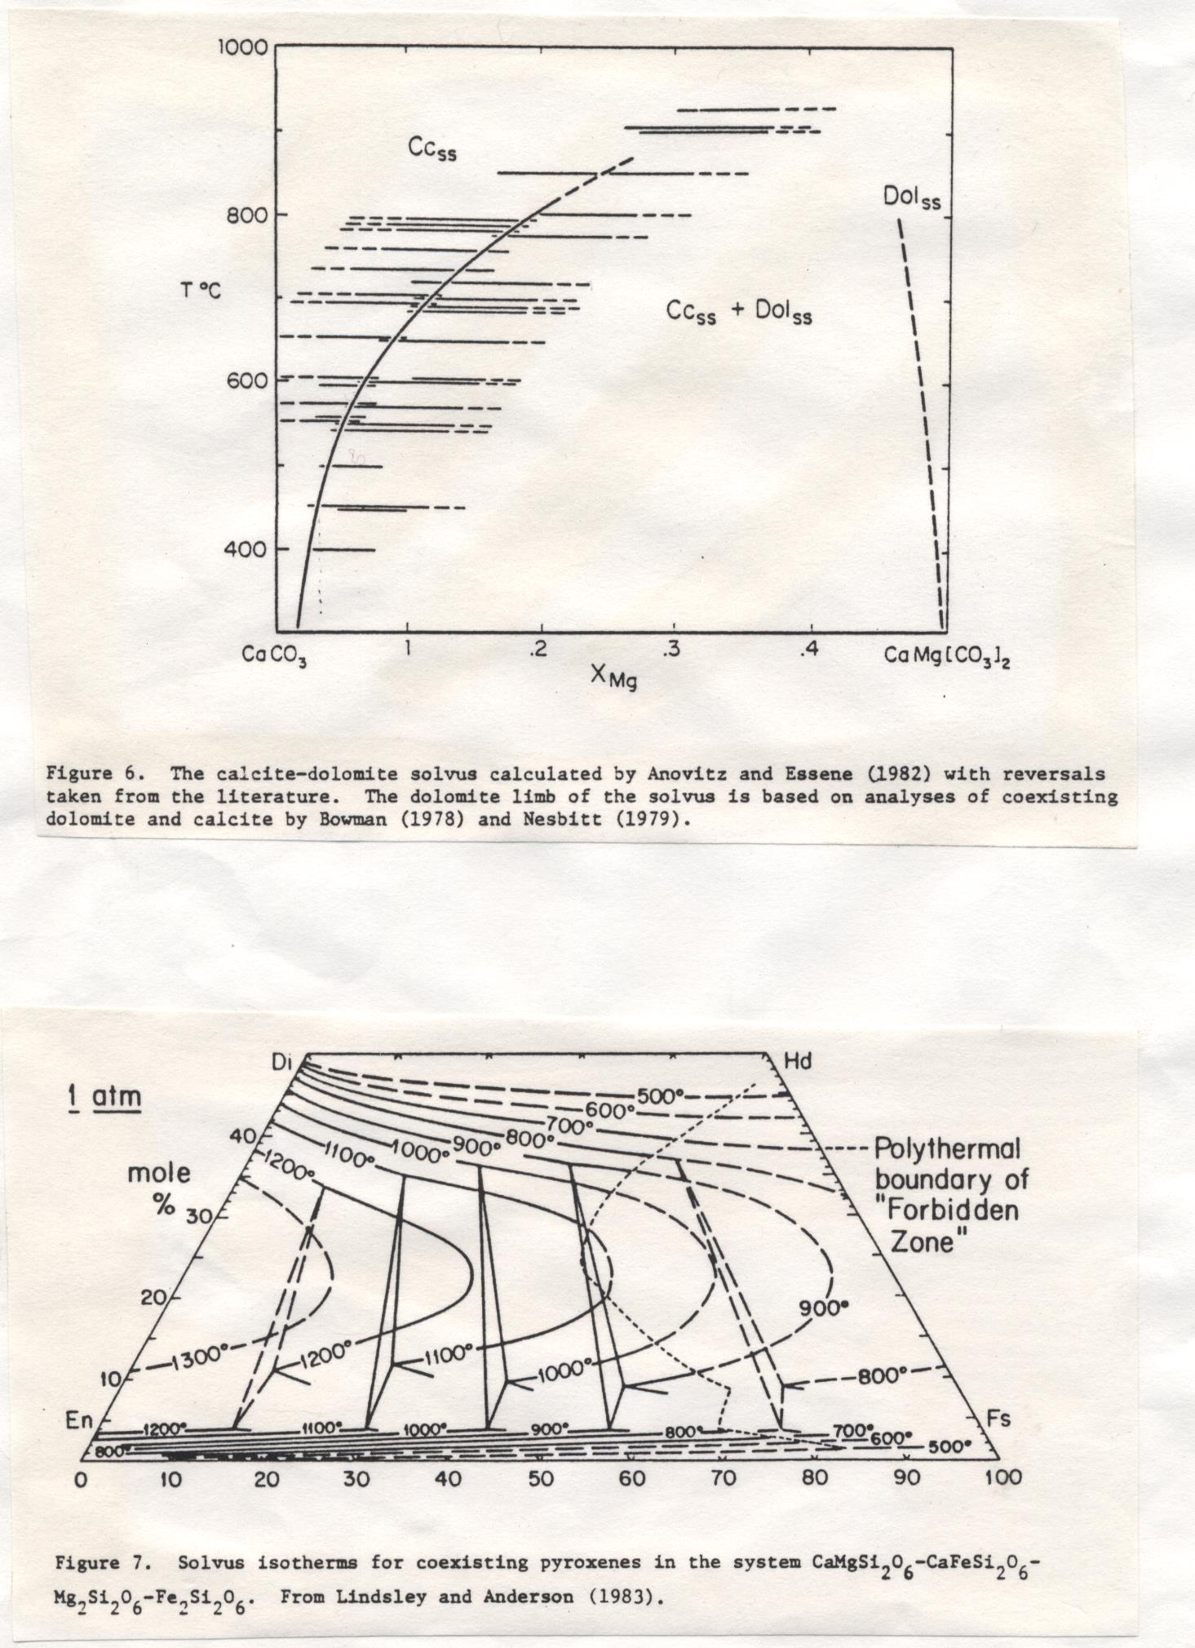
From E.J. Essene (1986) Ch.5 Geologic thermometry and barometry. In Reviews in Mineralogy , Vol.10 (Ed. JM Ferry). Mineral. Soc. Am. , pp.153-206

Slide 5
Solid-Solid Reactions
Widely used as geobarometers (T may be determined using the methods prviously described)
Then, general equation becomes
$∆H°−T∆S°+\left(P−1\right)∆V°+RTlnK=0$ of the univariant curve on P-T space

Slide 6
Andalusite-sillimanite-kyanite (Al₂SiO₅)
The disagreement in the invariant point:
6.5kbar – 595C (Althaus, 1967)
5.5kbar – 620C (Richardson et al., 1969)
3.8kbar – 600C (Holdaway, 1971)
3.9kbar – 492C (Berman, 1988)
4.5kbar – 550C (Pattison et al. 2002)

Slide 7
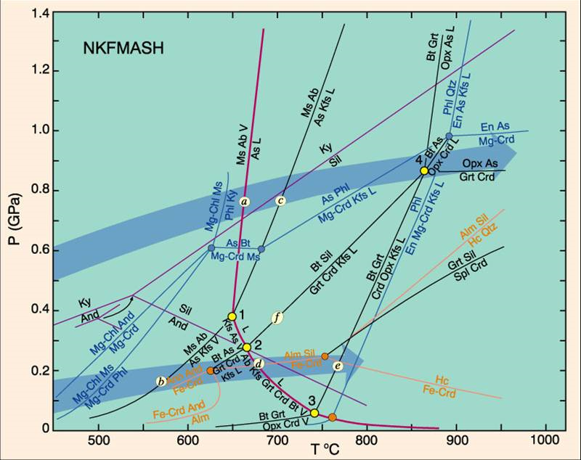
http://all-geo.org/metageologist/2011/09/what-you-ought-to-know-about-metamorphism/

Slide 8
Pyroxene/pyroxenoid-olivine-quartz
Pyroxene/pyroxenoid = olivine + quartz
2RSiO₃ = R₂SiO₄ + SiO₂
Ferrosilite = fayalite + quartz
2FeSiO₃ = Fe₂SiO₄ + SiO₂

Slide 9
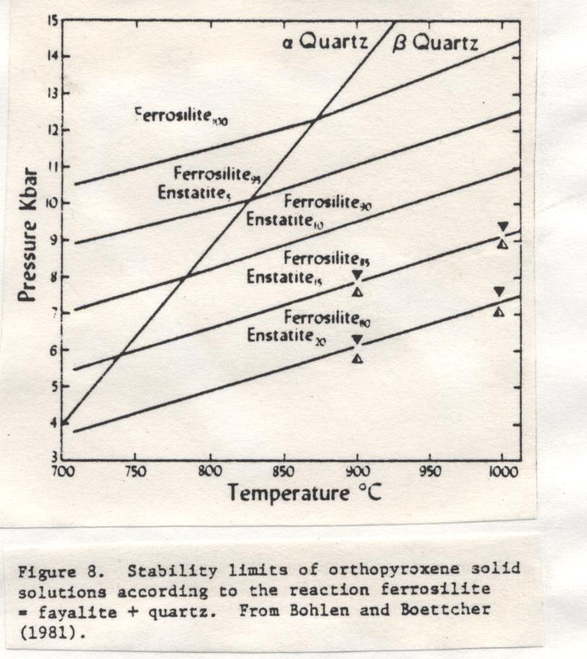
From E.J. Essene (1986) Ch.5 Geologic thermometry and barometry. In Reviews in Mineralogy , Vol.10 (Ed. JM Ferry). Mineral. Soc. Am. , pp.153-206

Slide 10
Pyroxene-plagioclase-quartz
Albite = jadite + quartz
NaAlSi₃O₈ = NaAlSi₂O₆ + SiO₂
Anorthite = tschermakite + quartz
CaAl₂Si₂O₈ = CaAl₂SiO₆ + SiO₂
Garnet-plagioclase-Al₂SiO₅-quartz
Most widely used for the mid- to high-grade metamorphic rocks
Anorthite = grossular + sillimanite + quartz
3CaAl₂Si₂O₈ = Ca₃Al₂Si₃O₁₂ + 2Al₂SiO₅ +SiO₂

Slide 11
Garnet-plagioclase-olivine
Plagioclase(ss) + olivine(ss)=garnet(ss)
Anorthite + fayalite = grossular/almandine
CaAl₂Si₂O₈ + Fe₂SiO₄ = CaFe₂Al₂Si₃O₁₂
Garnet-plagioclase-orthopyroxene-quartz
Applicable to garnet granulite and amphibolite
Plagioclase + orthopyroxene = garnet + quartz
Anorthite + ferrosilite = grossular/almandine + quartz
CaAl₂Si₂O₈ + 2FeSiO₃ = CaFe₂Al₂Si₃O₁₂ + SiO₂

Slide 12
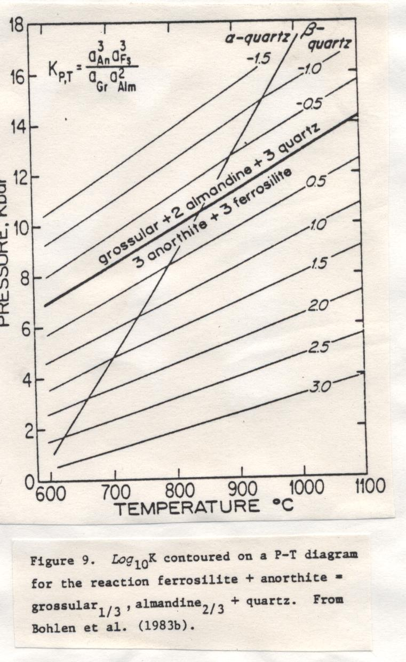
From E.J. Essene (1986) Ch.5 Geologic thermometry and barometry. In Reviews in Mineralogy , Vol.10 (Ed. JM Ferry). Mineral. Soc. Am. , pp.153-206

Slide 13
Garnet-cordierite-sillimanite-quartz
Disagreement among researchers
Iron cordierite = almandine + sillimanite + quartz
3Fe2Al4Si5O18 = 2Fe₃Al₂Si₃O₁₂ + 4Al₂SiO₅ + 5SiO₂
Garnet-spinel-sillimanite-quartz
Garnet + sillimanite = spinel + quartz
R₃Al₂Si₃O₁₂ + Al₂SiO₅ = 3RAl₂O₄ + SiO₂

Slide 14
Garnet-rutile-ilmenite-sillimanite-quartz
The best geobarometer for high-grade metapelite
Ilmenite + sillimanite + quartz = almandine + rutile
3FeTiO3 + Al₂SiO₅ + 2SiO₂ = Fe₃Al₂Si₃O₁₂ + TiO₂
Sphalerite-pyrrhotite-pyrite
Very popular sulfide geobarometer
Range: 300-650ºC
Fe in sphalerite = Fe in pyrrhotite + Fe in pyrite
(Zn,Fe)S = Fe_{1-x}S + FeS₂

Slide 15
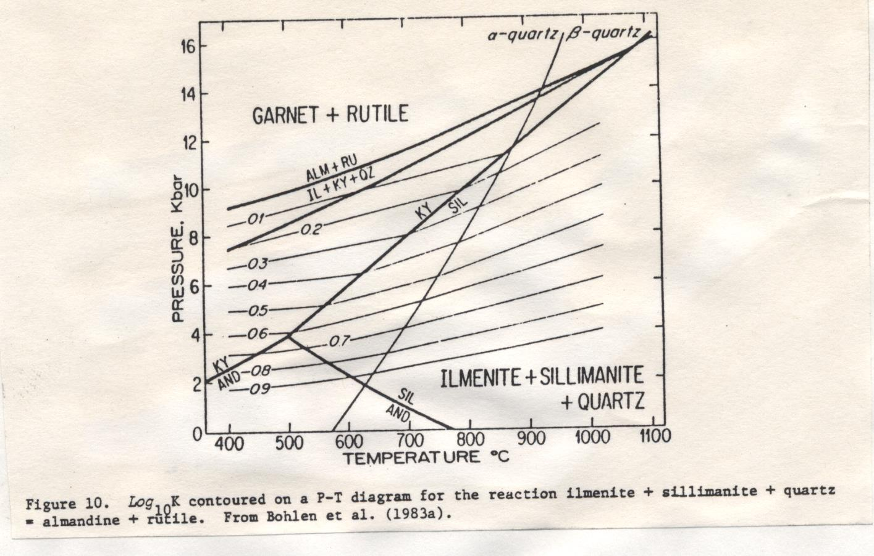
From E.J. Essene (1986) Ch.5 Geologic thermometry and barometry. In Reviews in Mineralogy , Vol.10 (Ed. JM Ferry). Mineral. Soc. Am. , pp.153-206

Slide 16
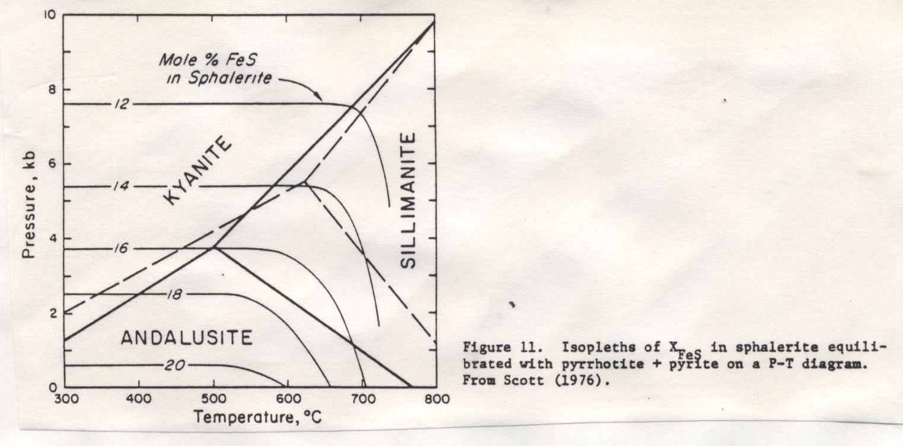
From E.J. Essene (1986) Ch.5 Geologic thermometry and barometry. In Reviews in Mineralogy , Vol.10 (Ed. JM Ferry). Mineral. Soc. Am. , pp.153-206

Slide 17
Reactions involving fluid species
FeO-TiO₂-O₂
CaO-SiO₂-CO₂
K₂O-Al₂O₃-SiO₂-H₂O
CaO-Al₂O₃-SiO₂-H₂O
K₂O-FeO-Al₂O₃-SiO₂-H₂O-O₂

Slide 18
4. Other Methods
Fluid inclusion
Illite crystallization

Slide 19
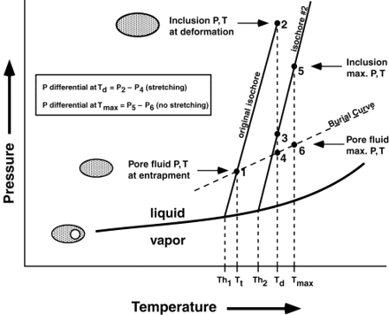
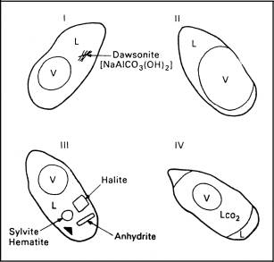
Figure 2
Hypothetical phase diagram showing pressure vs. temperature changes for fluid inclusions during burial overheating. An inclusion that forms at low pore fluid pressure and temperature (P, T) conditions (point 1) will have a measured homogenization temperature of Th1. Entrapment temperature is actually higher, at Tt, and must be estimated by adding a suitable pressure correction to Th1. If this same inclusion is overheated to higher internal P, T conditions sufficient to cause deformation (stretching) to occur (point 2), the volume of the inclusion cavity will increase slightly, and the corresponding fluid density will decrease, altering its phase behavior to follow a lower density isochore that is appropriate for the new density of the fluid (isochore #2). After stretching, internal temperature remains unchanged, but internal pressure drops to point 3, which is slightly higher than pore fluid pressure (point 4). Measured Th from this inclusion will be observed at Th2, which is higher than Tt but less than the temperature at which deformation actually occurred (Td). Estimation of Td would again require a suitable pressure correction. However, if the purpose of the analysis is to determine Tt, then Th2 or pressure-corrected Th2 would greatly overestimate Tt. If the inclusion is heated beyond Td without further deformation (point 5), then the measured Th will still be observed at point Th2, but this temperature will be significantly less than the maximum temperature sustained by the inclusion (Tmax). If the purpose of the analysis is to determine Tmax, then a suitable pressure correction must be made to Th2.
http://aapgbull.geoscienceworld.org/content/84/10/1647/F2.expansion.html
http://geol-amu.org/notes/m7-1-12.htm

Slide 20
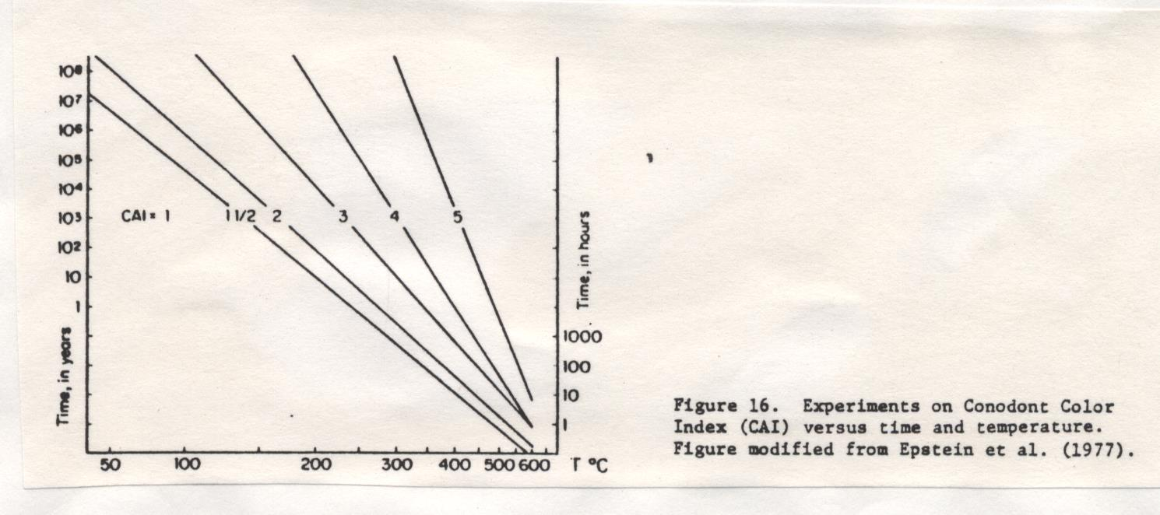
From E.J. Essene (1986) Ch.5 Geologic thermometry and barometry. In Reviews in Mineralogy , Vol.10 (Ed. JM Ferry). Mineral. Soc. Am. , pp.153-206

