Slide 1
Ch.5. Agriculture & Environment Most of this lecture is based on the wikipedia article “Environmental Impact of Agriculture”
Issues
Climate change
Deforestation
Genetic engineering
Irrigation
Pollutants
Soil degradation
Waste – plastics & other garbages

Slide 2
Climate change:
Esp., in terms of T and Pptn.
influenced (on productivity): Good or bad?
Effects on climate change (by CO₂, CH₄, NO₂ prod., land use (defrostration etc), and others)

Slide 3
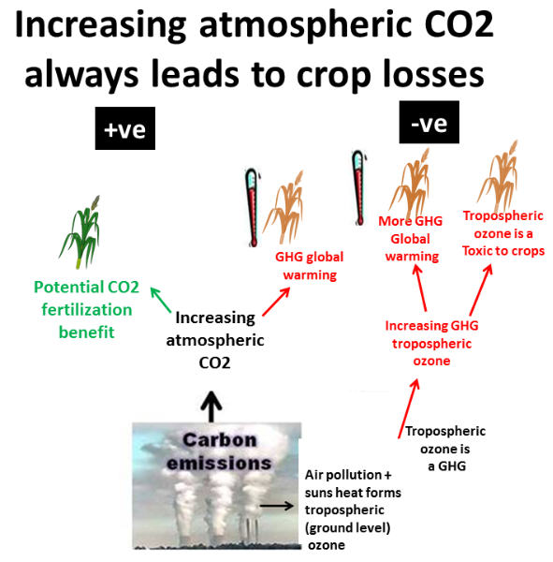

Slide 4
http://www.climatechange-foodsecurity.org/science.html

Slide 5
Deforestation:
Atmospheric – enhance greenhouse effect
Hydrological
Affect water cycle
Water pollution
Soil
Erosion
Landslide
Flooding
Biodiversity

Slide 6
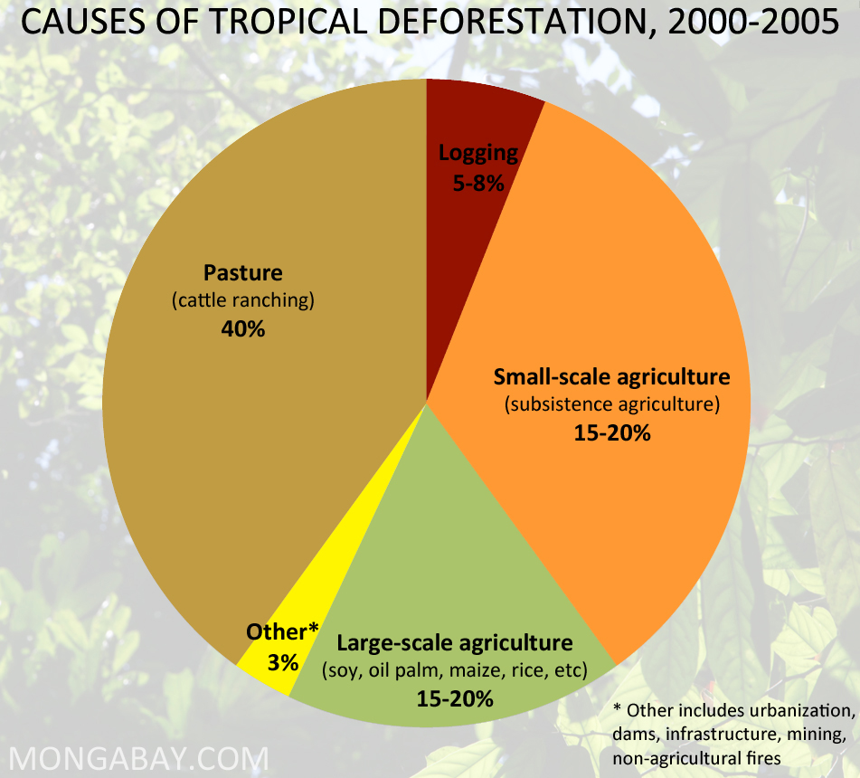
http://rainforests.mongabay.com/0803.htm

Slide 7
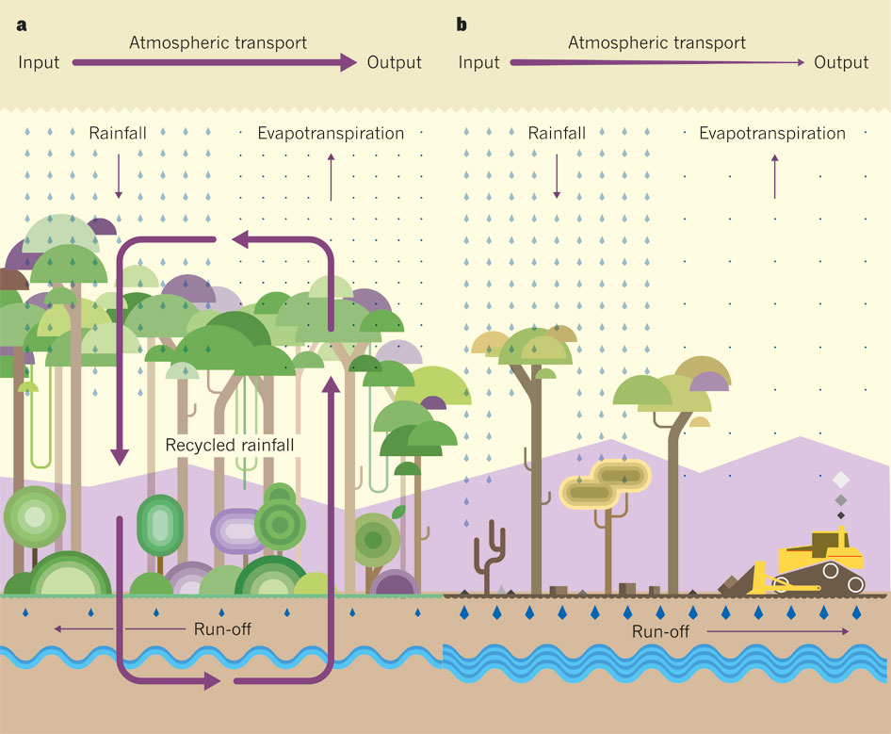
http://www.nature.com/nature/journal/v489/n7415/fig_tab/nature11485_F1.html

Slide 8
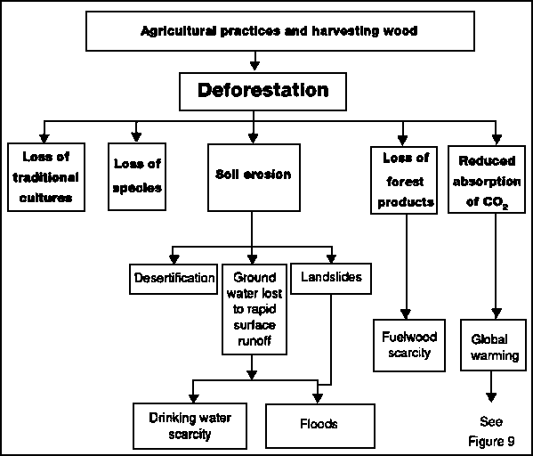
http://www.nzdl.org/gsdlmod?e=d-00000-00---off-0aedl--00-0----0-10-0---0---0direct-10---4-------0-1l--11-en-50---20-help---00-0-1-00-0-0-11-1-0utfZz-8-10&cl=CL1.1&d=HASH0198ca64f44cf9457f3c759d.9&gt=2

Slide 9
Genetic engineering:
Genetic engineering alters the genetic make-up of an organism using techniques that remove heritable material or that introduce DNA prepared outside the organism either directly into the host or into a cell that is then fused or hybridized with the host
Controversy
ethical
ecological
economic (rel. w/ intellectual property)
food controversies
GMO labeling disputes
(health) risk assessment debates
http://rainforests.mongabay.com/0803.htm

Slide 10
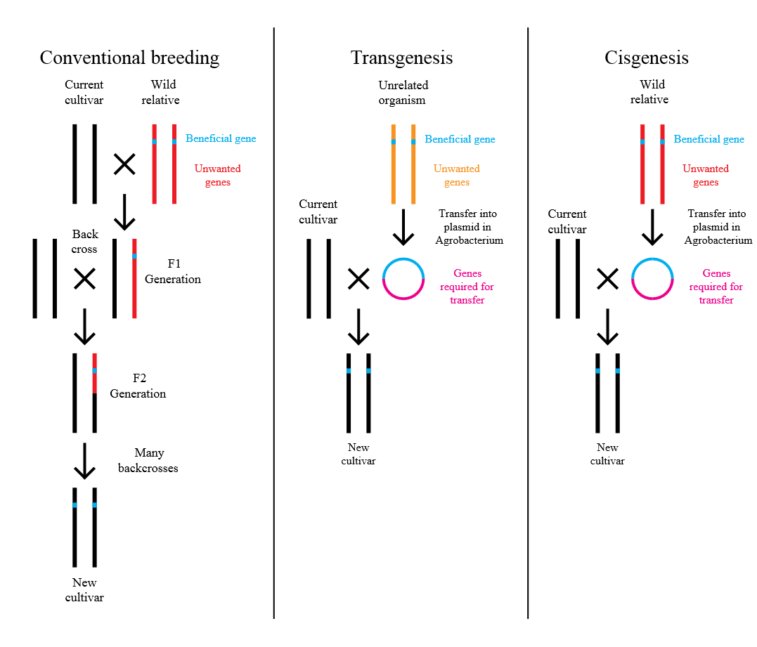
http://en.wikipedia.org/wiki/Genetic_engineering

Slide 11
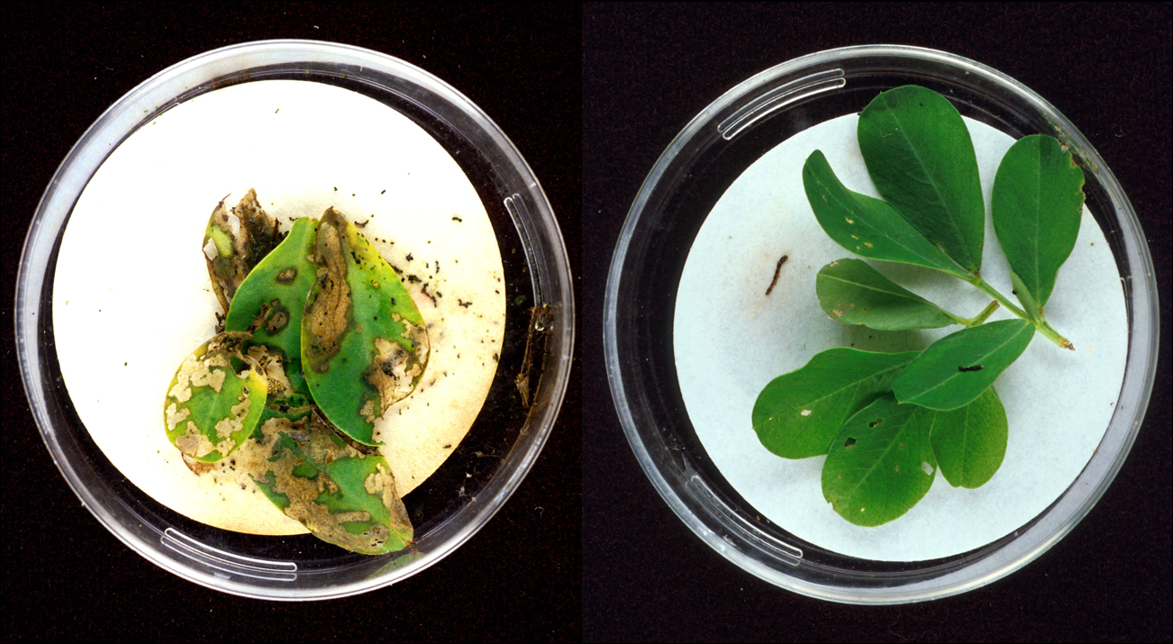
Bt-toxins present in peanut leaves (right image) protect it from extensive damage caused by European corn borer larvae (left image). (from Suszkiw, Jan (November 1999). "Tifton, Georgia: A Peanut Pest Showdown". Agricultural Research magazine. Retrieved 23 November 2008).
http://en.wikipedia.org/wiki/Genetic_engineering#Controversy

Slide 12
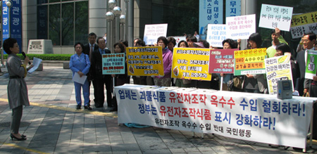
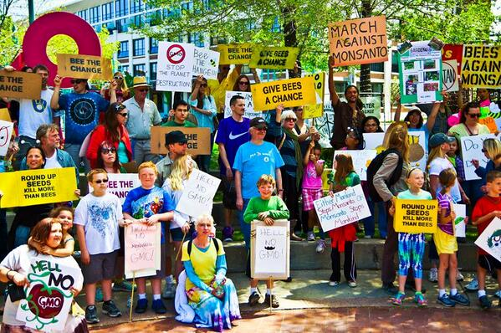
http://www.cacpk.org/report_view.php?kind_idx=15&cacpk_idx=1954&list_num=233&page=5
http://rt.com/news/161356-anti-gmo-monsanto-protest/

Slide 13
Irrigation:
Depletion of (underground) water & disturbance of water cycle
Subsidence
Poor salinity control & waste water management → water pollution & soil structure damage

Slide 14
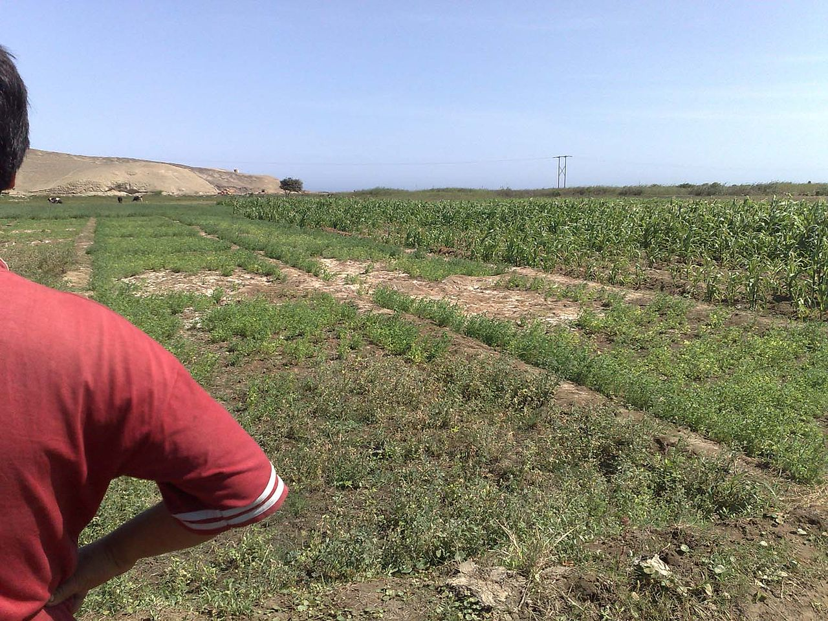
Looking over the shoulder of a Peruvian farmer in Huarmey delta at waterlogged and salinised irrigated land with poor crop stand. This illustrates an environmental impact of upstream irrigation developments causing an increased flow of groundwater to this lower lying area leading to the adverse conditions.
http://en.wikipedia.org/wiki/Environmental_impact_of_irrigation

Slide 15
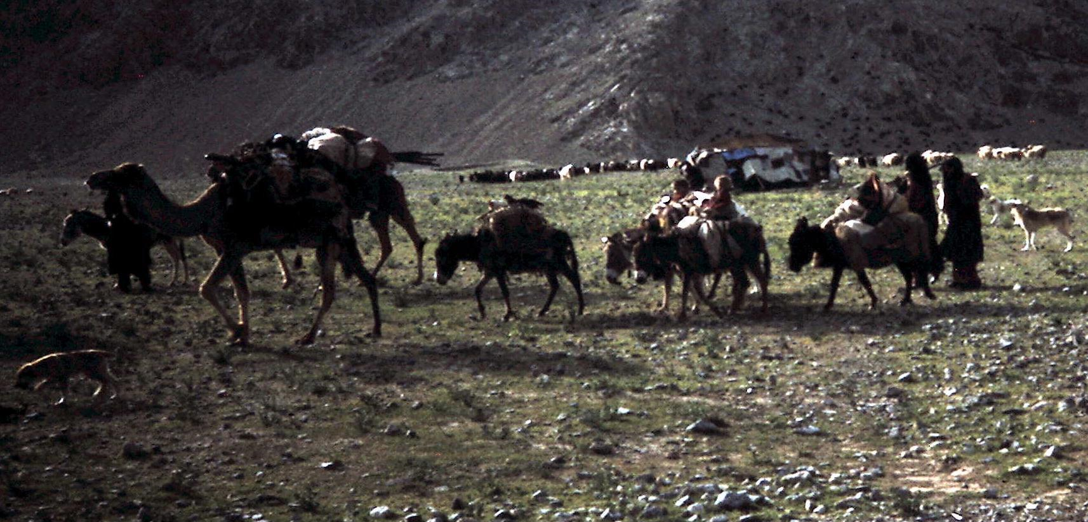
Water becomes scarce for nomadic pastoralist in Baluchistan due to new irrigation developments
http://en.wikipedia.org/wiki/Environmental_impact_of_irrigation

Slide 16
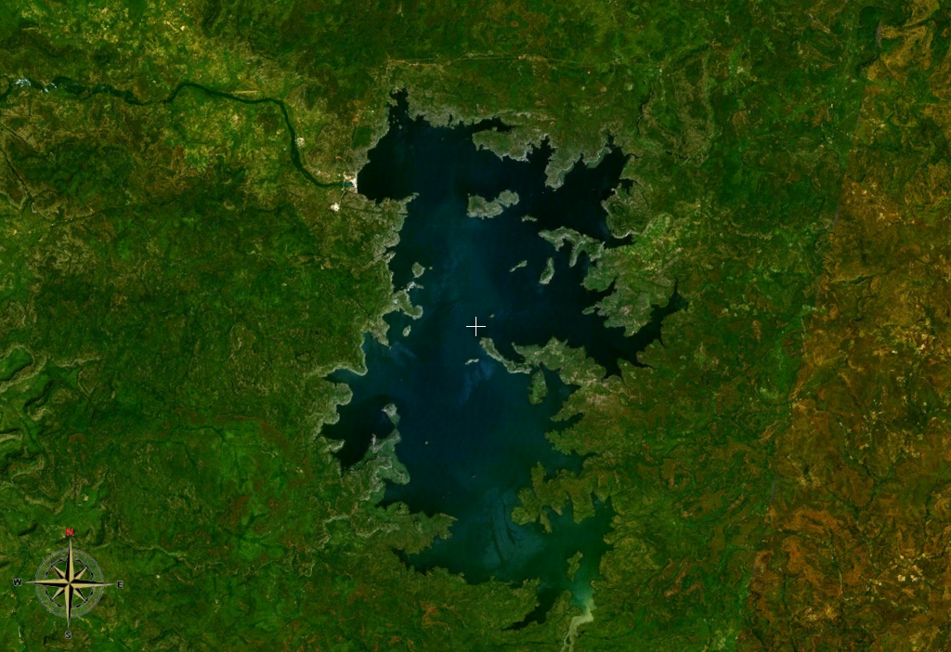
Lake Manantali (artificial lake in Mali), 477 km², displaced 12,000 people
http://en.wikipedia.org/wiki/Environmental_impact_of_irrigation

Slide 17
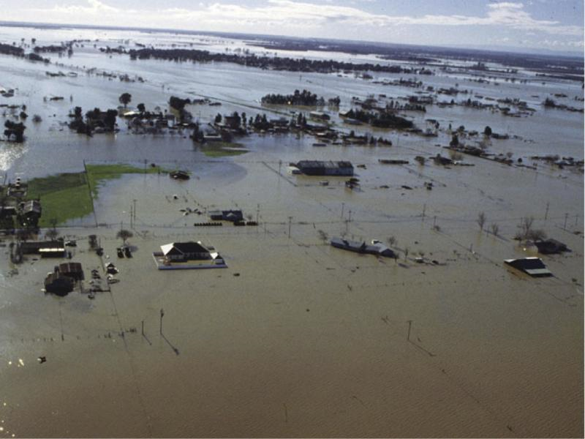
Flooding in 1997 along the Feather River in northern California
https://www.e-education.psu.edu/earth103/node/733

Slide 18
Pollutants: Typical non-point sources
Pesticides:
Fertilizers
Hormones
Growth agents
Manure
Indirect chemicals (eg. heavy metals)
Miscellaneous

Slide 19
Pesticides
Health effects
Irritation
Affecting the nervous system
Reproductive problems
Cancer
Environmental effects
Pesticide drift – suspended in the air & pollute other areas
Water and soil pollution
Reducing biodiversity
Biological deposition and magnification (esp. of Cl-organic pesticides)

Slide 20
Type of pesticide | Target pest group
Herbicides | Plant
Algicides or Algaecides | Algae
Avicides | Birds
Bactericides | Bacteria
Fungicides | Fungi and Oomycetes
Insecticides | Insects
Miticides or Acaricides | Mites
Molluscicides | Snails
Nematicides | Nematodes
Rodenticides | Rodents
Virucides | Viruses

Slide 21
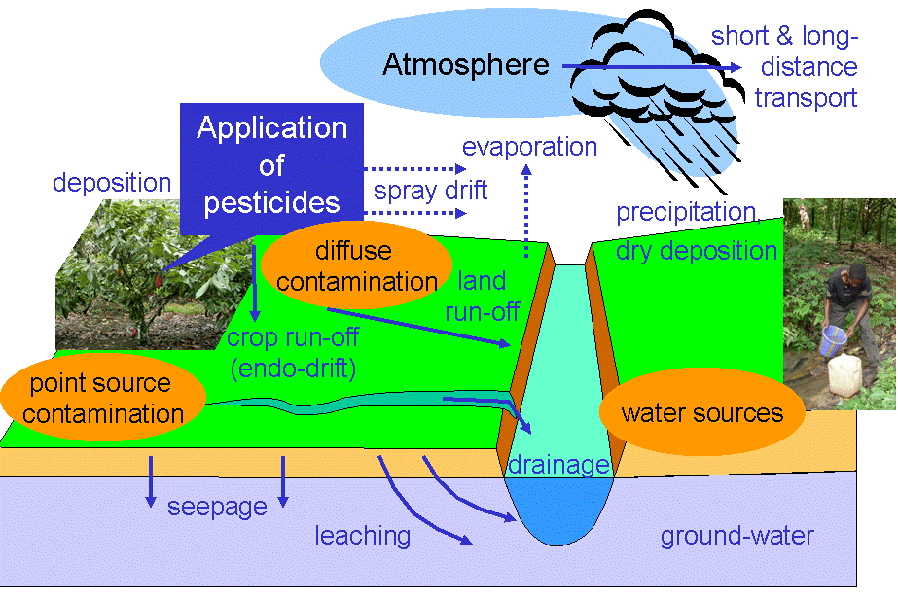
Pesticide pathways
http://en.wikipedia.org/wiki/Environmental_impact_of_pesticides

Slide 22
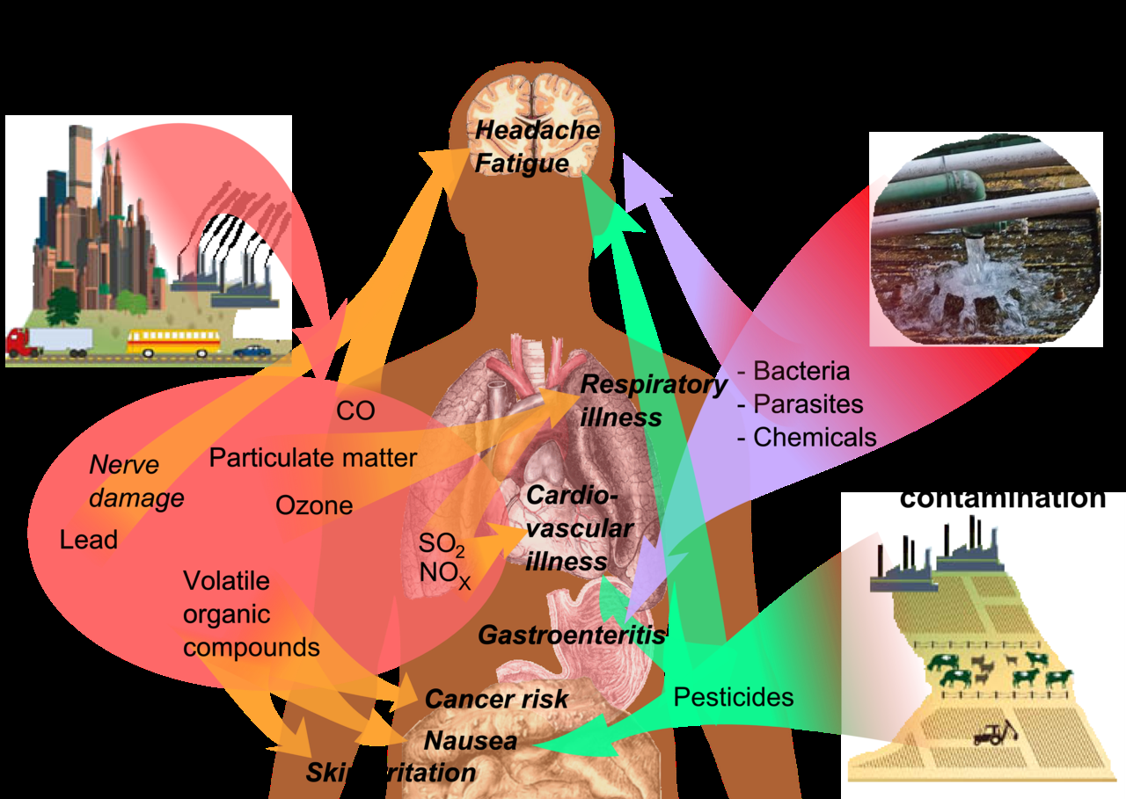
Air pollution
Water pollution
Soil
Contamination
Pesticides are implicated in a range of impacts on human health due to pollution
http://en.wikipedia.org/wiki/Environmental_impact_of_pesticides

