Slide 1
Ch.2.
Earth: The planet of water & life
From http://1.bp.blogspot.com/_Y9ucDp_oGA8/SAejGbW-_eI/AAAAAAAABjA/F3rAo_hX1vI/s1600-h/Sunset-on-Seascale-Beach.jpg

Slide 2
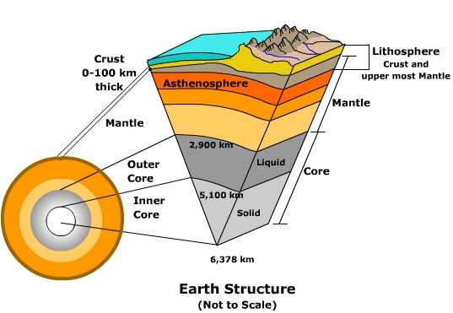
The Earth’s structure
From http://www.uwsp.edu/geo/faculty/ritter/glossary/a_d/asthenosphere.html

Slide 3
The Earth’s evolution
Origin: homogeneous vs. sequentially aggregated Earth
Origin of water and air : from self evolution vs. grabbing planetesimal/cometesimal
Appearance of life: abiotic spontaneous generation? Cosmogenic?
Oxygen
Present Earth

Slide 4
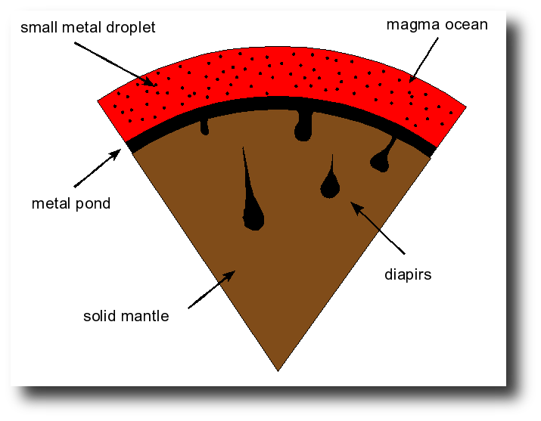
From http://geodynamics.rice.edu/tobias.hoeink/index.php?page=research

Slide 5
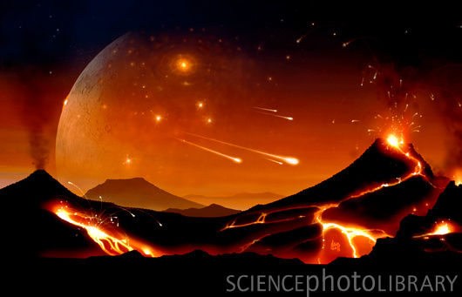
From http://www.sciencephoto.com/media/168543/enlarge

Slide 6
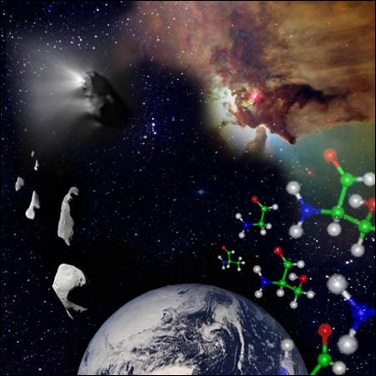
The origin of life?
Figure: Amino acids, the 'building blocks' of life, may form in dust grains in the space between the stars. (c) ESA 2002.
From http://www.astrobiologia.pl/eana/originoflife.html

Slide 7
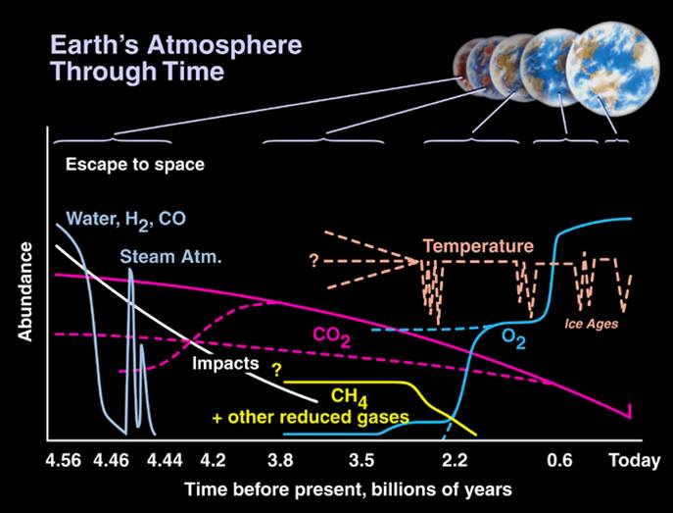
From http://www.astro.wisc.edu/~townsend/static.php?ref=diploma-9

Slide 8
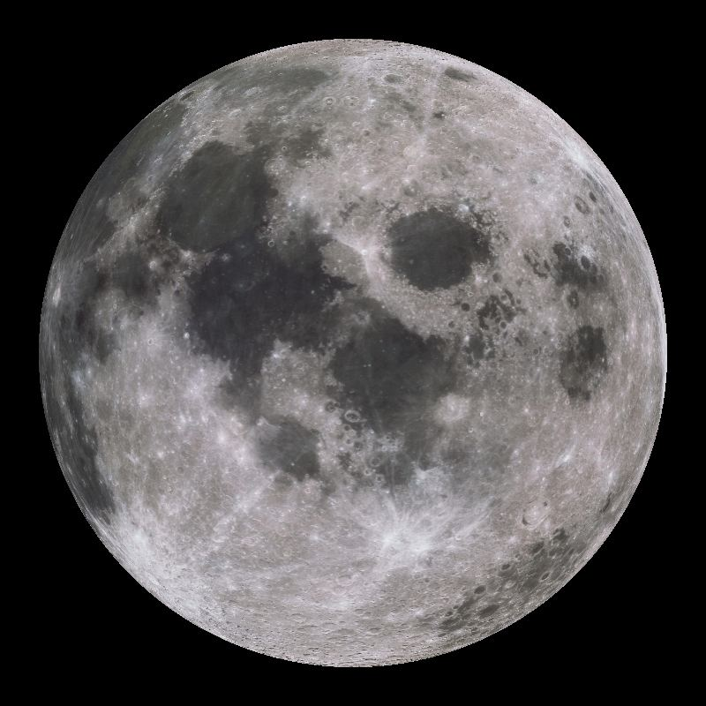
Ch.2.
Moon: The only satellite of the Earth
From http://sos.noaa.gov/datasets/solar_system/moon.html

Slide 9
The comparison of Moon with Earth
Earth Moon
Mean diameter 12,742 km 3,476 km
Volume 1.08321 x 10¹² km³ 2.199 x 10¹⁰ km³
Mass 5.9736 x 10²⁴ kg 7.349 x 10²² kg
Mean density 5.515 3.342
Surface gravity 9.78 m/s² 1.62 m/s²
Escape velocity 11.2 km/s 2.38 km/s
Visual albedo 0.367 0.12
Visual magnitude -3.86 +0.21

Slide 10
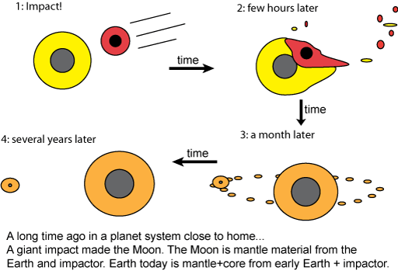
The hypotheses of the origin of the Moon
Fission
Capture
Co-accretion
Gigantic impact
From http://www.astronomynotes.com/solarsys/s13.htm

