Slide 1
Ch.2. Tracing the Hydrological Cycle
Craig’s meteroic relationship in global fresh water
δD = 8δ¹⁸O + 10 ‰ SMOW (Craig, 1961)
From IAEA-GNIP
δD = 8.13δ¹⁸O + 10.8 ‰ VSMOW

Slide 2
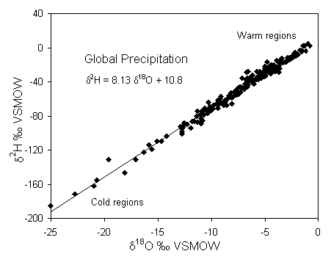

Slide 3
Partitioning of isotopes through the hydrological cycle
Isotopic composition of ocean waters
The early oceans were isotopically depleted and warmer than today → gradually enriched through Proterozoic and Phanerozoic time by exchange with isotopically enriched crustal rocks
The isotopic composition varies with
Salinity (evaporation)
Dilution by runoff
Ice melting (glacier retreat) etc.
See Fig. 2-2 & 2-3 on p.38.

Slide 4
The atmosphere & vapour mass formation
The troposphere contains more than 90% mass (very little vapour circulates to the stratosphere)
The greatest supply (>70%) of vapor to the troposphere is from evaporation over the warm subtropical seas (Fig. 2-4 on p. 39)

Slide 5
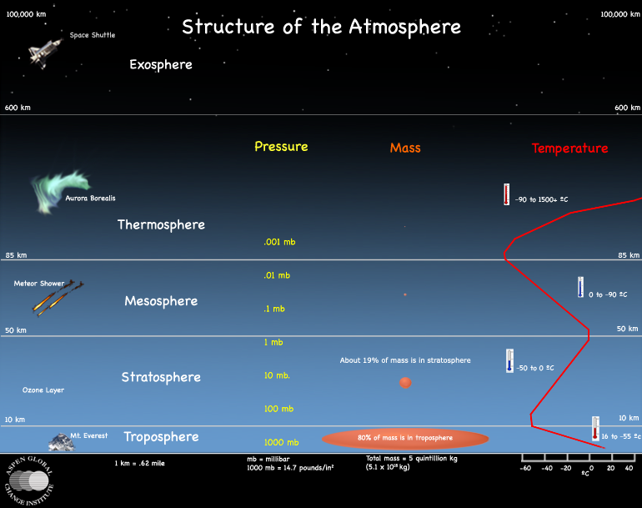
From http://www.agci.org/classroom/atmosphere/index.php

Slide 6
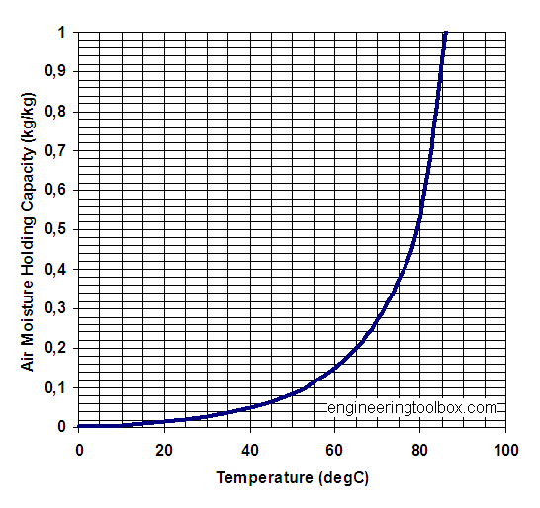
From http://www.engineeringtoolbox.com/moisture-holding-capacity-air-d_281.html

Slide 7
Isotopic equilibrium in water-vapor exchange
For an equlibrium evaporation at 25ºC,
δ¹⁸O_{v}=δ¹⁸O_{w} + ε¹⁸O_{v-w}=0 + (-9.3)=-9.3 ‰
δD_{v}=δD_{w} + εD_{v-w}=0 + (-76)=-76 ‰
See Fig. 2-5 on p.40.

Slide 8
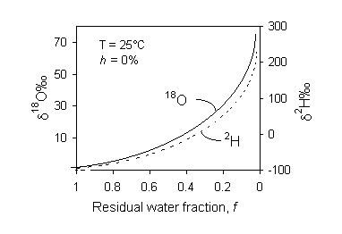
Humidity & kinetic evaporation
Fig. 2-2 Enrichment of ¹⁸O and ²H in distilled water during evaporation of water under controlled conditions. Humidity h is 0% and temperature is 25&deg;C. As the fraction of water remaining approaches 0, a Rayleigh distillation causes an exponential increase in the heavy isotopes. Under conditions of increasing humidity, exchange with the vapour phase reduces the exponential enrichment. Under conditions of high humidity, a steady state value is reached due to complete exchange with the vapour mass.

Slide 9
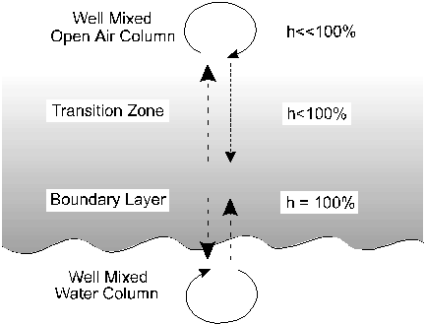
Model for nonequilibrium evaporation over a water body. Arrows indicate relative fluxes of water between the mixed water column and the boundary layer, and between the boundary layer and the well mixed air column. Differences in the rate of diffusion of ¹⁸O to ¹⁶O and ²H to ¹H impart a "kinetic" isotope depletion in the overlying air column.

Slide 10
The maximum kinetic enrichment that this diffusive effect can impart is calculated from our formula for diffusive fractionation of a gas in air (Chapter 1). In this case it is calculated for ¹⁸O in H₂O_{v} from the boundary layer (bl) to the vapour reservoir of the open air water vapour (v):
Using the molecular mass of H₂¹⁸O (20), H₂¹⁶O (18), and air (m_{air} = 28.8 for 79% N₂ and 21% O₂), gives De¹⁸O_{bl-v} = 1.0323.
Δε¹⁸O_{bl-v} = (α¹⁸O_{bl-v} – 1) · 10³ = 32.3‰
Similarly, ²H in the water vapour would be depleted by a maximum of:
ΔεD_{bl-v} = (αD_{bl-v} – 1) · 10³ = 16.6‰

Slide 11
Kinetic effects in terms of humidity (Gonfiantini, 1986)
Δε¹⁸O_{bl-v} = 14.2 (1–h) ‰
ΔεD_{bl-v} = 12.5 (1–h) ‰
The total fractionation between the water column and the open air is then the sum of the fractionation factor for equilibrium water-vapour exchange (ε_{l-v}) and the kinetic factor (Δε_{bl-v})
δ¹⁸O_{l} – δ¹⁸O_{v} = ε¹⁸O_{l-v} + Δε¹⁸O_{bl-v}

Slide 12
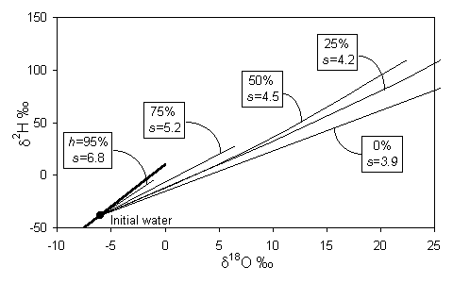
Isotopic enrichment in evaporating water and the effect of humidity. Slopes are approximations of early portion of each curve near the GMWL (heavy line) (modified from Gonfiantini, 1986

Slide 13
Deuterium excess “d” in meteoric water
See Fig, 2-9. & 2-10 on p. 44
Dansgard (1964):
d= δD-8δ¹⁸O
See Fig. 2-11 & Table 2-6. on p. 45

Slide 14
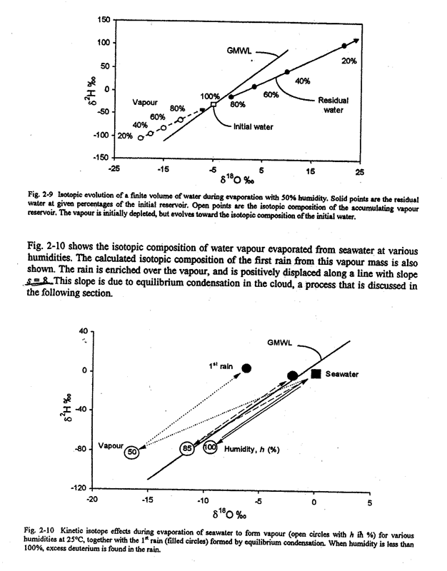

Slide 15
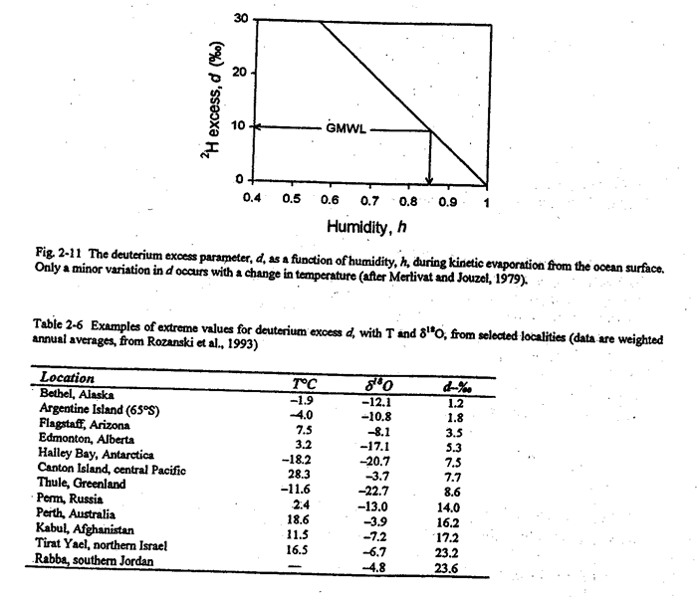

Slide 16
Atmospheric mixing and global atmospheric water vapor
Craig & Gorden (1965): mean isotopic composition of global precipitation
δ¹⁸O=-4‰ , δD=-22‰

Slide 17
