Slide 1
Ch.1. The Environmental Isotopes
What is isotopes?
ISO (same) + TOPE (position)
Elements having same no of proton (Z), but different no of neutron (N)
The same elements with different masses (A)
^{A}_{Z}E_{N} (¹⁸₈O₁₀) → Or smiply ^{A}E (¹⁸O) .

Slide 2
Types of isotopes
Stable
Unstable
Radiogenic
Heavy
Light
Nontraditional stable
Isotones & isobars ?

Slide 3
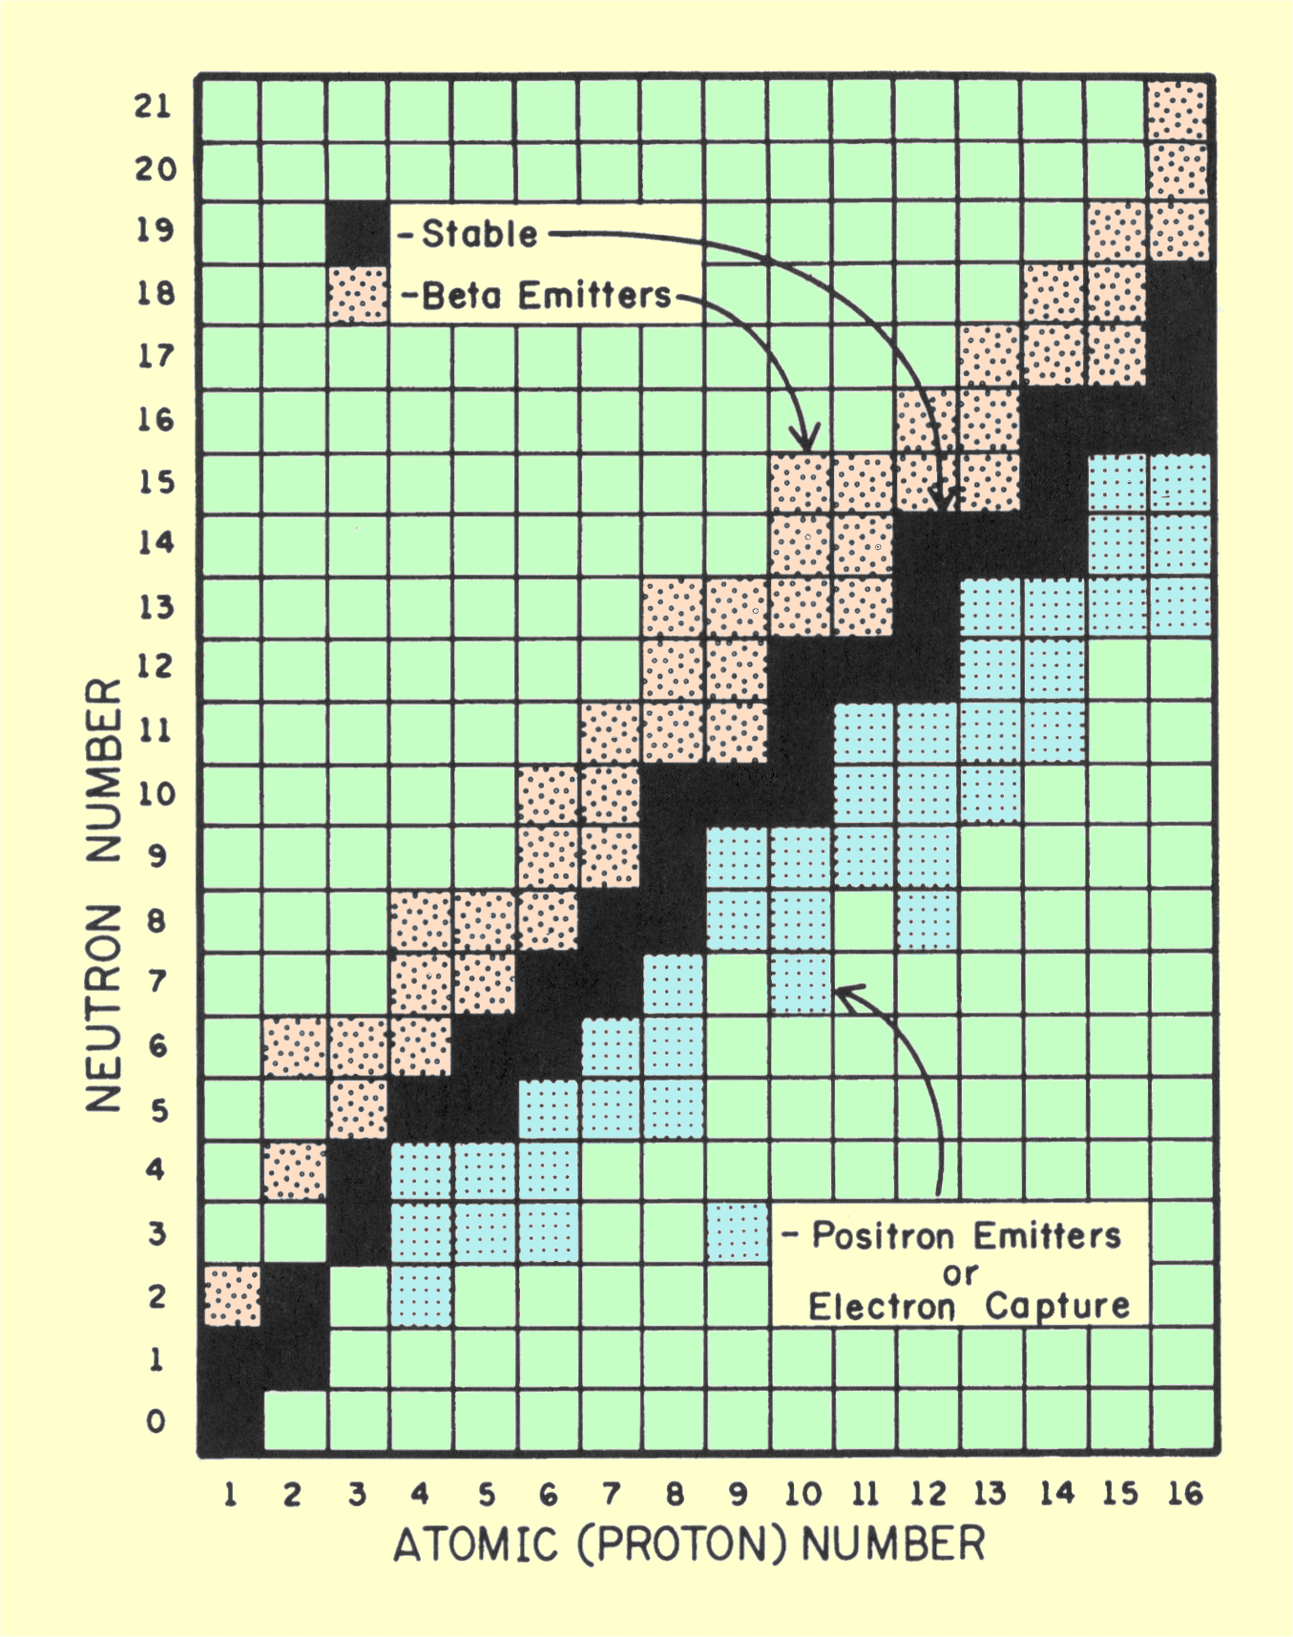
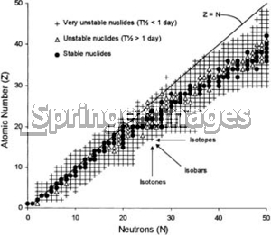
Plot of Z vs. N for nuclides up to tin (Z = 50) showing the’ stable valley’ of the nuclides.
See Fig. 1-1 on p.3
From
www.sprawls.org/ppmi2/RADIOTRANS/

Slide 4
Magic number of neutron? (2, 8, 28, 50, 82, 126)
What is environmental isotopes?
The isotopes used in the environmental studies (in the text, especially for the environmental hydrogeological studies)

Slide 5
Significance of environmental isotopes (in hydrogeology)?
Trace groundwater provenance
Estimate groundwater age
Interpretation of groundwater quality
Understanding geochemical evolution (reactions and reaction rates) and recharge processes
Recognizing geochemical & biogeochemical cycles of pollutants among soil-water-atmosphere

Slide 6
How to express isotopic compositions?
δ = (R_{sample}-R_{std})/R_{std} * 1,000 (‰)
Where R=(heavier isotope)/(lighter isotope)
Example:
δ¹⁸Ο = {(¹⁸O/¹⁶O)_{sample} - (¹⁸O/¹⁶O)_{std} }/ {(¹⁸O/¹⁶O)_{std} *1,000
See Table 1-1 on p.6 for the commonly used stable environmental isotopes

Slide 7
Stable isotope standards and measurements
Also See Table 1-1 on p.6.
Discuss
The expression of each isotopic compositions
Standard materials for different isotopes
Preparation for the measurements (extraction methods)
Read from p.7 to p.13

Slide 8
Isotope ratio mass spectrometry (IRMS)
See Fig. 1-4 on p.14
Discuss
The basic instrumentation of mass spectrometer
What would be the advantage of ratio mass
How does the carrier gas He (continuous flow inlet) improve the system
What kind of interface would be possible for the smple inlet (front end) (for example Elemental analyzer or laser ablation)

Slide 9
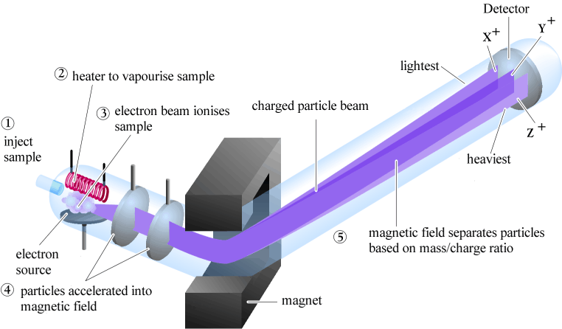
General Instrumentation of Mass Spectrometer (TIMS)
From http://www.mhhe.com/physsci/chemistry/carey/student/olc/ch13ms.html

Slide 10
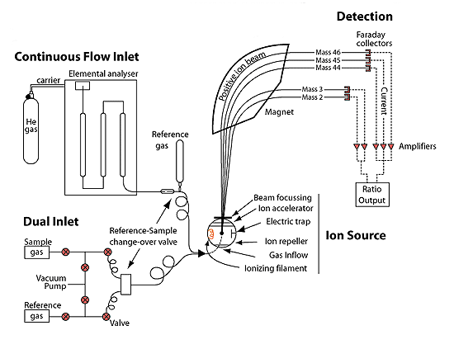
General Instrumentation of Isotope Ratio Mass Spectrometer
From http://web.sahra.arizona.edu/programs/isotopes/methods/gas.html

Slide 11
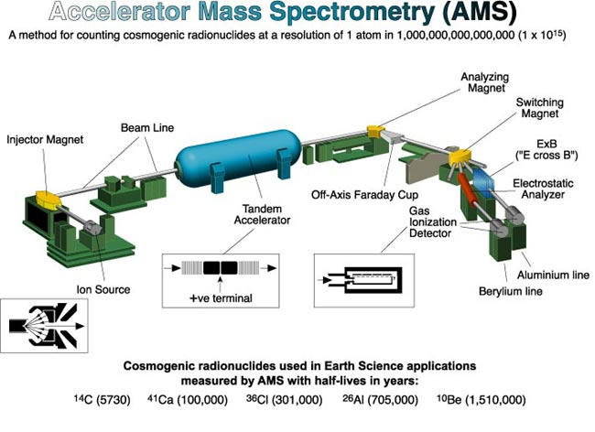
Typical Instrumentation of Accelerator Mass Spectrometer
From http://web2.ges.gla.ac.uk/~dfabel/AMS/AMS_schematic.html

