Slide 1
Ch.4.
Other (Atmospheric) Environmental Problems Due to Fossil Fuels
Urban ozone
Particulates in air pollution (Fly ash)
Others in troposphere

Slide 2
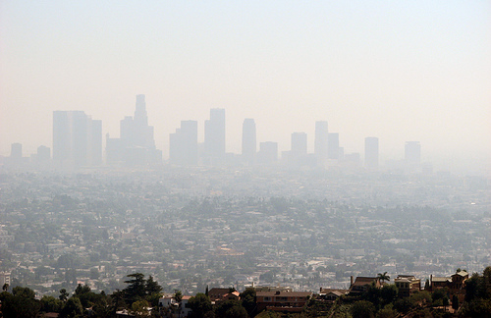
Urban ozone
VOC + NO* + sunlight → mixture of O3, HNO3, organics
Primary polllutants → secondary pollutants
From http://frontpagemag.com/2010/01/13/politicizing-smog-by-rich-trzupek/
Urban smog causing ozone

Slide 3
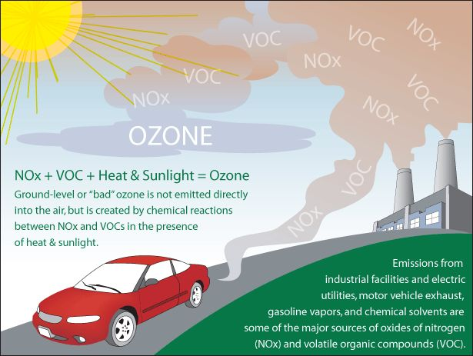
From http://www.kdheks.gov/bar/air-monitor/ozone.jpg

Slide 4
Health effects of urban ozone
Irritation of the respiratory system , causing coughing, throat irritation, and/or an uncomfortable sensation in the chest.
Reduced lung function, making it more difficult to breathe deeply and vigorously
Aggravation of asthma
Increased susceptibility to respiratory infections
Inflammation and damage to the lining of the lungs
Maximum allowable level of O3
ROK: 0.06 ppm average for 8 hrs, 0.1 ppm average for 1 hr.
USA: 0.12 ppm average for 1 hr
Canada: 0.08 ppm average for 1hr
WHO: 0.1 ppm vaerage for 1 hr.

Slide 5
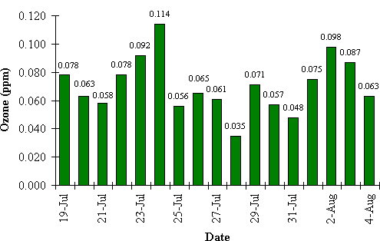
Daily Peak Ozone Concentrations in Atlanta July 19 - August 4, 1996
From http://www.air.dnr.state.ga.us/tmp/olympic_ozone/index.html

Slide 6
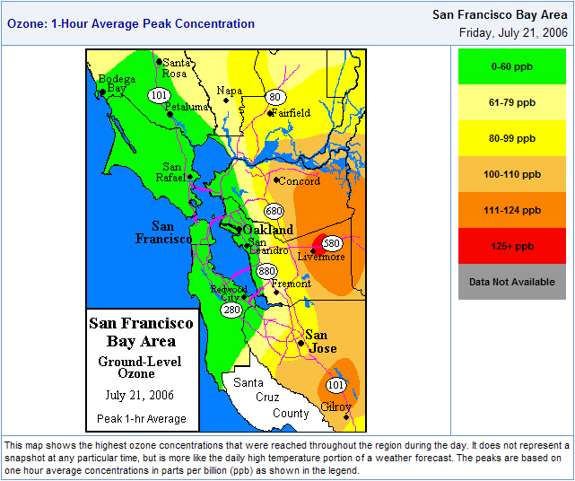
From http://www.edunewz.com/2007_07_21_archive.html

Slide 7
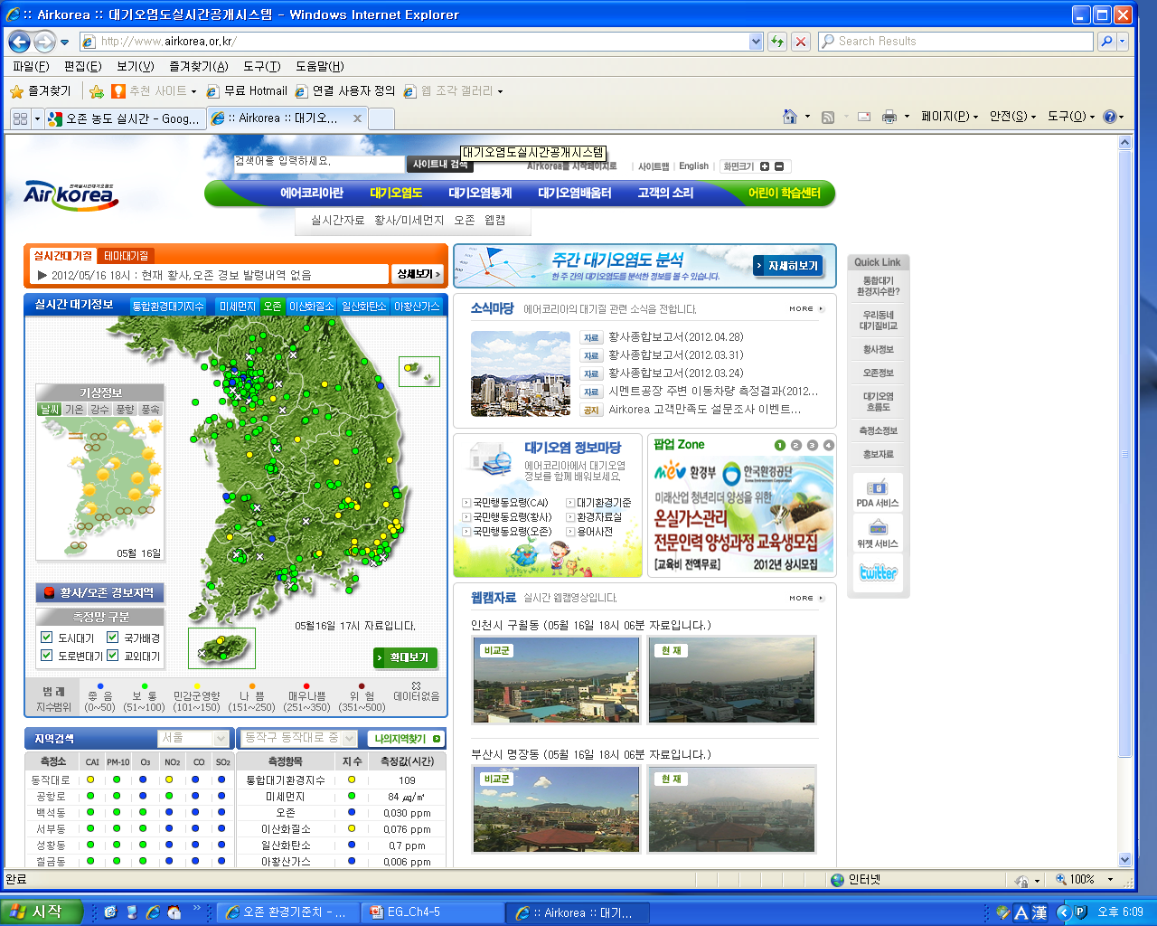

Slide 8
Particulates in air pollution
Solids (dust, soot), liquids (mist, fog)
Sizes of particles
Fine: < 2.5 μm
Coarse : > 2.5 μm
TSP (total suspended particulates) → common air quality standard; < 75μg/m³.
PM₁₀: Particulate matter w/ diameter less than 10μm → now more commonly used criteria
150 μg/m³ (USA)
50 μg/m³ (annual average)
100 μg/m³ (daily avergae) (ROK)

Slide 9
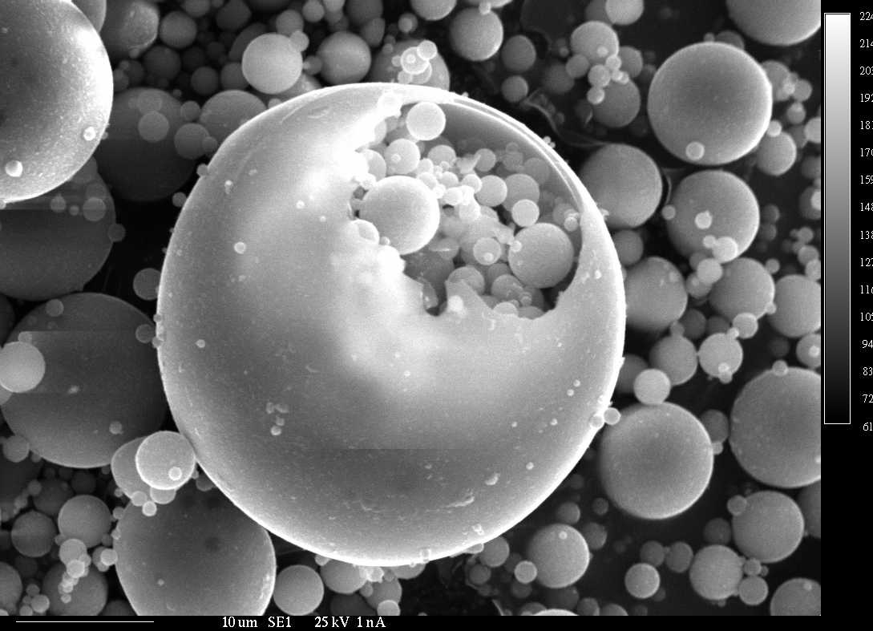
Fly ashes
Very fine grained mineral ashes
Commonly produced from cal burning
Has higher conc. of a few toxic metals
Now most of them collected and processed
From http://geoinfo.nmt.edu/staff/hoffman/flyash.html

Slide 10
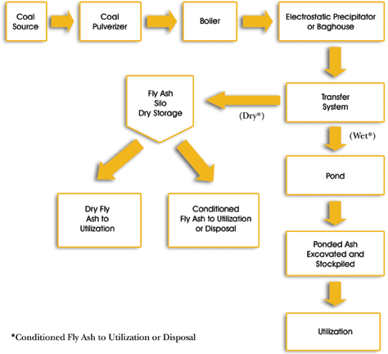
Method of fly ash transfer can be dry, wet, or both.
From http://www.fhwa.dot.gov/pavement/recycling/fach01.cfm

Slide 11
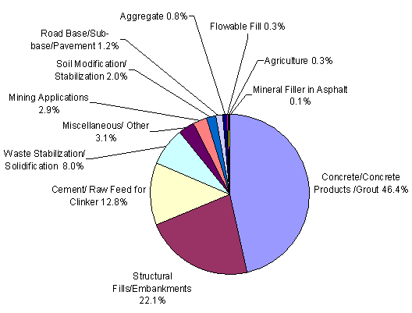
Common application of fly ash
From http://www.rmrc.unh.edu/tools/uguidelines/cfa51.asp

