Slide 1
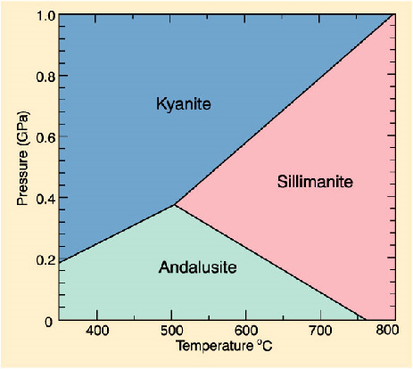
A
C
B
For the three points A, B, and C,
What are the existing phases & number of them
Calculate the degrees of freedom
What mineral do you expect from a contact metamorphic rock? Reasons?
If your thinsection has all the three phases stably coexisting, what are the temperature and pressure condition the rock experienced?

