Slide 1
How to reduce atmospheric CO₂?
Reduce consumption of energy (production of CO₂)
Using alternative energy/renewable energy (changing in energy mix)
Enhance the energy efficiency
Development of technology
Change in individual’s action
Remove CO₂ from atmosphere (sequestration, capture & storage (CCS))
Geological storage
Ocean storage
Mineral carbonation
Biomass & soil

Slide 2
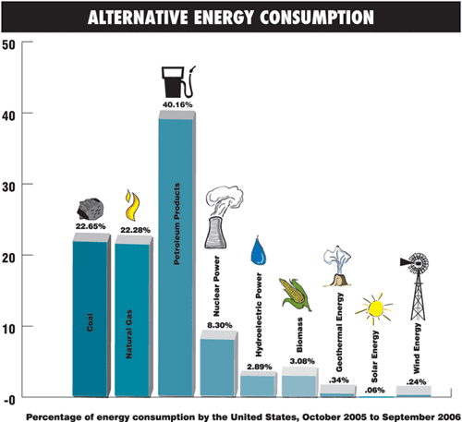
From http://alternative-energy-bulletin.tripod.com/

Slide 3
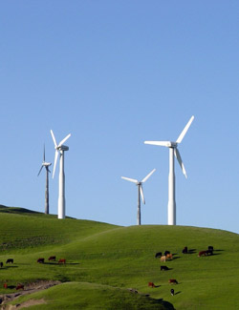
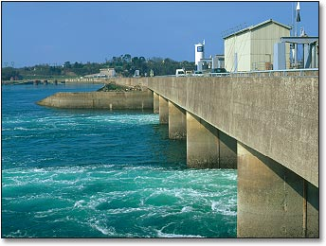
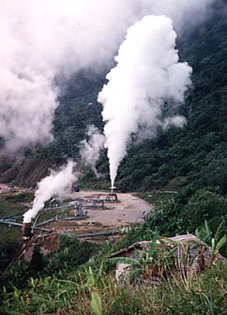
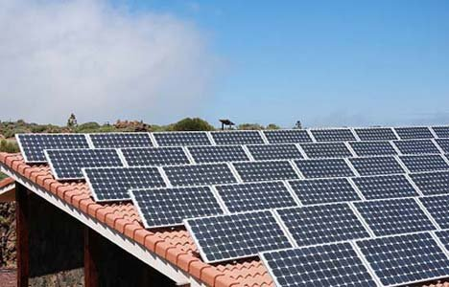
Renewable
Energies

Slide 4
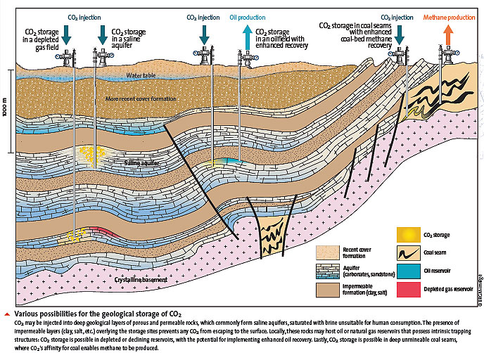
Geological storage of carbon dioxide
http://www.brgm.fr/brgm/CO2-en/images/stockco2_schema.jpg

Slide 5
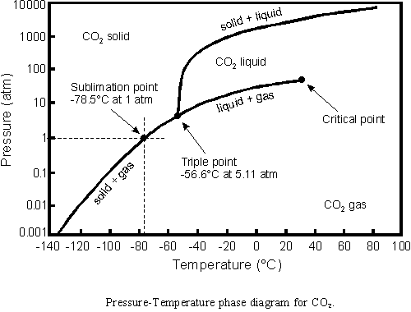
Phase diagram of CO₂
From http://stevengoddard.wordpress.com/2010/09/05/the-freezing-point-and-the-dew%C2%A0point-part-2/

Slide 6
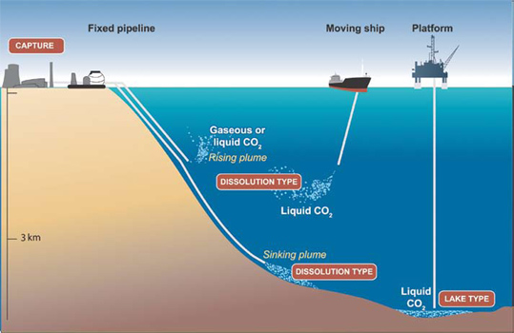
Ocean Storage of carbon dioxide
From http://www.global-greenhouse-warming.com/marine-ccs.html

Slide 7
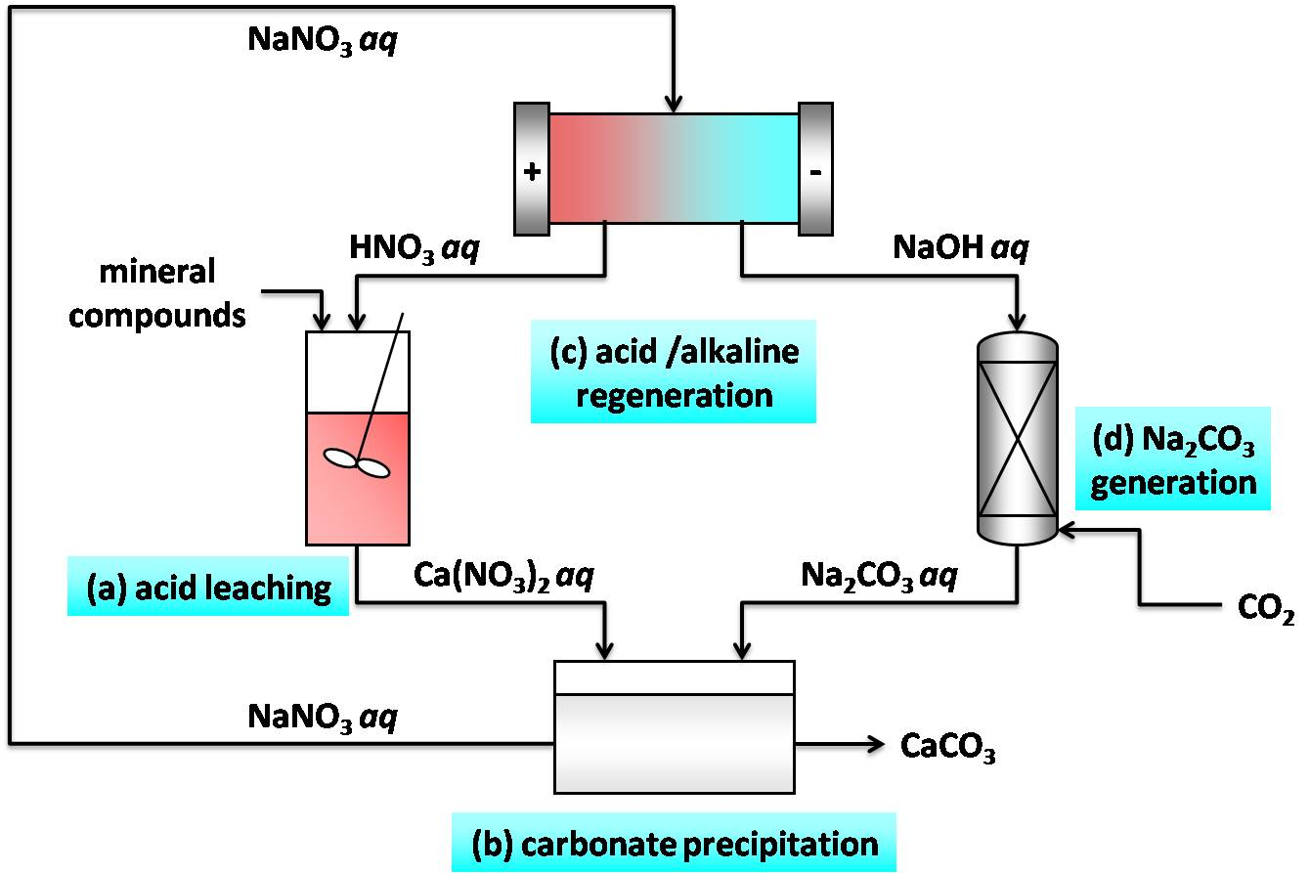
Mineral carbonation
From http://aicheproceedings.org

Slide 8
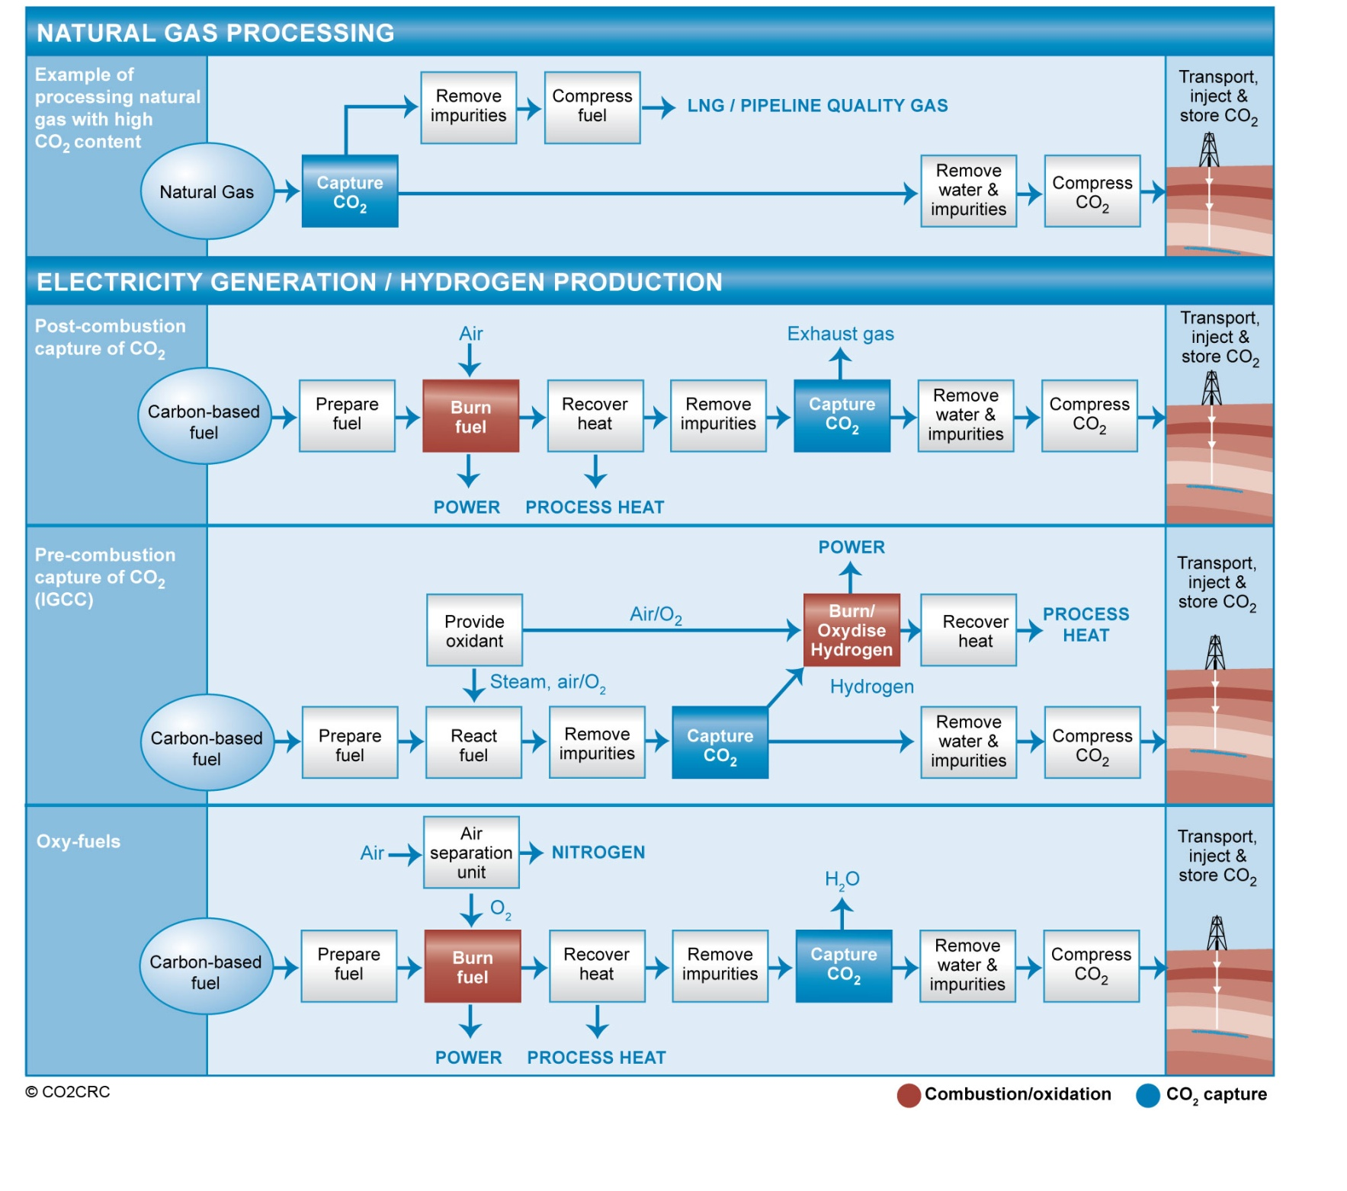
From http://www.co2crc.com.au/images/imagelibrary/cap_diag/Captureprocesses_media.jpg

