Slide 1
188042 AQUEOUS GEOCHEMISTRY
Jae-Young Yu
Dept. Geology
Kangwon Nat’l Univ.

Slide 2
Course Information
Professor:
Jae-Young Yu
Natural Science Building 3-212
Ext. 8557
E-mail: jyu@kangwon.ac.kr
Web: http://www.korearth.net
Office hrs: Students can visit anytime
whenever he is in.

Slide 3
Text Book
Aqueous Environmental Geochemistry,
D. Langmuir, 1997
Prentice Hall
Suppl. Book (optional)
Aquatic Chemistry, 3rd Ed.
W. Stumm and J.J. Morgan, 1996
Wiley

Slide 4
Objectives
Helping understand the chemical processes occuring in low-temperature geoenvironment associated with water
Grading
A+ - D0
Mid. E.(30%), Final E. (30%), Reports (30%), Attendance (10%)
Absence more than 1/3 brings ‘F’

Slide 5
Prerequisites
Undergraduate level inorganic geochemistry
Mineralogy
(Other geological & geochemical courses will definitely help)

Slide 6
Lecture Schedule
Week # | Contents
1 | Definition & application of aqueous geochemsitry
2 | Thermodynamics for aqueous geochemists I
3 | Thermodynamics for aqueous geochemists II
4 | Equilibrium vs. kinetic modeling
5 | Acids & bases: Definitions, pH, and Carbonic acids
6 | Acids & bases: Acidity, alkalinity, and buffer capacity
7 | Complexes: Classification
8 | Midterm examination
9 | Complexes: Models & Stability
10 | Carbonate geochemistry
11 | Silica geochemistry
12 | Aluminum geochemistry
13 | Redox equilibria & Iron geochemistry
14 | Sorptions
15 | Final examination

Slide 7
Ch.1. INTRODUCTION
Definition
Aqueous Geochemistry =
AQUA (water) +
GAIA (earth) +
Chemistry
A field of geochemistry dealing w/ (studying ) the phenomena & materials involved in water-related processes in the system Earth (or Earth-like planet), esp, in a low P-T condition

Slide 8
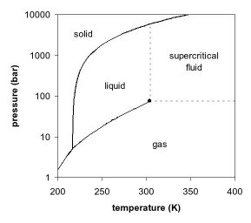
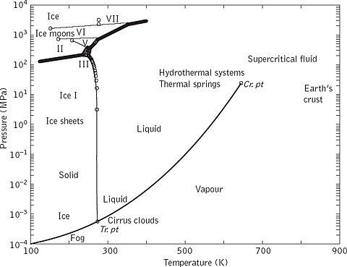
How low is low?
http://mathmodelingfall2007.pbworks.com/w/page/20545446/Week-Two-Questions
http://science.jrank.org/pages/48260/water-water-types.html

Slide 9
Applications
Management of Water Resources
Exploration of ore bodies
Pollution from the mines (AMD, ARD problems)
Problems in utilizing gethermal energy
Wastes and wastewater treatment/deposit
Urbanization & land use problems
Groundwater studies
Acid rains and other air pollution problems
Others

