Slide 1
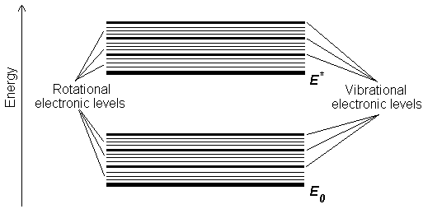
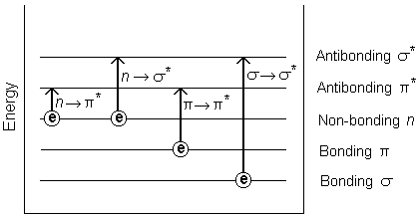
Ch. 6. 분광분석(SPECTROSCOPY)
Electronic transitions – UV-VIS region
Transitions involving p, s, and n electrons
Transitions involving charge-transfer electrons
Transitions involving d and f electrons (not covered in this Unit)

Slide 2
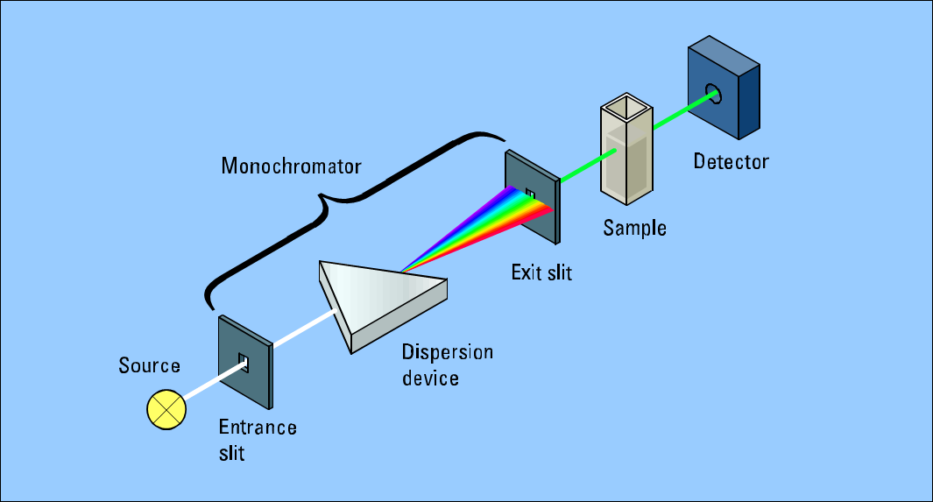
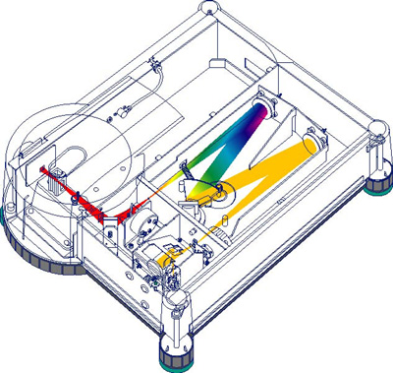
Ch. 6. 분광분석(SPECTROSCOPY)
UV-VIS 분광기 (Spectrometer)
http://faculty.sdmiramar.edu/fgarces/LabMatters/Instruments/UV_Vis/Cary50.htm

Slide 3
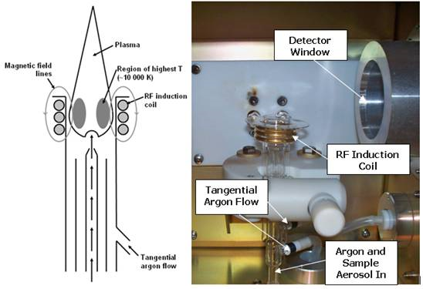
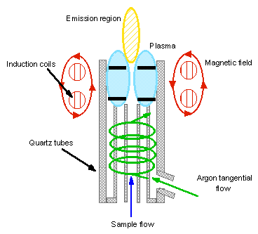
ICP-AES (Inductively coupled plasma-atomic emission spectromter)
http://www.chemistry.nmsu.edu/Instrumentation/NMSU_Optima2100.html
http://wwwp.cord.edu/dept/chemistry/analyticallabmanual/experiments/icpaes/intro.html

Slide 4
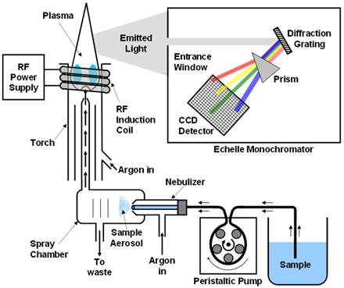
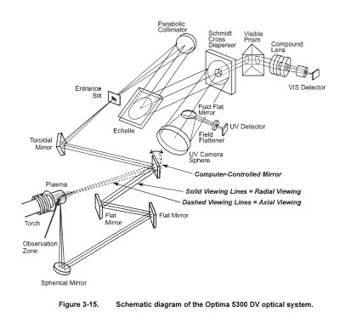
http://www.personal.psu.edu/hxg3/MCL/icpaes.htm

Slide 5
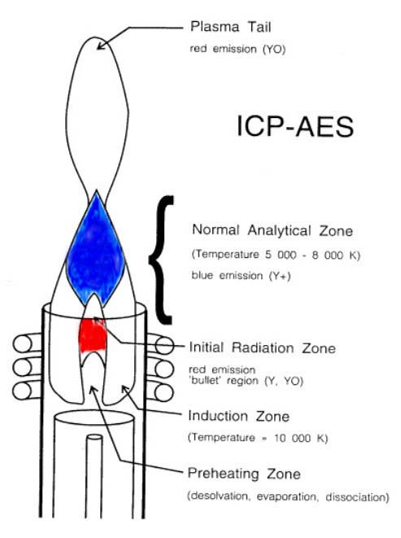
http://www.chemistry.nmsu.edu/Instrumentation/NMSU_Optima2100.html

Slide 6
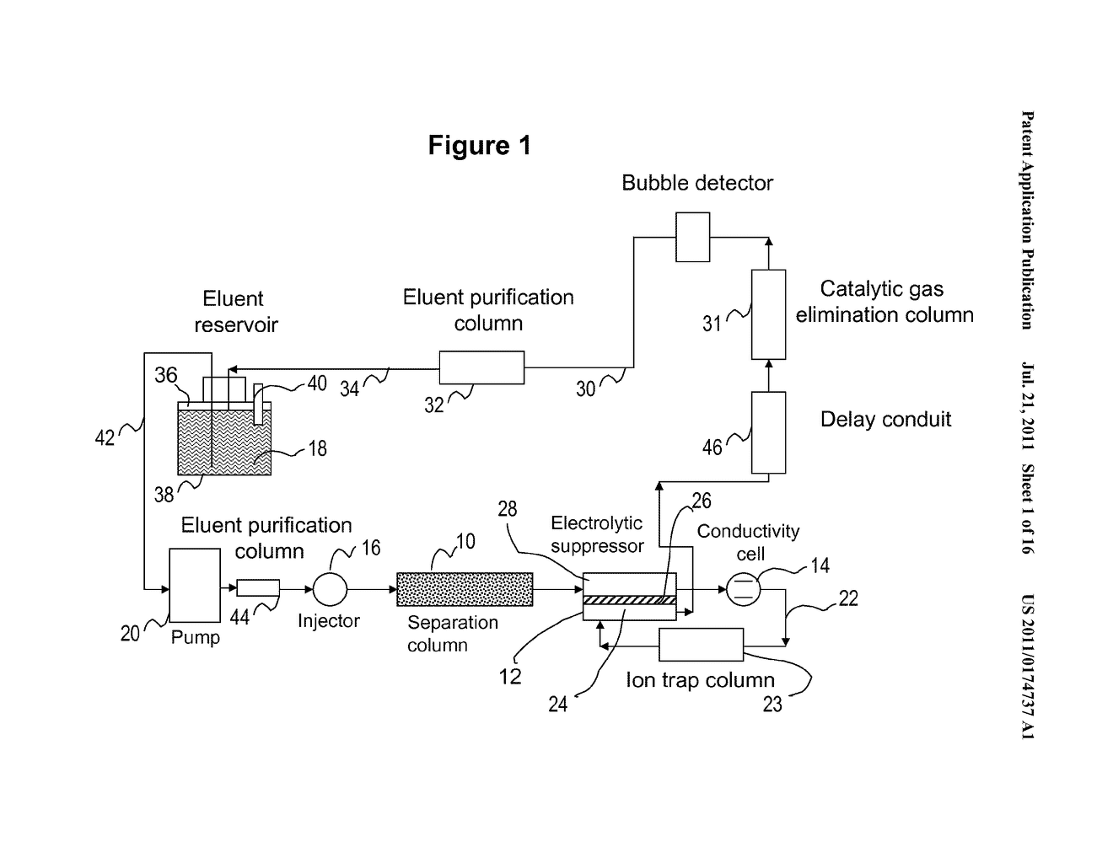
IC (Ion chromatograph)
http://www.faqs.org/patents/imgfull/20110174737_02

Slide 7
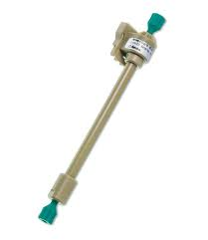
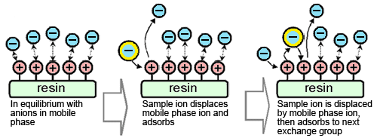
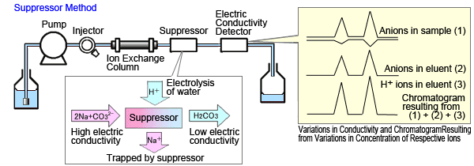
http://www.shimadzu.com/an/hplc/support/lib/lctalk/64intro.html

