Slide 1
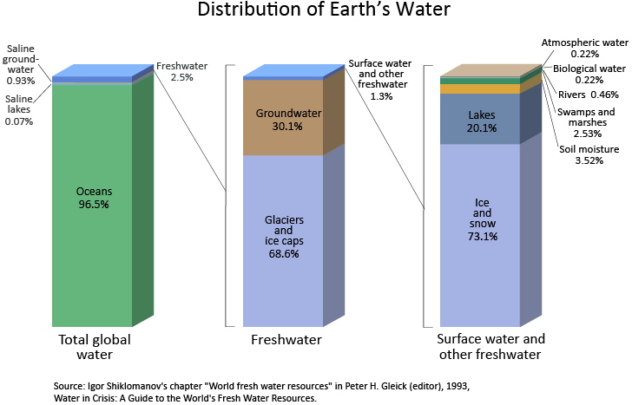
Ch.2.
Hydrosphere: System of water on Earth
From http://ga.water.usgs.gov/edu/earthwherewater.html

Slide 2
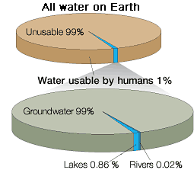
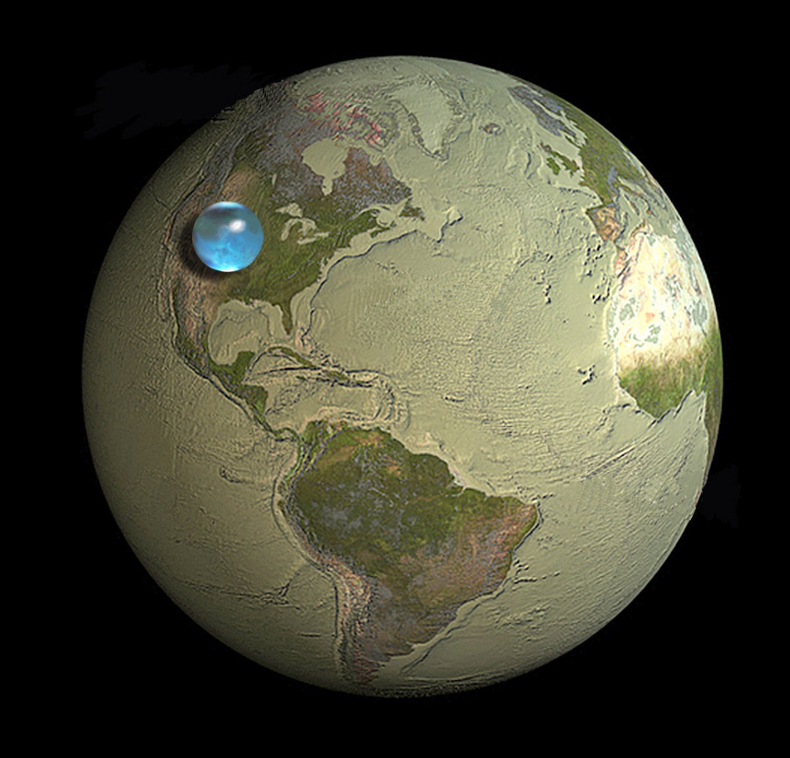
Picture of Earth showing if all Earth's water (liquid, ice, freshwater, saline) was put into a sphere it would be about 860 miles (about 1,385 kilometers) in diameter. Diameter would be about the distance from Salt Lake City, Utah to Topeka, Kansas, USA. Credit: Illustration by Jack Cook, Woods Hole Oceanographic Institution; USGS.
From http://ga.water.usgs.gov/edu/earthwherewater.html

Slide 3
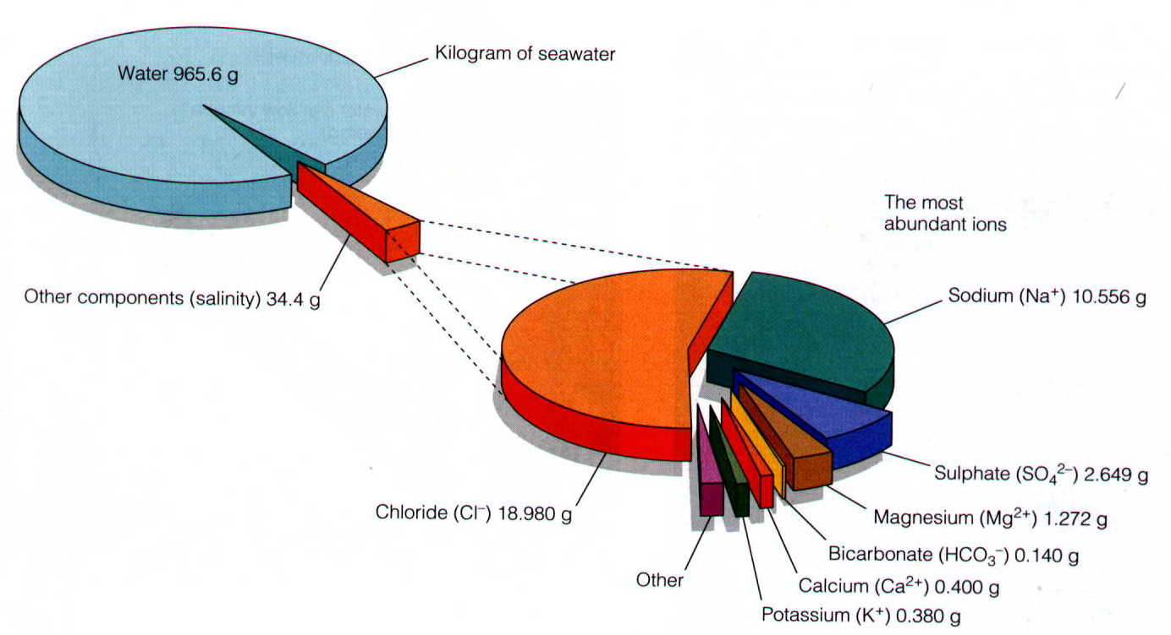
Chemical composition of seawater
From http://earth.usc.edu/classes/geol150/stott/variability/deepocean.html

Slide 4
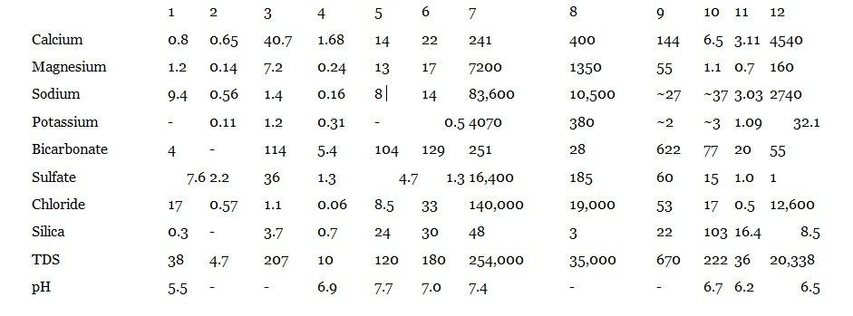
Comparison of the water compositions
Key to Analyses: (1) Rainwater from Menlo Park, California; (2) Average rainwater from sites in North Carolina and Virginia; (3) Composition of the Rhine River as it leaves the Alps; (4) Stream draining igneous rocks in the Washington Cascades; (5) Jump-Off Joe Creek, southwestern Oregon, wet season, November, 1990; (6) Jump-Off Joe Creek, southwestern Oregon, dry season, September, 1991; (7) Great Salt Lake, Utah; (8) Average seawater; (9) Groundwater from limestone of the Supai Formation, Grand Canyon; (10) Groundwater from volcanic rocks, New Mexico; (11) Groundwater from a spring, Sierra Nevada Mountains: short residence time; (12) Groundwater from metamorphic rocks in Canada: long residence time.

Slide 5
Significance of water on Earth
Climate modulator (keeps the temperature mild, hindering from the extreme change)
Essential constituent of Life
One of the natural resources we must have
Involved in almost every (geochemical) processes on surface

Slide 6
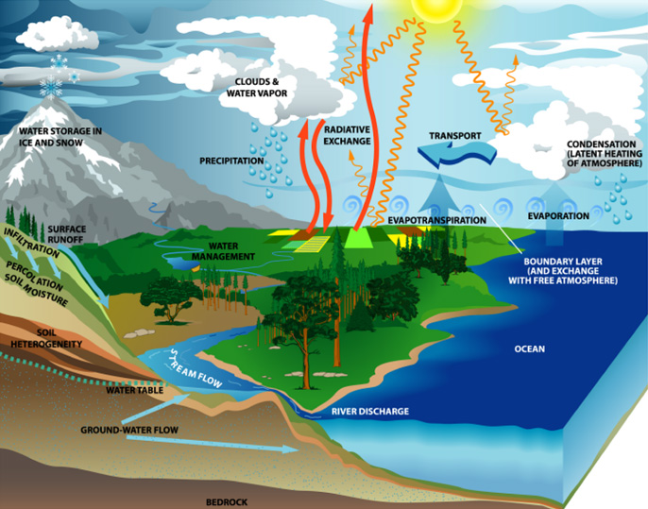
Water & Climate
From http://www.mnforsustain.org/water_climate_global_water_cycle_study.htm

Slide 7
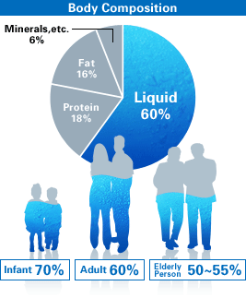
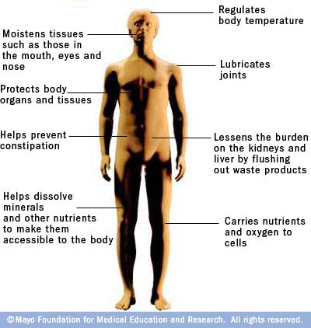
Water in our body and it’s functions
From http://www.waterevolution.co/2011/functions-of-water-in-the-body/
From http://reminiscentray.tumblr.com/

Slide 8
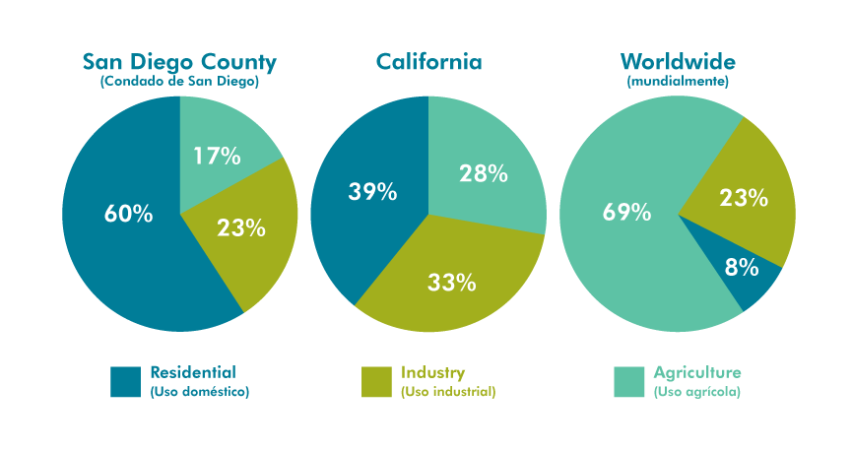
Water Usage
2010?
From http://www.wrsc.org/attach_image/water-usage-san-diego-compared-california-and-rest-world

Slide 9
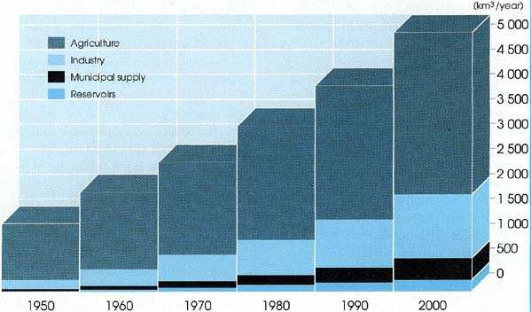
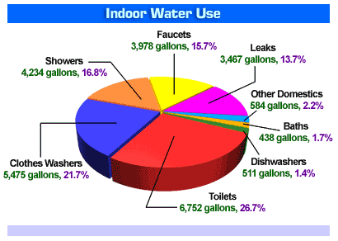
World water consumption
From http://www.fao.org/docrep/003/t0800e/t0800e0a.htm
From http://www.mrbobs.com/septic-services/water-usage-chart/

Slide 10
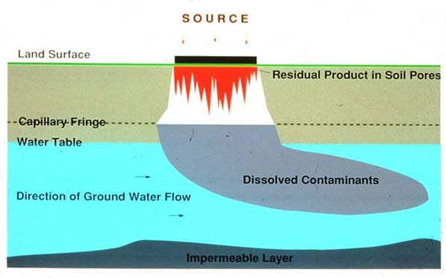
Contaminant migration in groundwater
From http://www.wesleyan.edu/ctgeology/GroundwaterPollution/GroundwaterPollution.html

