Slide 1
Environmental (Health) Hazards
1C, Strabo & Pliny recognized lung problems among the slaves working on asbestos weaving
Pliny advised not to buy the slaves working on asbestos because of their early death
1897, A doctor diagnosed lung malfunctioning due to aspiration of asbestos dust in Vienna
Early 1900s, speculated a relation between the pulmonary disease/fatality of miners and the asbestos aspiration
1906, documented the evidence of fibrosis by post mortem exam
1908, Metropolitan Insurance co. charged higher fees for asbestos workers
1923, Dr. Cook studied the death of number of asbestos handling workers and first named the disease ‘asbestosis’

Slide 2
1931, the term “mesothelioma” first used
1930s, Regulations included industrial hygiene standards, medical examinations, and inclusion of the asbestos industry into the British Workers' Compensation Act
1970s, an USA court document indicate that asbestos co. hided the fatality of asbestos from the workers
1970s, EPA & OSHA put regulations on asbestos use
Now, the asbestos is totally banned in most countries

Slide 3
Korea’s regulation on asbestos
“ENFORCEMENT DECREE OF THE QUALITY CONTROL AND SAFETY MANAGEMENT OF INDUSTRIAL PRODUCTS ACT” → Asbestos use in any industrial product had been banned or at least limited since Sep. 2009
“OCCUPATIONAL SAFETY AND HEALTH ACT”. → Manufacturing, importing, or usage of any product containing asbestos has been completely banned since Sep. 1, 2009.

Slide 4
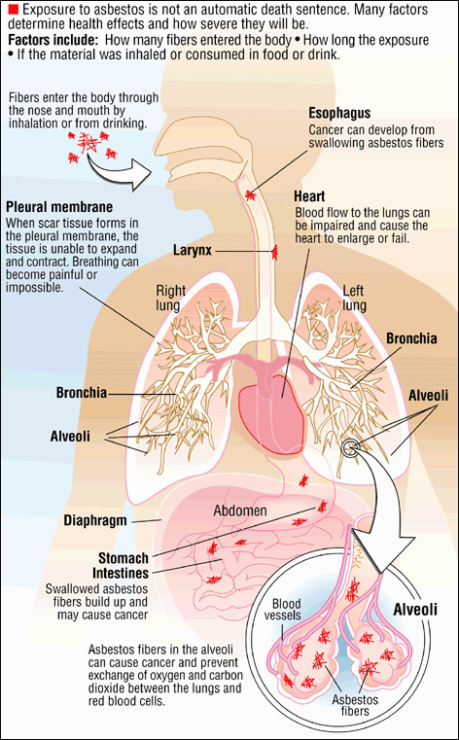
Asbestos can enter your body when you
1) breath (aspiration)
2) drink water and other fluid, and
3) eat foods.
In ordinary people’s lung,
a few 10,000 - 100,000 crystals/1g
alveoli
Air quality standards for asbestos
In work place: < 0.1/cm³
In public place: < 0.01/cm³
(Korean standards)

Slide 5
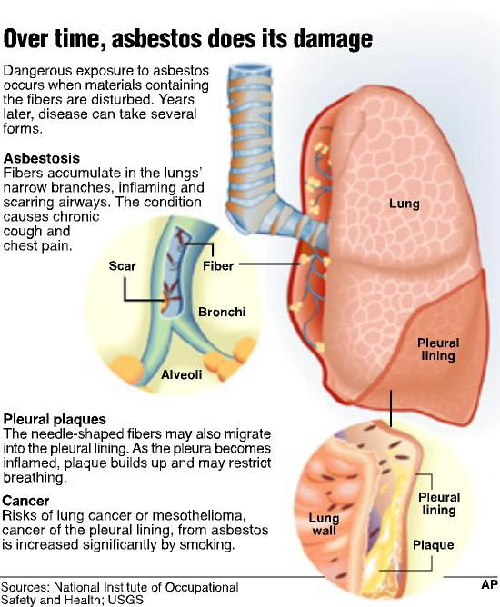

Slide 6
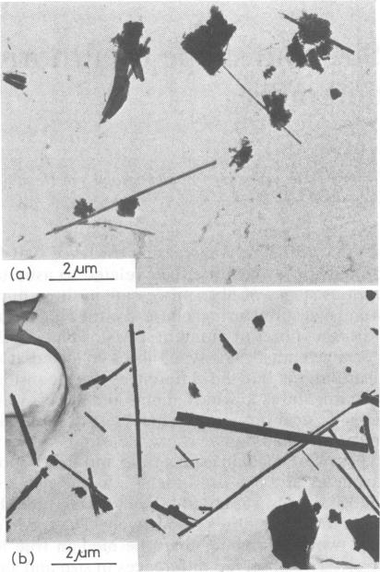
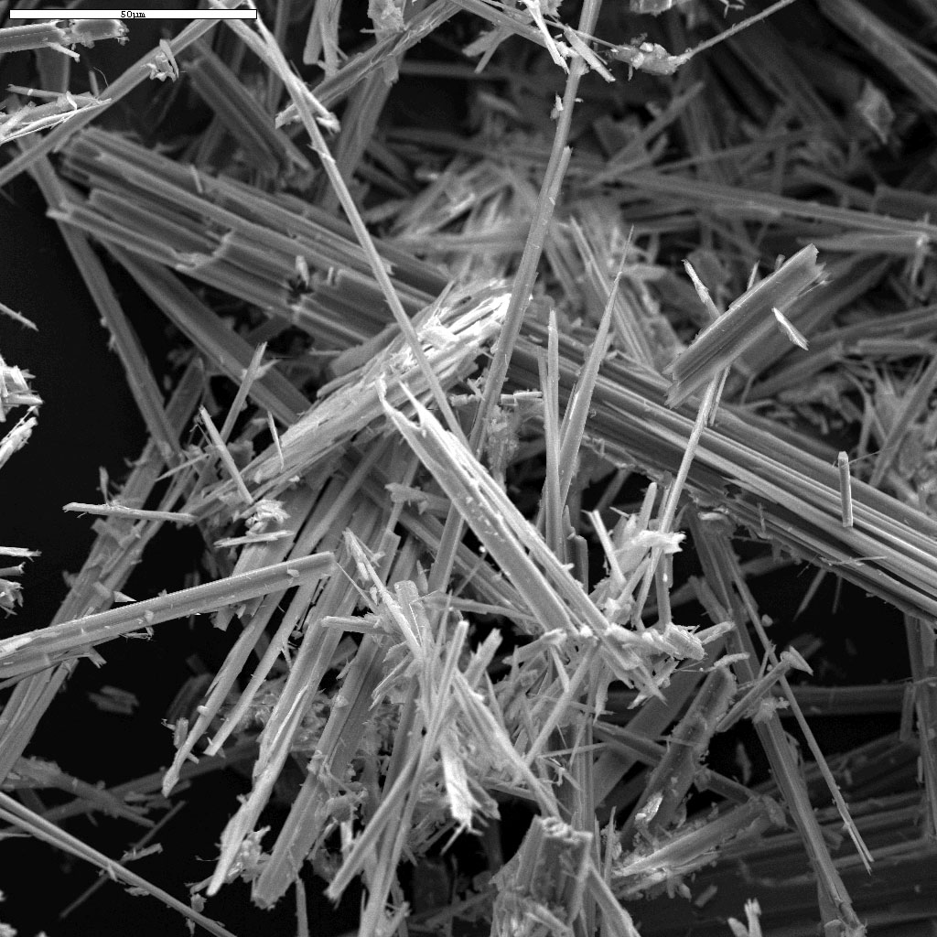
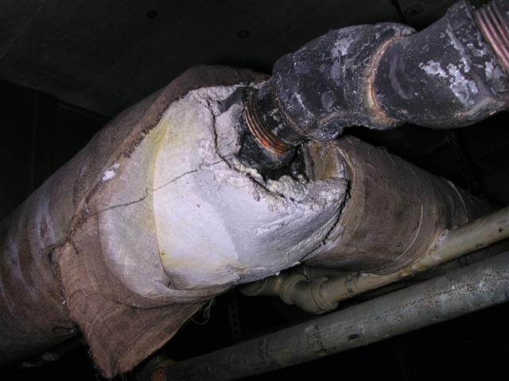

Slide 7
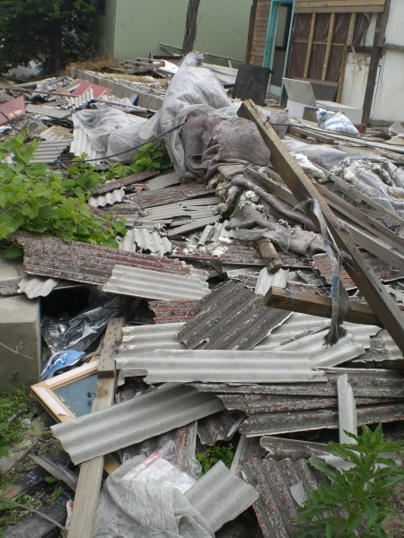
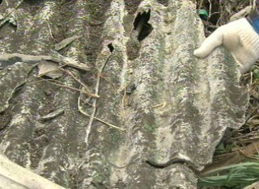
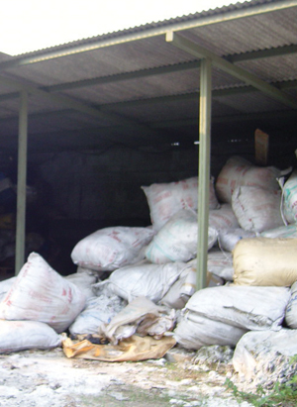
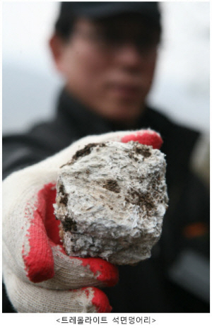
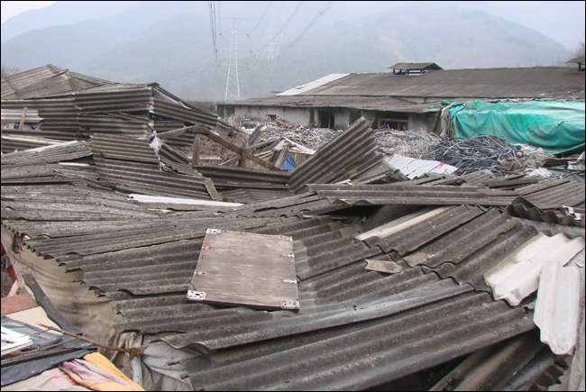

Slide 8
