Slide 1
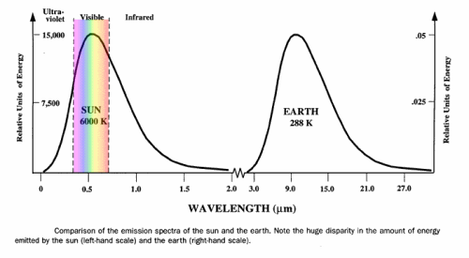
Ch.4.
지구온난화(온실효과)
From http://civicbc.com/articles.php?AID=ENV-100501Q001

Slide 2
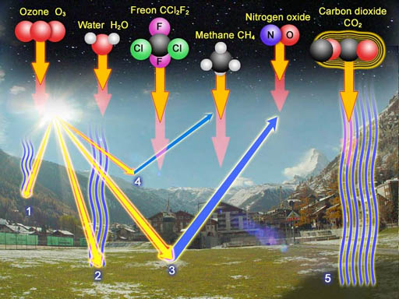
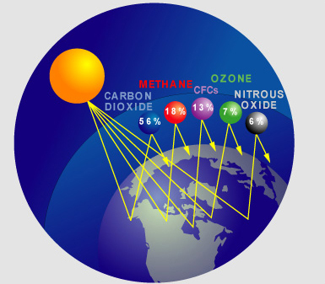
지구의 온도 균형
온실효과 vs. 냉각효과(Albedo effect)
http://www.chemistryland.com/CHM107Lab/Exp04_biodiesel/BiodieselLab/Exp4Biodiesel.html
www.koshland-science-museum.org/.../causes02.jsp

Slide 3
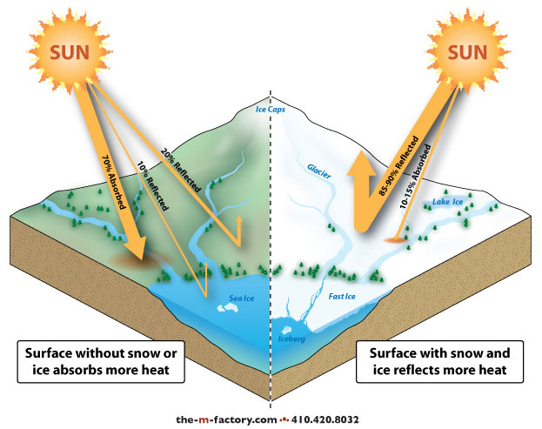
From http://www.the-m-factory.com/portfolio/illustrated/illustrated_08.html

Slide 4
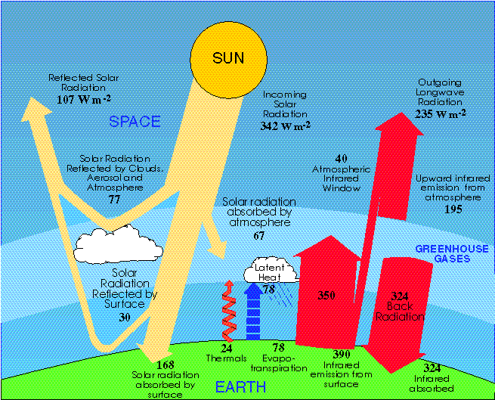
From http://www.atmos.washington.edu/2006Q1/211/Lecture0_notes.html

Slide 5
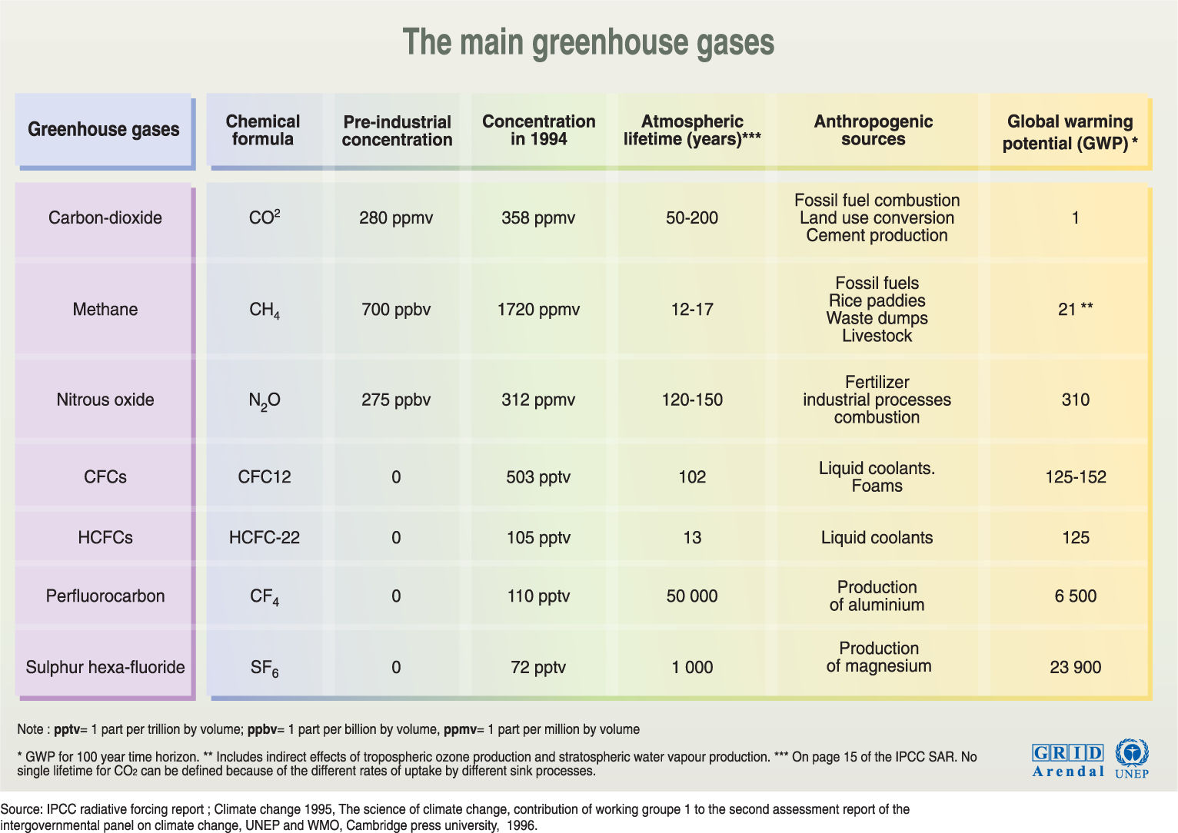
http://maps.grida.no/go/graphic/main-greenhouse-gases

Slide 6
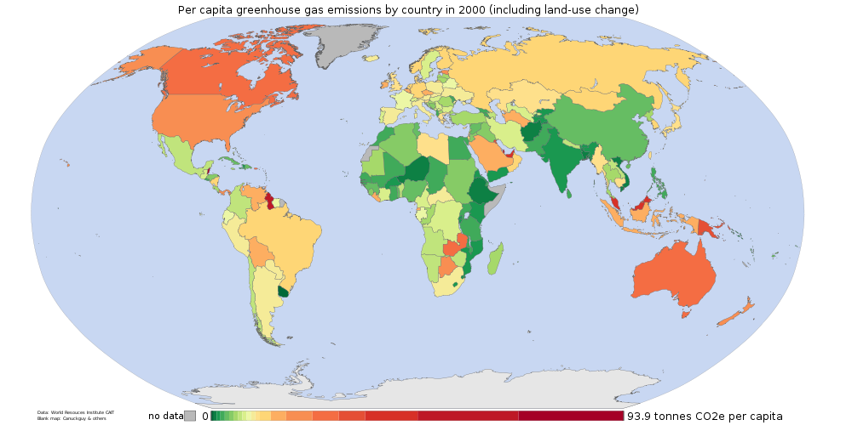
From http://www.ei.lehigh.edu/learners/cc/greenhouse/Diagram1.png

Slide 7
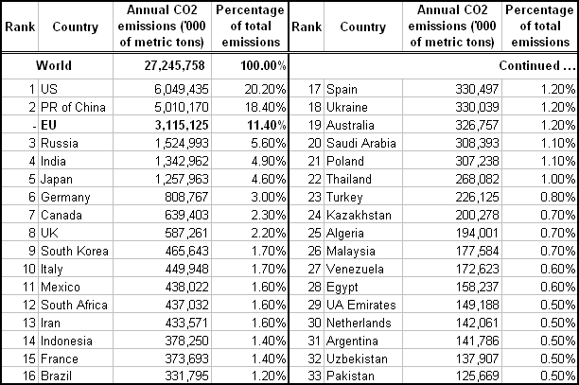
20개 국가가 전체 CO2 오염의 80% 차지. (Source: Wikipedia/Data were collected in 2004 by the CDIAC for United Nations. )
From http://edro.wordpress.com/tag/co2/

Slide 8
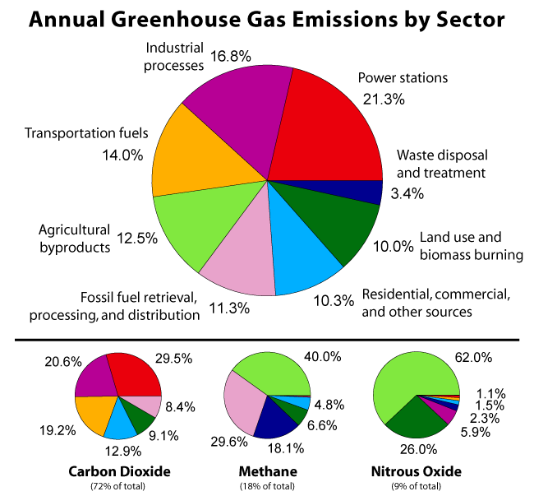
From http://www.ei.lehigh.edu/learners/cc/greenhouse/Diagram3.png

Slide 9
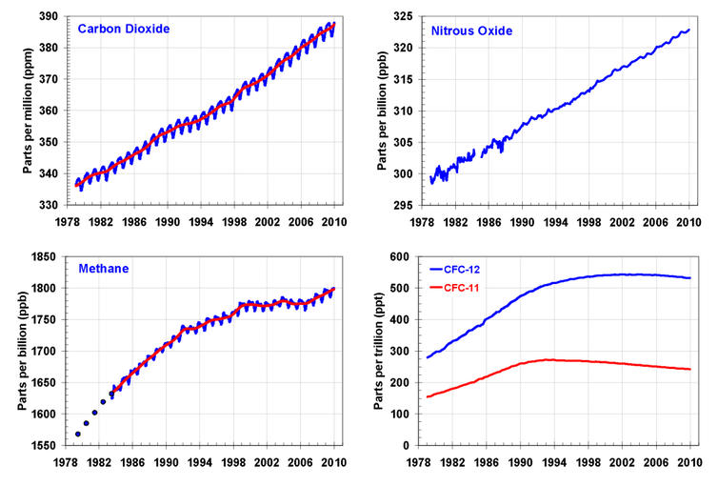
Global Major greenhouse gas trends 2015
http://theconversation.com/when-it-comes-to-greenhouse-gases-carbon-dioxide-isnt-the-only-culprit-2729

Slide 10
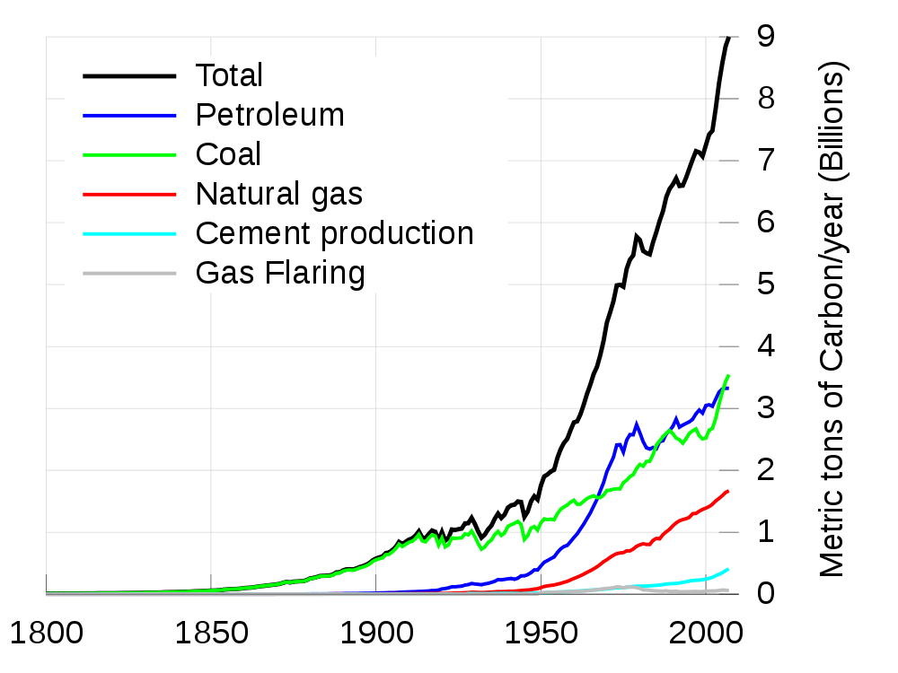
From http://www.ei.lehigh.edu/learners/cc/greenhouse/Diagram2.png

Slide 11
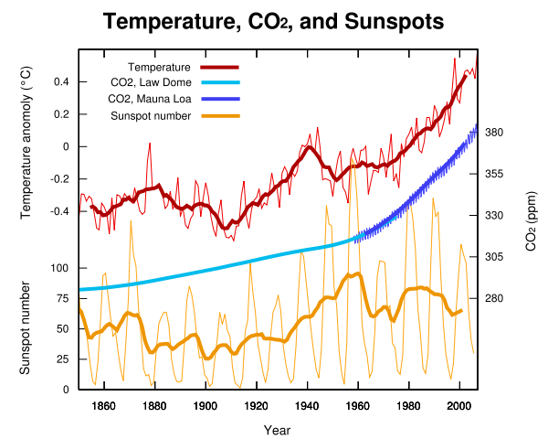
From http://solar-center.stanford.edu/sun-on-earth/glob-warm.html

Slide 12
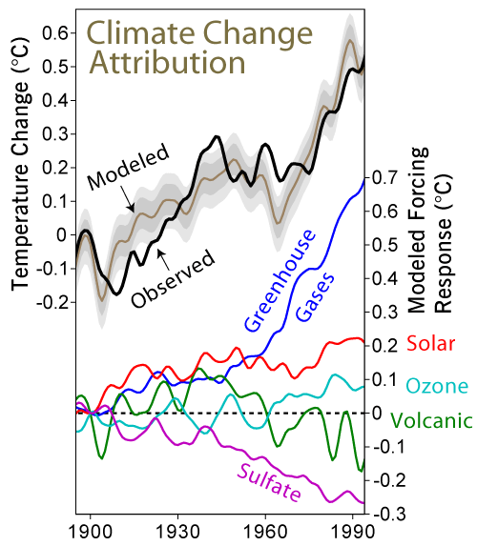
From http://solar-center.stanford.edu/sun-on-earth/glob-warm.html

Slide 13
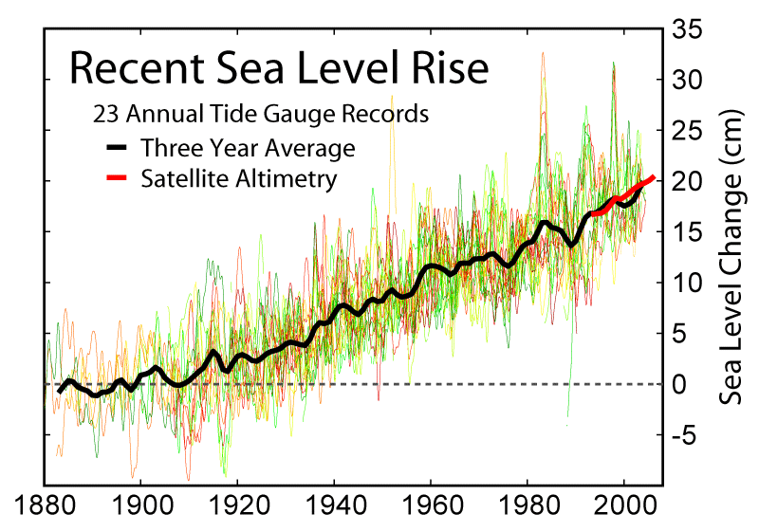
From http://www.globalwarmingart.com/images/0/0f/Recent_Sea_Level_Rise.png

Slide 14
