Slide 1
Ch.1 Introduction
Geochemistry?
Geo (geology, gaia) + chemistry
A field of study dealing geological phenomena and problems with chemical tools and principles
Prerequisites?
Physical geology, minerlaogy, petrology, economic geology
General chemistry, inorganic chemistry, physical chemistry

Slide 2
Early history
1838, Chritian Friedrich Schönbein (Basel Univ., Switcherland) first used the term ‘Geochemistry’.
1908-1924, Frank W. Clarke (USGS, USA) published the monumental book “The Data of Geochemistry”.
1924, Vladimir Ivanovich Vernadsky publsihed “Geochemistry” (Russian). 1926, publsihed “The Biosphere” (Russian).
1934-1939 Alexander Fersman publsihed 4 volemes of “Geochemistry”
1888-1947 Victor M. Goldsckimdt primarily studied elemental distribution and crystal chemistry.

Slide 3
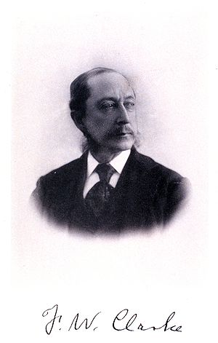
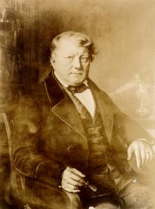
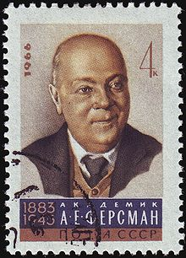
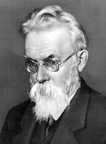
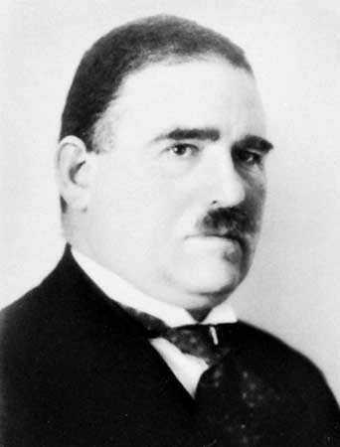
(Form top left to right and then bottom, Schönbein,
Clarke, Vernadsky, Fersman, and Goldschmidt)

Slide 4
More history
1952 B. Mason’s “Geochemistry”-first widely used textbook of geochemistry.
R.M. Garrels, W. Stumm, & J.J. Morgan. → Aqueous geochemistry
K.B. Krauskopf , H. Helgeson, R.A. Robie, J.M. Hollaway, D.K. Nordstrom, R.G. Berman → Geochemical thermodynamics
P. Currie & M. Curie, E. Rutherford, F. Soddy, B. Boltwood, A. Holmes (1913, The Age of the Earth) → Geochronology
H. Urey, H. Craig, G. Faure → Stable isotope geochemistry
B.P. Tissot & D.H. Welte. → Organic geochemistry

Slide 5
Study fields of modern geochemistry
Crystal chemistry
Isotope geochemistry
Igneous/metamorphic (petro)geochemsitry
Aqueous geochemistry
Organic geochemistry
Biogeochemistry & geomicrobiology
Geochemical analysis
Geochemical exploration
Cosmogeochemistry
Environmental geochemistry

Slide 6
What would be the future of geochemistry?
Discussion
Recognized international journals
Geochimica et Cosmochimica Acta (GCA)
Chemical Geology
Applied Geochemistry
Organic geochemistry
Biogeochemistry
Geochemistry International
Environmental Geochemistry & Health
Journal of Geochemical Exploration

