Slide 1
Ch.4. Environmental Problems Caused by Fossil Fuel Consumption
Fossil Fuel?
Petroleum
Natural gases
Coals
Environmental Problems
Acid deposition
Acid mine drainages
Global warming
Others: Ozone, VOC, Nox, fly ashes

Slide 2
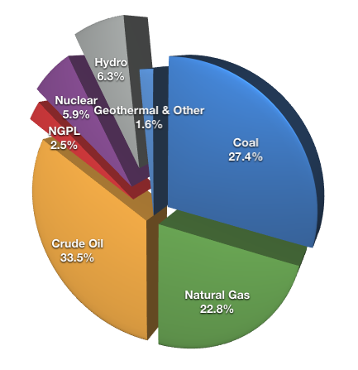
Global Fuel Mix in 2006
From http://www.getreallist.com/can-renewables-replace-fossil-fuels.html

Slide 3
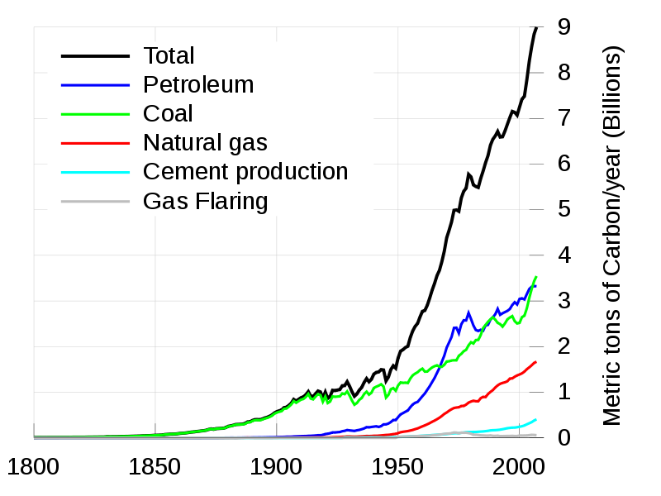
Global carbon emission
From http://www.getreallist.com/can-renewables-replace-fossil-fuels.html

Slide 4
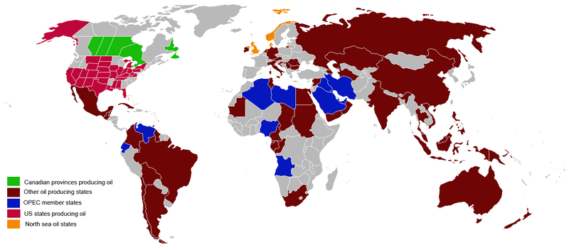
Oil producing areas on the world
From http://en.wikipedia.org/wiki/Fossil_fuel

Slide 5
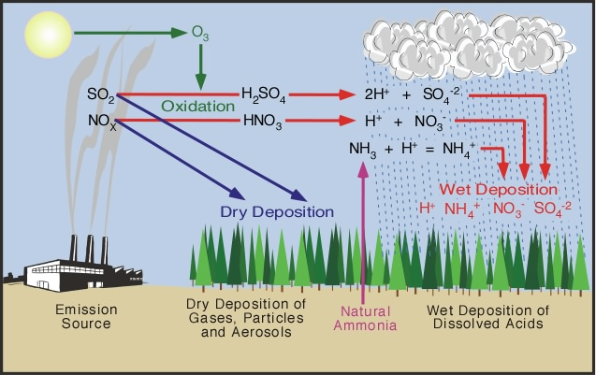
Acid Depositions
From http://www.physicalgeography.net/fundamentals/8h.html

Slide 6
How acid is acid for acid rain? <pH 5.6
What acids are in these acid deposition? H2SO4, HNO3
Chemistry
Combustion of fuels produces sulfur dioxide and nitric oxides. They are converted into sulfuric acid and nitric acid.
Gas phase chemistry
SO₂ + OH· → HOSO₂·
HOSO₂· + O₂ → HO₂· + SO₃
SO₃ (g) + H₂O (l) → H₂SO₄ (l)
NO₂ + OH· → HNO₃
Chemistry in cloud droplets
SO₂ (g) + H₂O = SO₂·H₂O
SO₂·H₂O =H⁺ + HSO₃⁻
HSO₃⁻ =H⁺ + SO₃²⁻

Slide 7
Oxidant
O₃
H₂O₂
O₂.
Damages by acid rain
Forests & other vegetations
Buildings and stone cultural heritages
Lakes
Soils
Human health

Slide 8
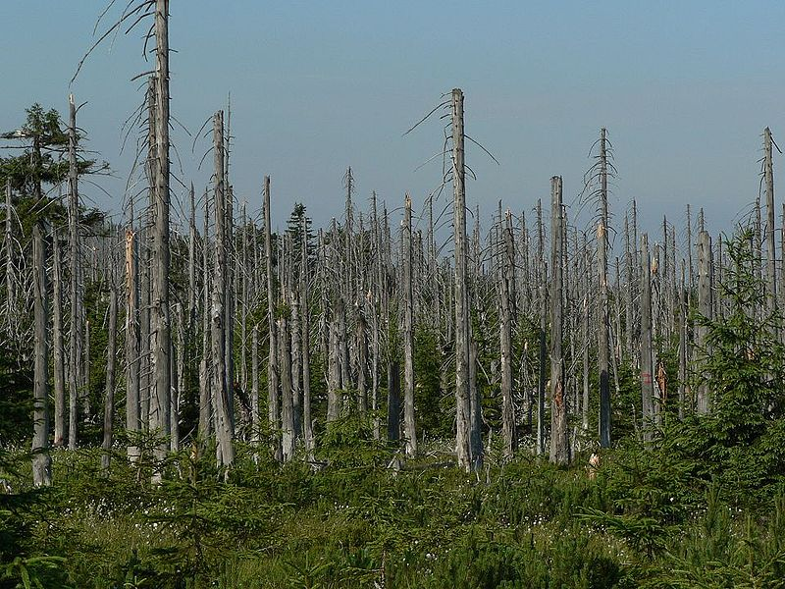
Effect of acid rain on a forest, Jizera Mountains, Czech Republic
From http://en.wikipedia.org/wiki/Acid_deposition

Slide 9
Effect of acid rain on statues
From http://en.wikipedia.org/wiki/Acid_deposition

Slide 10
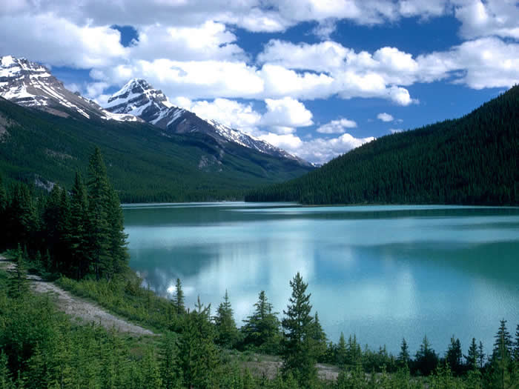
Lake acidification
From http://www.papermasters.com/images/acidification-on-freshwater-research-paper.jpg

Slide 11
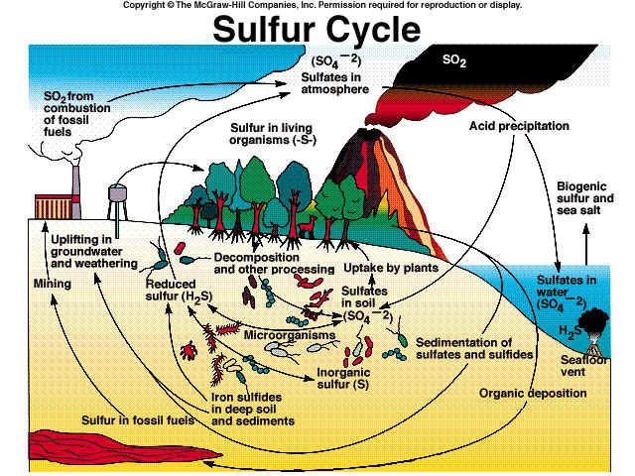
From http://faculty.southwest.tn.edu/rburkett/ES%20%20we34.jpg

Slide 12
Sources of atmospheric S
Sea salt spray (SO₄)
Biogenic (DMS, DMDS)
Volcanogenic (H₂S, SO₂)
Pollution - Anthropogenic (H₂S, SO₂)

Slide 13
Sulfur in fossil fuels
Inorganic
Sulfides: FeS₂
Sulfates:CaSO₄.2H₂O
Elemental S
Organic
Thiols
Sulfides
Disulfides
Thiophenes
Thiolanes

